Slide 1
False Teachers
“Beloved, while I was very diligent to write to you concerning our common salvation, I found it necessary to write to you exhorting you to contend earnestly for the faith which was once for all delivered to the saints.” Jude 3
Richie Thetford www.thetfordcountry.com

Slide 2
Be Alert
Guardians have a serious responsibility
Titus 1:9-11
Acts 20:28-32
Richie Thetford www.thetfordcountry.com

Slide 3
Need for Vigilance
Warnings
Matthew 7:15
1 Timothy 4:1-2
2 Timothy 4:1-4
Richie Thetford www.thetfordcountry.com

Slide 4
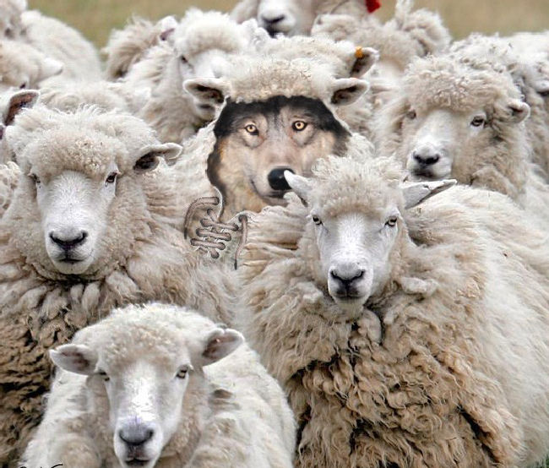
An Inside Job
From within the local church
2 Corinthians 11:13-15
1 John 4:1; Acts 17:11
Galatians 1:6-7; 2 Corinthians 2:17
2 Peter 3:16; 1 Thessalonians 5:21
Richie Thetford www.thetfordcountry.com

Slide 5
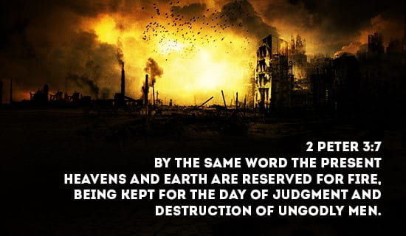
Future of the Ungodly
What happens to the false teacher?
2 Peter 3:3-7
Matthew 24:37-39
Richie Thetford www.thetfordcountry.com

Slide 6
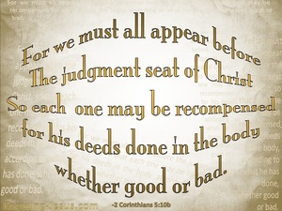
Twisting Grace
Turning Grace into “lewdness”
Romans 2:6
2 Corinthians 5:10
Richie Thetford www.thetfordcountry.com

Slide 7
Denying Jesus
Denying Christ by our works
Titus 1:16
Matthew 15:16-20
Matthew 7:21
Luke 6:46
Richie Thetford www.thetfordcountry.com

Slide 8
Grace of God (God’s Part)
Obedience (Man’s Part)
Richie Thetford www.thetfordcountry.com

