Slide 1
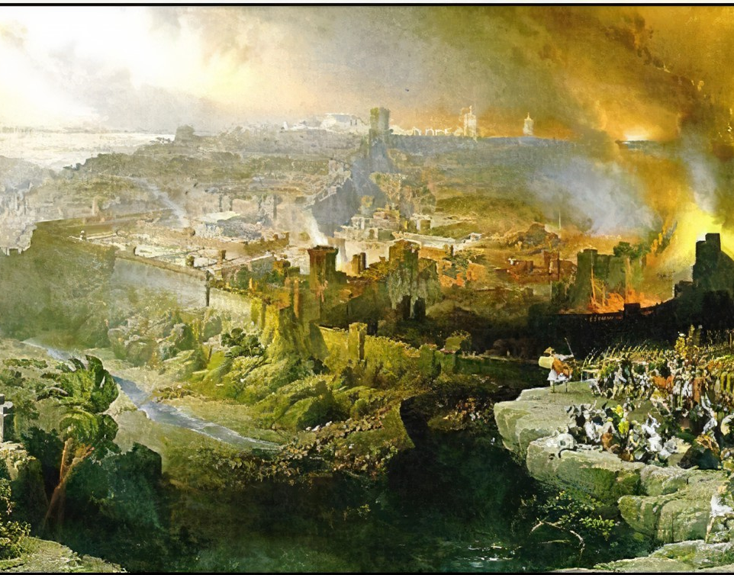
The Fall of Israel
Romans 15:4
1 Corinthians 10:11-12
Acts 20:29-31
Richie Thetford www.thetfordcountry.com

Slide 2

Lack of Knowledge
Must know His law
  Deuteronomy 31:9-13
  2 Timothy 2:15
  1 Peter 3:15
  2 Peter 3:18
Hosea 4:6
Richie Thetford www.thetfordcountry.com

Slide 3
Lack of Knowledge
Needed to be faithful
  Ephesians 3:4
  Romans 10:1-3, 17
  Matthew 28:19
  Ephesians 4:11-18
  Hebrews 10:24-26
Hosea 4:6
Richie Thetford www.thetfordcountry.com

Slide 4

Pride
Condemned in the Bible
  Proverbs 29:23
  1 Peter 5:6
  Luke 18:9-14
  2 Timothy 3:16-17
Hosea 5:5
Richie Thetford www.thetfordcountry.com

Slide 5
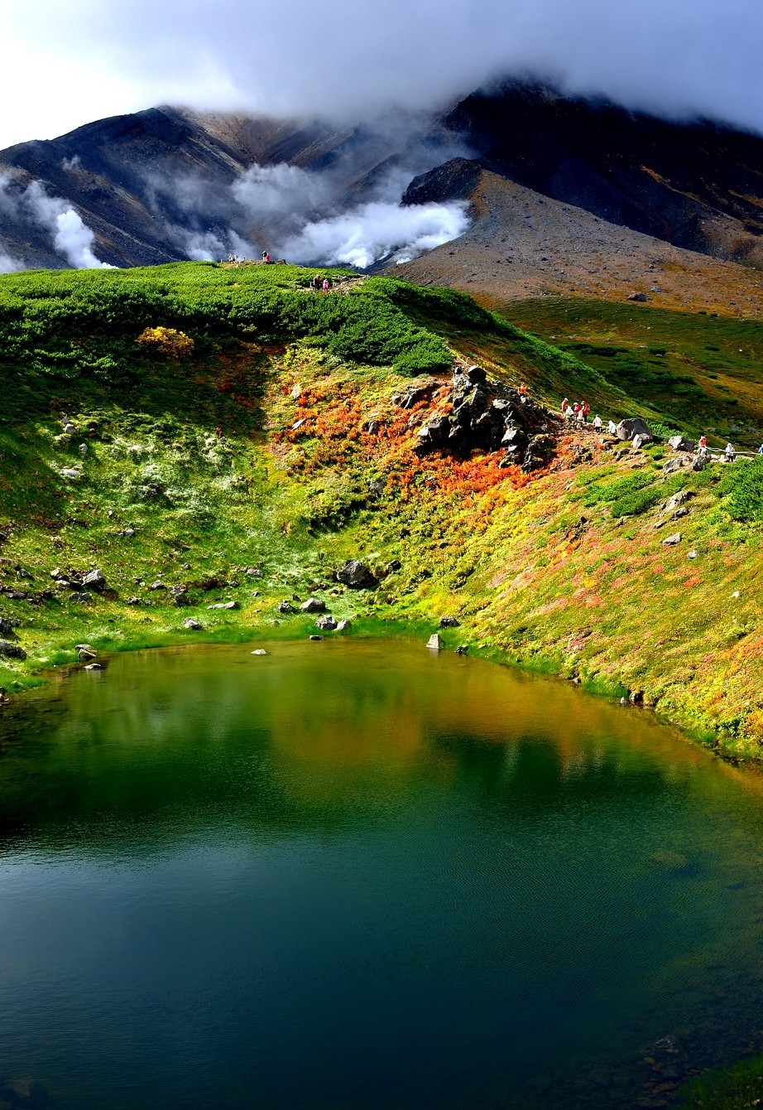
Instability
Can be lost because of it
  James 1:8
  1 Corinthians 15:58
Be stable in application of knowledge
  Proverbs 14:30
Hosea 6:4
Richie Thetford www.thetfordcountry.com

Slide 6

Mixing with the World
Must be separate
  Exodus 23:31-33
  Psalms 106:34-36
  1 Kings 11:1-8
Always a problem
  1 Corinthians 5:6-9
  2 Corinthians 6:17
Hosea 7:8
Richie Thetford www.thetfordcountry.com

Slide 7
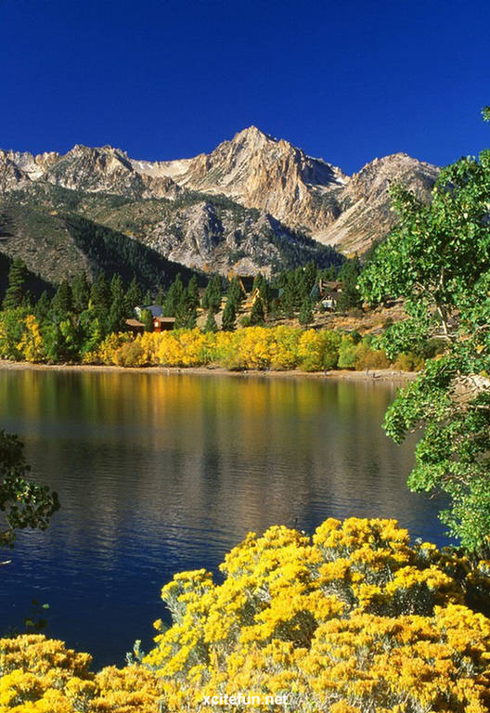
Corruption
Sins cause a great problem
  Matthew 23:25-28
God’s concern is the heart
  Proverbs 23:7
  Luke 6:45
Hosea 9:9
Richie Thetford www.thetfordcountry.com

Slide 8

Backsliding
External sin proceeded by internal deterioration
  Hebrews 3:12
Must treat the cause
  John 14:23-24
Hosea 11:7
Richie Thetford www.thetfordcountry.com

Slide 9

Idolatry
People worship
  Not always God
    Israel: Graven Images
    Today: Money, jobs, pleasure, etc.
Hosea 13:2
Richie Thetford www.thetfordcountry.com

Slide 10
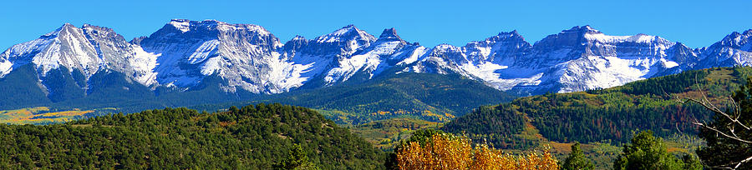
Conclusion
Hindsight is always 20/20
Strive to do the right thing!
It begins with the knowledge of knowing what to do
Richie Thetford www.thetfordcountry.com

