Slide 1

The facts of life
Hebrews 9:27-28
Richie Thetford www.thetfordcountry.com

Slide 2

Death is the result of sin
Created to have fellowship with Him
  Genesis 1:27
  Genesis 2:9; 3:8
  Genesis 5:24
  Psalms 73:24
  Hebrews 11:5
  Jude 14-15
Richie Thetford www.thetfordcountry.com

Slide 3

Death is the result of sin
God made man with free will
  Genesis 2:16-17
  Genesis 3:4-6
Death resulted from sin
  Genesis 3:8
  Genesis 3:19, 24
Richie Thetford www.thetfordcountry.com

Slide 4
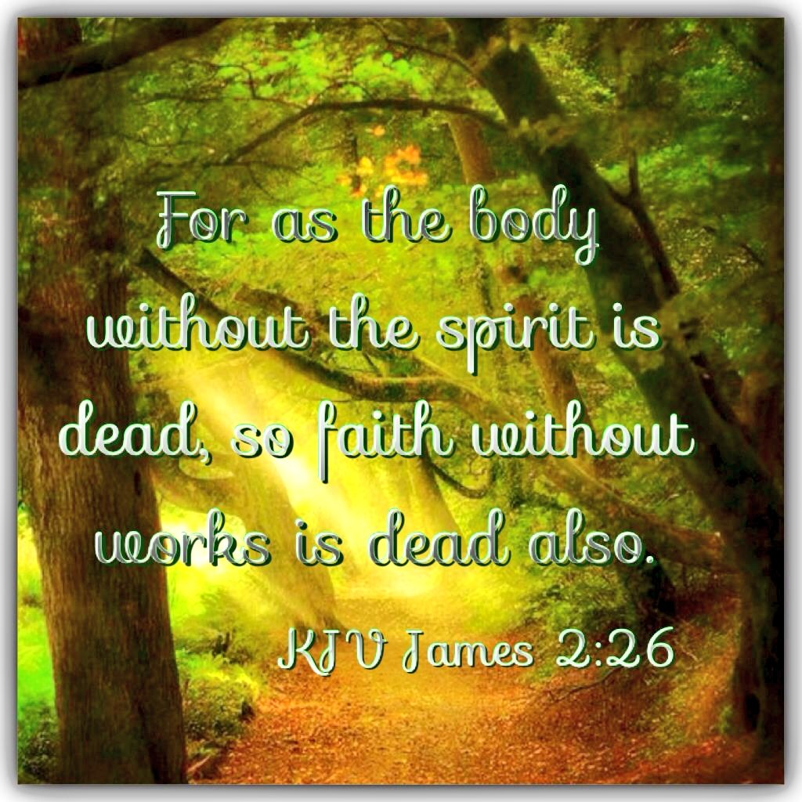
Death is a separation
Separates our body and soul
  James 2:26
  Genesis 25:8
  Genesis 49:33
  Matthew 22:32
  Luke 23:43, 46
  Ecclesiastes 12:7
  Ecclesiastes 9:5-6
Richie Thetford www.thetfordcountry.com

Slide 5
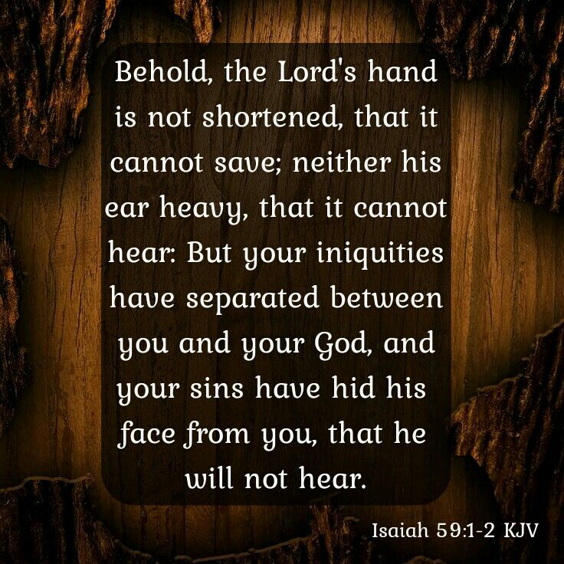
Death is a separation
Spiritual death is the death that separates man from God
  Genesis 3:8
  Isaiah 59:1-2
  Ephesians 2:1-3
  Romans 5:12-15
Richie Thetford www.thetfordcountry.com

Slide 6
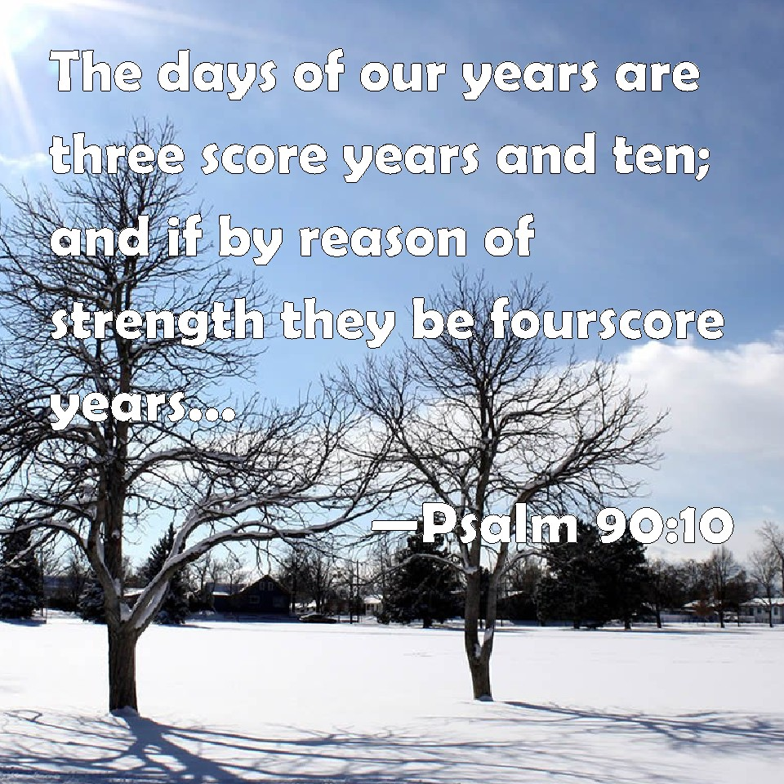
Every day we are preparing to die
Physical death may be caused by many factors
  Life is short
    Job 14:1
    Psalms 90:10
    James 4:14
  Death is beyond our control
  Some choose to die
    Sacrifice – John 15:13; or Suicide
Richie Thetford www.thetfordcountry.com

Slide 7
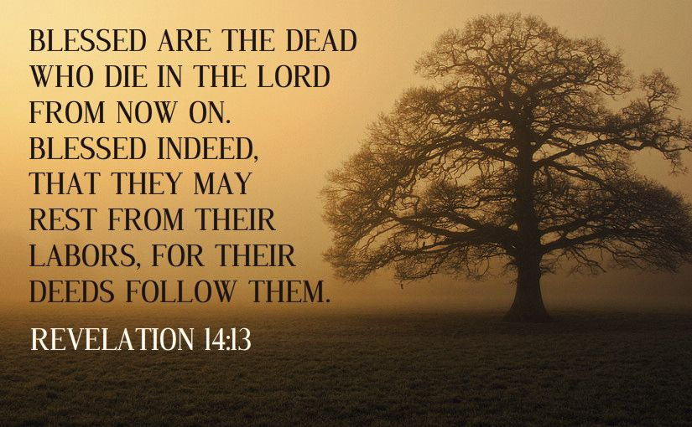
Every day we are preparing to die
Prepare to die the death of the righteous
  Isaiah 57:1-2
  Revelation 14:13
  Luke 16:22
  Luke 23:43, 46
Live and die by faith in Christ
  Galatians 3:26-29
  Revelation 2:10
Richie Thetford www.thetfordcountry.com

Slide 8
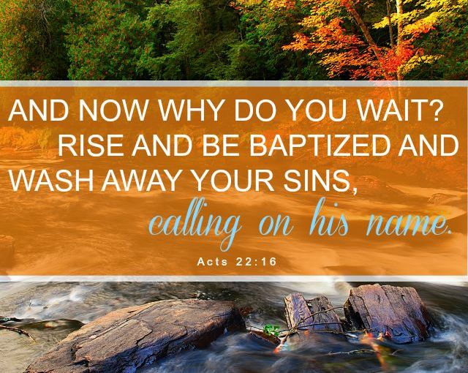
Death is not the end
Christ conquered death
  John 5:28-29
Death and Christ’s return are certain
  Hebrews 9:27-28
Prepare for death now
  Don’t delay
  Acts 22:16
Richie Thetford www.thetfordcountry.com

