Slide 1
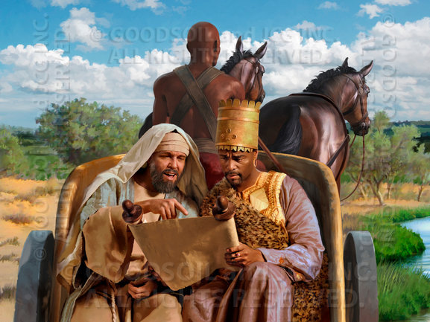
The Example of Philip
Acts 8:26-27
Richie Thetford www.thetfordcountry.com

Slide 2
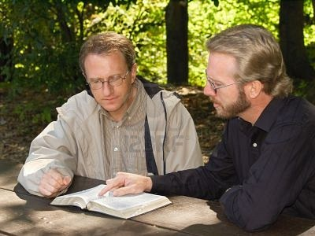
Proper Attitudes to Reach Others
Obedience
  Left Samaria to go to Jerusalem
  To be effective we must be submissive
Willingness to teach
  Travel miles to teach one soul
  One soul is very valuable
Richie Thetford www.thetfordcountry.com

Slide 3

Proper Attitudes to Reach Others
Unprejudiced
  Ethiopian considered an outcast
    Deuteronomy 23:1
  We must be like Philip
    Must not show partiality
      Acts 10:34-35
    All need salvation
      Romans 1:16
Richie Thetford www.thetfordcountry.com

Slide 4
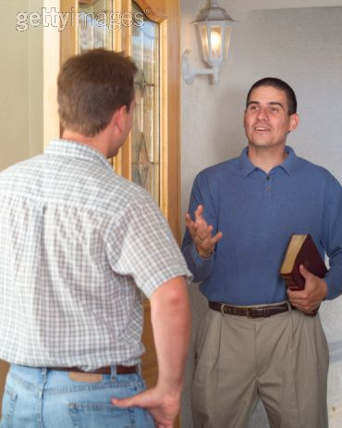
Proper Attitudes to Reach Others
An urgency to reach others
  Philip “ran to him”
    Acts 8:29
  Need this kind
  of enthusiasm today
Richie Thetford www.thetfordcountry.com

Slide 5

Proper Techniques
Ask questions
  Acts 8:30
Know and use the scriptures
  Acts 8:31-35
  Hebrews 5:11-14
  John 8:32
  Romans 10:17
  James 1:21
Richie Thetford www.thetfordcountry.com

Slide 6

Proper Techniques
Preach Jesus
  John 14:6
  Acts 4:12
Look for more opportunities
  Acts 8:40
Richie Thetford www.thetfordcountry.com

Slide 7

Conclusion
We need to be more
like Philip
He was a dedicated,
effective servant
We need to be effective
workers for the Lord
Richie Thetford www.thetfordcountry.com

