Slide 1

EVIL
Romans 3:23
Ecclesiastes 7:20
Hebrews 11:25
Romans 12:9
Matthew 5:30
Richie Thetford www.thetfordcountry.com

Slide 2

What Am I Becoming?
Deuteronomy 32:29
Proverbs 19:20
Proverbs 5:11
Psalms 1:4
Matthew 7:22-23
Richie Thetford www.thetfordcountry.com

Slide 3
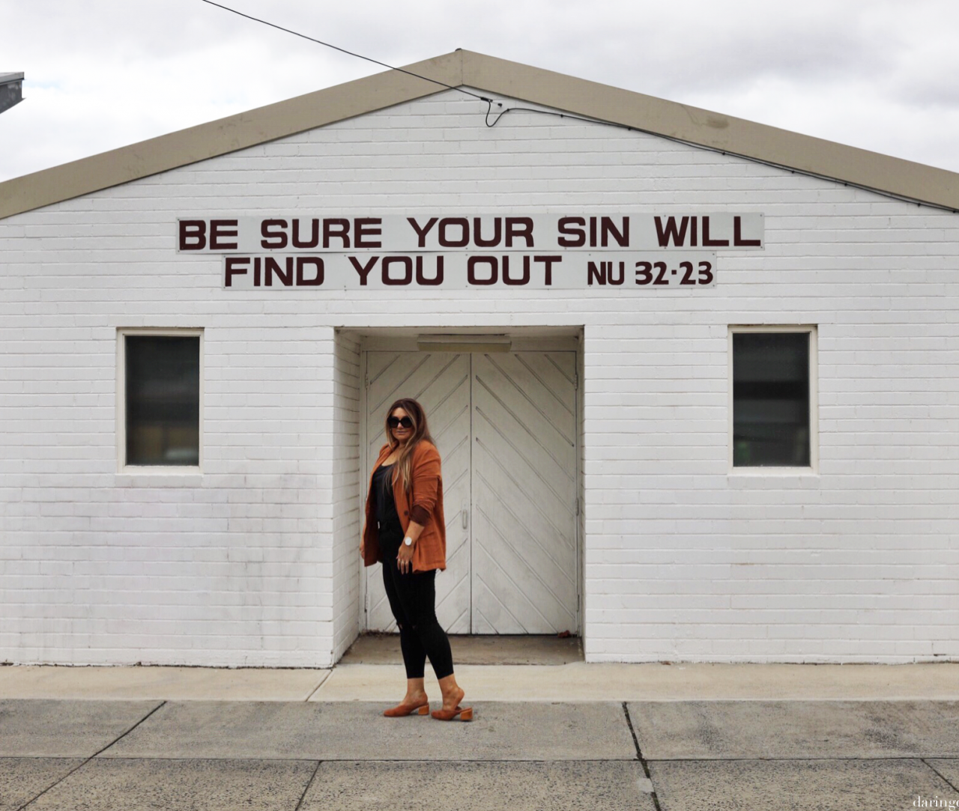
It Will Always Catch Up to Us
Numbers 32:23
Ecclesiastes 12:14
1 Timothy 5:24
Galatians 6:7-8
Richie Thetford www.thetfordcountry.com

Slide 4
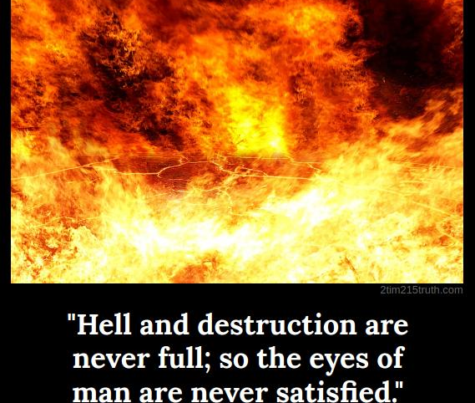
Nothing Will Get Better
Proverbs 27:20
1 Corinthians 5:5
Ephesians 4:22
2 Timothy 3:13
Richie Thetford www.thetfordcountry.com

Slide 5

It Is Slavery
Proverbs 5:22
John 8:24
Richie Thetford www.thetfordcountry.com

Slide 6

Humiliation Will Happen
Proverbs 6:32-33
Hebrews 4:16
1 John 3:21
1 John 4:17-18
Richie Thetford www.thetfordcountry.com

Slide 7

Sin Makes Light of Jesus’ Blood
1 Peter 1:18-19
Only Jesus’ death could atone for any of our sins
Richie Thetford www.thetfordcountry.com

