Slide 1
ETERNAL INSURANCE
Revelation 22:14

Slide 2
Essential Facts of the Company
Home office – heaven
2 Corinthians 5:1-2
Branch offices – local churches
Ephesians 3:10
Founder – Christ
Matthew 16:18
Matthew 28:18

Slide 3
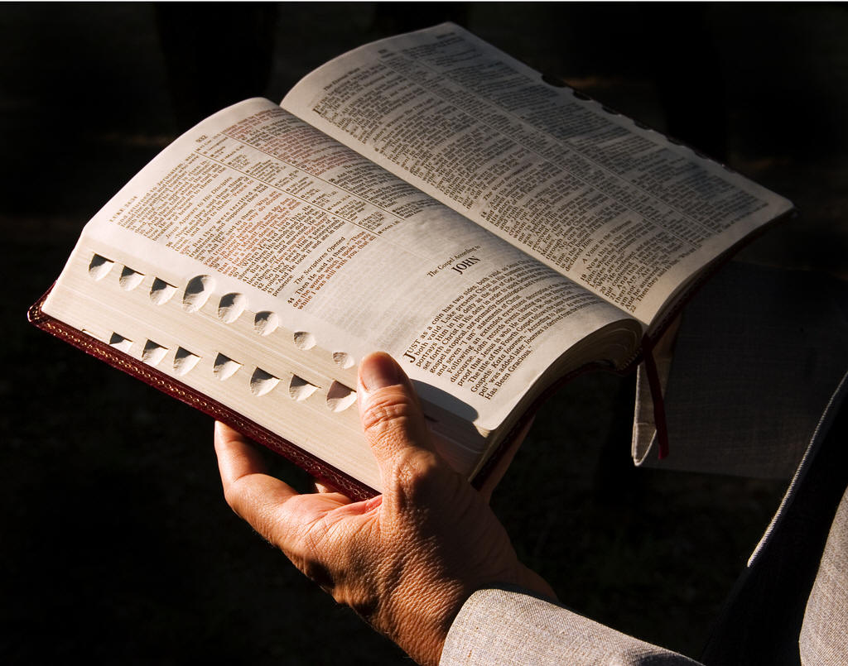
Essential Facts of the Company
Date of origin – AD 33
Acts 2:1
Acts 2:16
Acts 2:47
Rate book – Bible
2 Timothy 3:16-17

Slide 4
Company’s Standing
Capital: “unsearchable riches”
Ephesians 3:8
Reserve: Heaven
1 Peter 1:4
Liabilities: Accepts all
John 3:36
Surplus: Above asking
Ephesians 3:20
Dividend:
Hundredfold
“who shall not receive a hundredfold now in this time--houses and brothers and sisters and mothers and children and lands, with persecutions--and in the age to come, eternal life.”
Mark 10:30

Slide 5
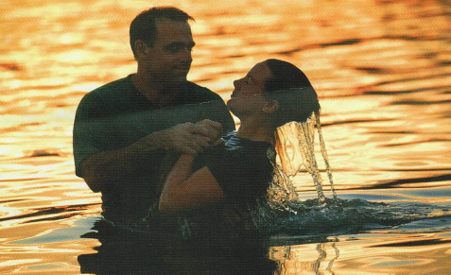
Conditions of the Policy
Belief in Christ
John 8:24
Acts 16:31
Repentance
Luke 13:3
Acts 17:30
Confess Christ
Romans 10:10
Acts 8:37
Baptism
Mark 16:16
Galatians 3:26-27

Slide 6
How to Pay Your Premiums
Worship
Acts 2:42
Acts 20:7
Hebrews 10:25
Service
1 Corinthians 15:58
Colossians 3:23
Keeping Pure
James 1:27
Faithfulness
2 John 9
Revelation 2:10
Revelation 22:14

Slide 7
Special Provisions
Salvation
Hebrews 5:8-9
Forgiveness
Ephesians 1:7
Colossians 2:12-13
Advocate provided
1 John 2:1-2

Slide 8
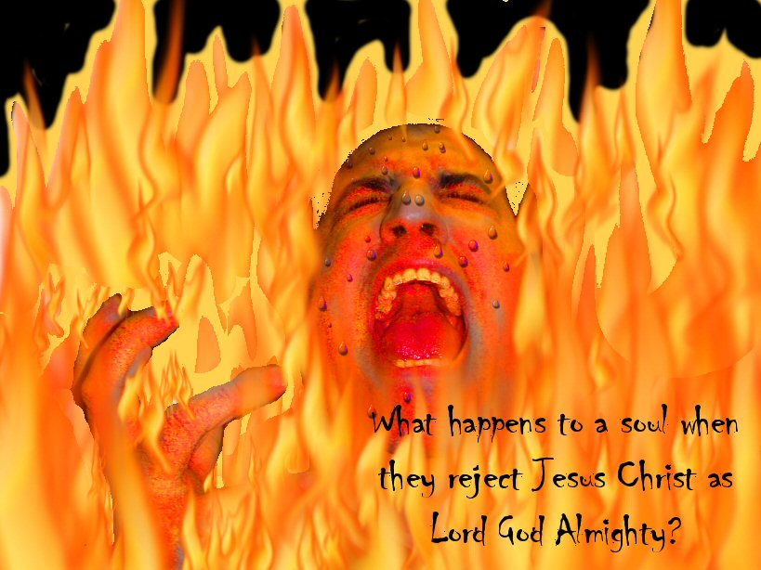
This Policy Does Not Cover
Those who do not hear Christ
Acts 3:23
The disobedient
2 Thessalonians 1:7-9
A “faith only” religion
James 2:24
The keeping of Moses’ law
Galatians 5:4

Slide 9
This Policy Does Not Cover
The fearful, murderers, etc.
Revelation 21:8
Those causing division
Romans 16:17
Those who deny Christ
Matthew 10:33

Slide 10
Conclusion
Sometimes we put off investing in an insurance policy
What may be keeping you from investing in the Lord’s eternal insurance policy?
“For what profit is it to a man if he gains the whole world, and loses his own soul? Or what will a man give in exchange for his soul?”
Matthew 16:26

