Slide 1
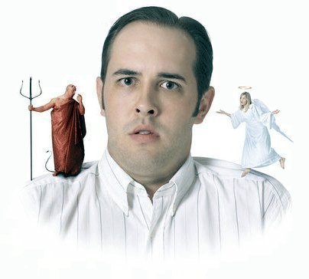
Enduring Temptation
James
Chapter 1

Slide 2

Counting It All Joy
James 1:1-12
Endure:
  “bear, survive, overcome, deal with”
Blessed:
  “acquires the benefits of temptation”
Key factors to help us
  Knowledge and understanding (vs 2-4)
  Wisdom (vs 5)
  Faith and trust in God (vs 6-7)
  Being content and humble (vs 9-11)

Slide 3

Not Blaming God
James 1:13-20
Who is trying to deceive us – Satan!
  Carnal senses and weaknesses
Instigated by Satan
God does not tempt anyone
  Good comes from God (vs 17-19)
  Cannot be tempted with evil (vs 13)

Slide 4

Laying Aside All Filthiness
James 1:21-27
We must accept responsibility for:
  Sinning
  Laying aside sin
We either:
  Grow and mature (vs 2-3)
  Allow it to give birth to sin (vs 13-14)

Slide 5
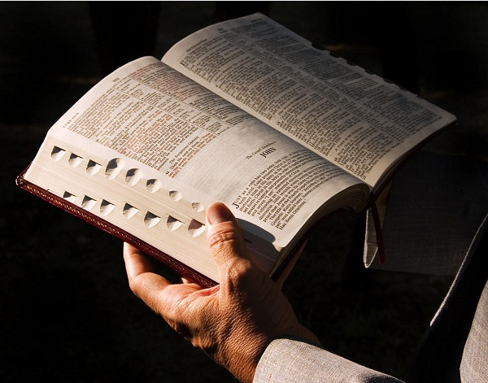
Laying Aside All Filthiness
James 1:21-27
We lay aside all filthiness by:
  Receiving the implanted word (vs 21)
  Being doers of the word (vs 22-27)
  Bridling our tongue (vs 13, 19, 26)
  Visiting orphans and widows (vs 27)
  Keeping ourselves pure (vs 14-16, 27)

Slide 6
Conclusion
God wants His children to learn
  To “endure” temptation
We can’t allow temptation
  To be an occasion for sin
God knows how we are tempted
  Provides the keys to overcome
Believe and trust His word!
  Be a “doer” and not a “hearer” only

