Slide 1
Drawing Close to God is a Matter of HEART
James 4:8

Slide 2
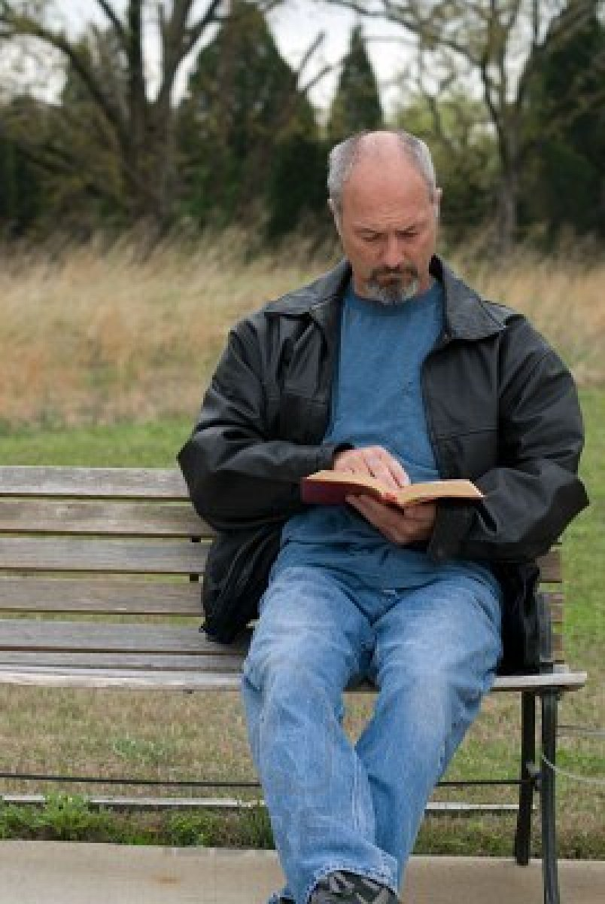
Simon the Sorcerer
Acts 8:13-23
Be on guard against old weaknesses
1 Peter 5:8
Acts 8:9-10
Avoid getting an “evil heart”
Jeremiah 17:9-10
Proverbs 4:23
Romans 2:5
Hebrews 3:8, 15
Hebrews 4:7

Slide 3
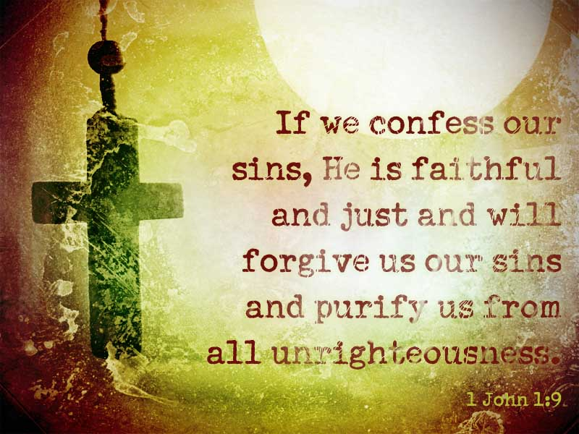
Simon the Sorcerer
Acts 8:13-23
Maintain a heart suitable for correction
Luke 8:15
Repent and pray
Acts 8:22

Slide 4
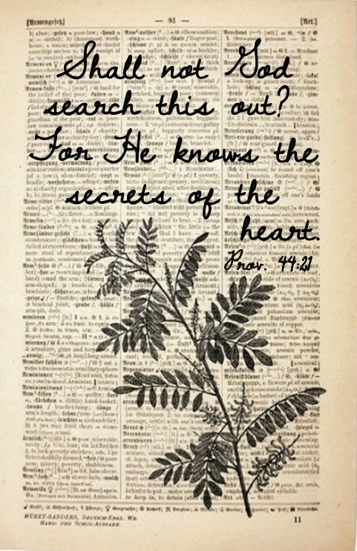
Depends on Our Heart
Do we have an evil heart?
Hebrews 3:12
Hebrews 3:15
2 Corinthians 13:5
God knows all things
1 Thessalonians 5:4-8
Psalm 44:20-21

Slide 5
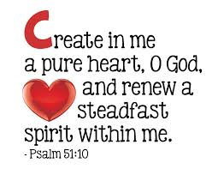
Depends on Our Heart
One can be self-condemned
1 John 3:19-20
Make corrections when needed
Hebrews 10:22
Maintain pure hearts
1 Timothy 1:5
2 Timothy 2:22

Slide 6
SINGLE PARENT FAMILY MAGAZINE
“Forgiveness means you give up your right to revenge. You choose not to keep score or get even. Unforgiveness allows who we are to be defined by the hurts we’ve known and leads to a victim mentality, leaving us expecting to be hurt again. We become negative and defensive, and communication becomes impossible. Forgiveness releases us from past injustices, from keeping score and from lashing out at other people.”

Slide 7
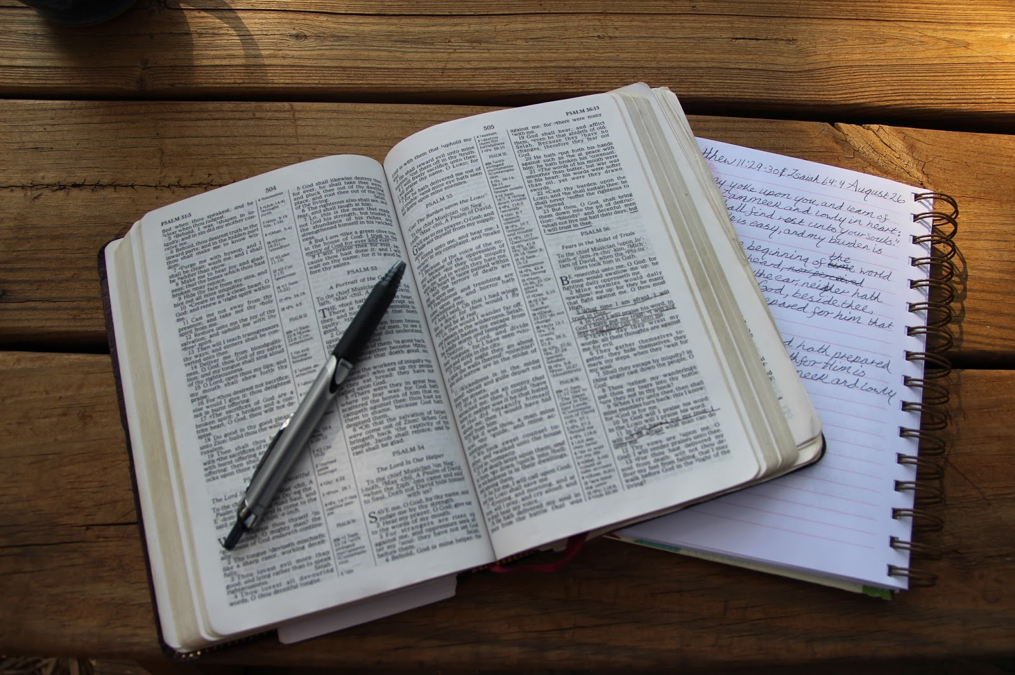
When is Our Heart Not Right?
Are services boring?
Psalm 122:1
Do we love Bible study?
2 Timothy 2:15
1 Peter 3:15
Do we enjoy being with each other?
1 Corinthians 15:33

Slide 8
When is Our Heart Not Right?
Do we get upset when we are rebuked?
Proverbs 9:7-9
Are we interested in souls?
Proverbs 11:30

Slide 9
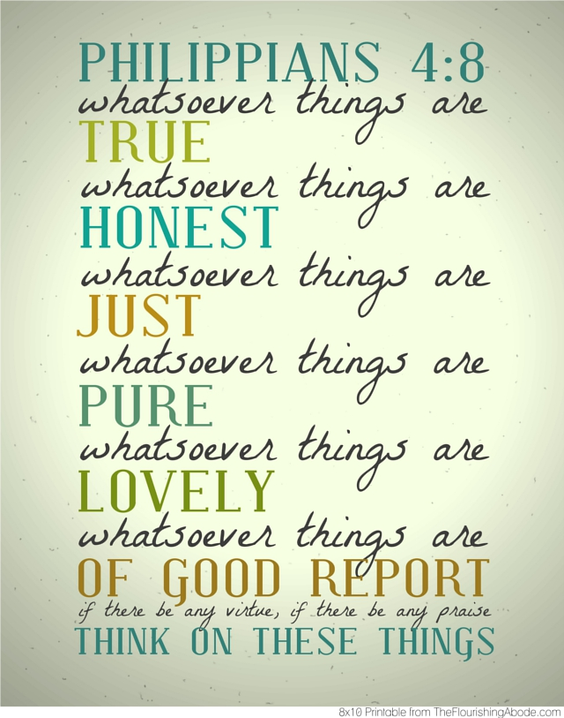
How Can We Improve Our Hearts?
Let wisdom reign
Proverbs 23:23
Colossians 3:16
Feed our minds with wholesome things
Philippians 4:8
Purpose to do good
Acts 11:23
Ezra 7:10

Slide 10
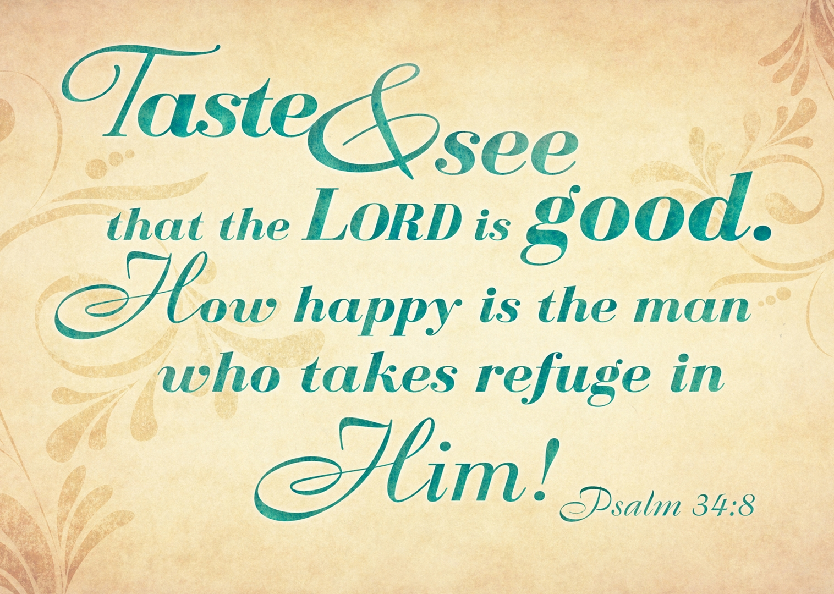
How Can We Improve Our Hearts?
Let joy reign in our hearts
Psalm 4:7-8
Seek God fully
Psalm 34:8-10

Slide 11
Drawing Close to God is a Matter of HEART
Do we have the right heart as to be able to draw close to God?

