Slide 1

Does
Jesus’ Church
Exist Today?
Acts 2:47
Acts 8:4
Richie Thetford www.thetfordcountry.com

Slide 2
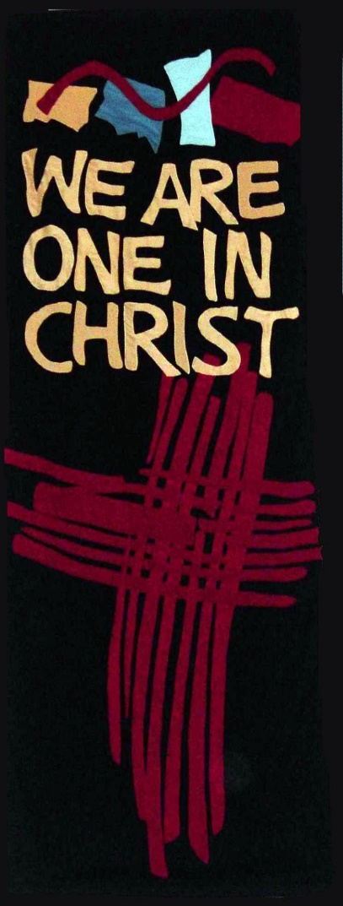
All Religious Organizations Are the Church?
Branches of the True Vine?
  John 15:1-8
Christ head over many bodies?
  Ephesians 1:22
  Ephesians 5:23
Christ prayed for unity
  John 17:20-23
Richie Thetford www.thetfordcountry.com

Slide 3

Does the Church in Acts 2 Exist Today?
Local Assembly of the Saints is Without
“Biblical Authority?”
  Hebrews 10:25
  Acts 8:3-4
  1 Thessalonians 5:11-15
  Acts 2:37-41
Richie Thetford www.thetfordcountry.com

Slide 4
Can a Continuous Line be Drawn?
To the establishment of the church?
  Roman Catholic Church
    Peter was married
    Peter refused man’s homage
    Peter taught others to wear Christ’s name
    Peter did not claim to be infallible
    Peter taught that Christ was head of church
    Peter never wore names Holy Father; Pope
No historical evidence of the Roman Catholic church until 606 A.D.
Richie Thetford www.thetfordcountry.com

Slide 5
Can a Continuous Line be Drawn?
To the establishment of the church?
  Baptist Church
    Can only be traced back to John Smyth (1607)
    Some claim John the Baptizer was Baptist
      This would place the establishment of the Lord’s church after the establishment of the Baptist church
Richie Thetford www.thetfordcountry.com

Slide 6
Can a Continuous Line be Drawn?
To the establishment of the church?
  Is it necessary to do so?
  Luke 8:4-15
    The nature of the good seed to produce believers in Christ Jesus
    Seed brings forth after its kind (Genesis 1:11)
    Know the seed by its fruit (Matthew 7:20)
    “Seed” is that which perpetuates all institutions.
Richie Thetford www.thetfordcountry.com

Slide 7
Can a Continuous Line be Drawn?
Luke 8:4-16
  What is the seed in the parable?
    Do we have the seed today?
    Is the seed alive today
      Hebrews 4:12
      1 Peter 1:23-25
    What is the soil?
    Who are the sowers today?
    Perpetuity of the church is in the “seed”
Richie Thetford www.thetfordcountry.com

Slide 8
Conclusion
The church belonging to Christ DOES exist today!
  Found in communities everywhere
  We strive to replicate Christ’s church
  Respond to Christ’s invitation
  Be part of His church by obeying HIM!
    Mark 16:16
    Acts 17:30
Richie Thetford www.thetfordcountry.com

