Slide 1

Does It Really Matter
Whether God Exists?
Ecclesiastes 12:9-14
Richie Thetford www.thetfordcountry.com

Slide 2


Theoretical Implications
Atheism
The universe and human life are without purpose
  Acts 17:28
  Ecclesiastes 12:13-14
Nothing distinguishes man from
other forms of animal life
  2 Corinthians 5:1-5
Man is autonomous, subordinate
to no higher authority
  Romans 1:18-32
Richie Thetford www.thetfordcountry.com

Slide 3

Theoretical Implications
Atheism
Man has no objective, absolute standard by which to calibrate his conduct
  Romans 4:15
  1 John 3:4
Religion is a delusion
  1 Corinthians 15:19
“If in this life only we have hope in Christ,
we are of all men the most pitiable”
Richie Thetford www.thetfordcountry.com

Slide 4

Practical Consequences
Atheism
Creature worship, worship of self, pride
  Romans 1:18-32
Amoral conduct, characterized by hedonism, sexual immorality, deceit, greed
  1 Corinthians 15:32
Anarchy, violence, fear
  Genesis 6:5, 11-12
Richie Thetford www.thetfordcountry.com

Slide 5
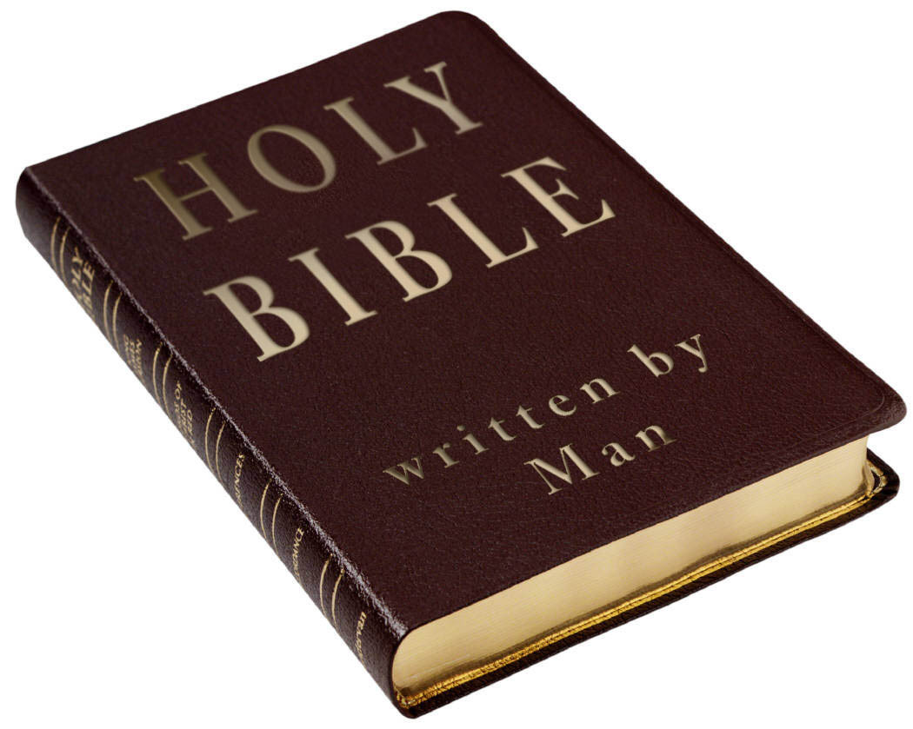
Practical Consequences
Atheism
Repudiation of the Bible, eradication of religion
Despair
  Psalm 22:1
  Ephesians 2:12
Suicide
Richie Thetford www.thetfordcountry.com

Slide 6

Theoretical Implications
Atheism
Man is subordinate to the authority of God
  Romans 1:32
  Romans 6:23
  Romans 12:1-2
Obtaining and maintaining a
correct relationship with God
  Ecclesiastes 12:13-14
Richie Thetford www.thetfordcountry.com

Slide 7

Theoretical Implications
Atheism
Any revelation of the Creator’s will concerning man’s purpose is vitally important
  Hebrews 1:1-3
  Hebrews 2:1-4
“Therefore we must give the more earnest heed
to the things we have heard, lest we drift away”
Richie Thetford www.thetfordcountry.com

Slide 8

Practical Consequences
Atheism
Voluntary and loving submission to God
Repentance
Virtue, morality
  2 Peter 3:11, 14
Devotion to religious exercises
Evangelism
  2 Corinthians 5:10-11, 20
Hope, optimism, courage, trust
Richie Thetford www.thetfordcountry.com

Slide 9
Does It Really Matter
Whether God Exists?
Joshua 24:15
Actions speak much louder than words!
Richie Thetford www.thetfordcountry.com

