Slide 1

Does Everyone Have A Right To
His Own Belief?
church of Christ
Lutheran
Baptist
Assembly of God
Attend the church of your choice!
7th Day Adventist
Mormon
Catholic
Methodist

Slide 2
The Reason Every Man Does Not Have A Right To
His Own Belief
“And do not fear those who kill the body but cannot kill the soul. But rather fear Him who is able to destroy both soul and body in hell.”
Matthew 10:28
“This is My beloved Son. Hear Him!” Mark 9:7
Rev 22:18-19
Acts 3:22-23
Matthew 7:21
Hebrews 5:9
“All authority has been given to Me in heaven and on earth.”

Slide 3
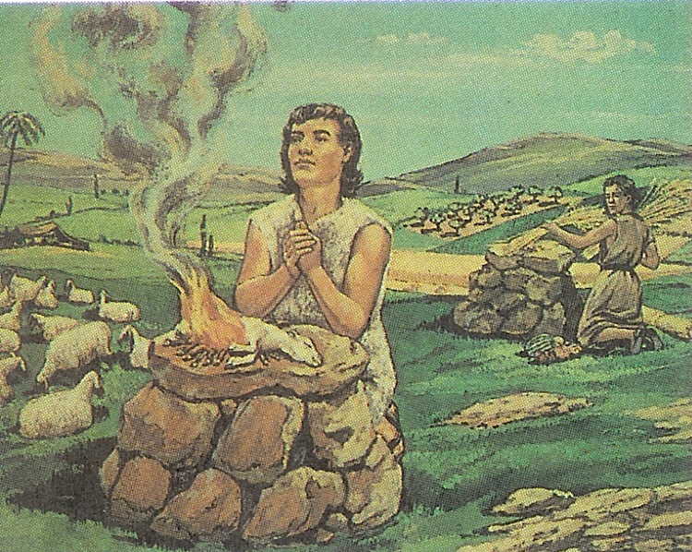
Bible Examples
Demonstrate That Man Does Not Have A Right To
His Own Belief
CAIN’S
WORSHIP
Gen 4:3-5;
Heb 11:4

Slide 4
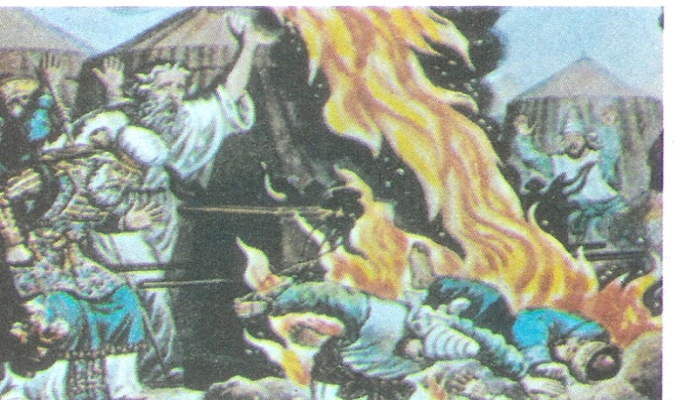
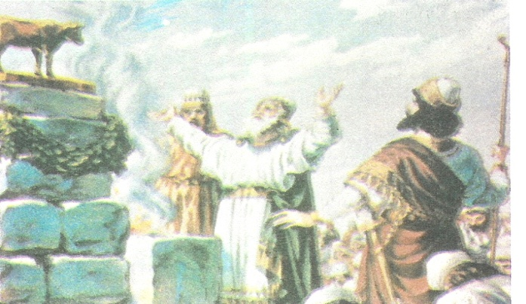
Bible Examples
Demonstrate That Man Does Not Have A Right To
His Own Belief
NADAB & ABIHU’S WORSHIP
Leviticus 10:1-2
JEROBOAM’S WORSHIP
1 Kings 12:26-33

Slide 5
Some Things
In Which We have No Personal Right To
Our Own Belief
To choose which church to belong
  Jesus only established one church
    Matthew 16:18
  He is the head over all things to the church
    Ephesians 1:22-23
  Denominations are religious plants of men
    Matthew 15:13-14

Slide 6
Some Things
In Which We have No Personal Right To
Our Own Belief
To choose what name we shall wear
  Some think we can choose to wear any name
    New Testament disciples wore the name Christian
      Acts 11:26
  Paul rejected the idea that men
  could wear another name
    1 Corinthians 1:10-13

Slide 7
Some Things
In Which We have No Personal Right To
Our Own Belief
To determine how to worship God
  God has given men a pattern of worship
    Singing (Ephesians 5:19)
    Praying (1 Thessalonians 5:17)
    Lord’s Supper (1 Corinthians 11:17-34)
    Giving (1 Corinthians 16:1-2)
    Preaching Sound Doctrine (Acts 2:42)

Slide 8
Some Things
In Which We have No Personal Right To
Our Own Belief
To determine how we will be saved
  God has revealed the conditions to be met
  Man does not have the right to change them
    Believe (John 8:24)
    Repent (Luke 13:3)
    Confess (Matthew 10:32)
    Be Baptized (Mark 16:16)

Slide 9
“that they all may be condemned who did not believe the truth but had pleasure in unrighteousness.” (2 Thes 2:12)
God made us creatures of free moral choice
Can choose to obey or disobey (2 Thessalonians 1:7-9)
The man who teaches us that “every man has the right to his own belief” is looking only at this
world and his own civil rights.
Matt 6:24
GOD
or
Man

