Slide 1

Discouragement
The greatest of saints can get discouraged
Richie Thetford www.thetfordcountry.com

Slide 2
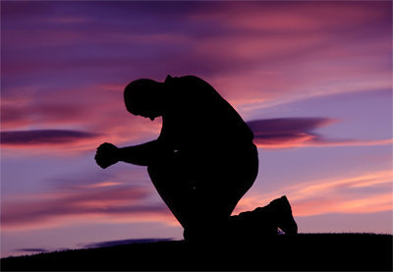
God’s Mighty Warriors
David
  1 Samuel 30:6
  Psalms 42:11
Jeremiah
  Lamentations 3:1-8
  Lamentations 3:21-31
John the Baptist
  Matthew 11:2-6
  Matthew 14:4
Richie Thetford www.thetfordcountry.com

Slide 3

Overcoming Discouragement
Give up the right to understand
  Isaiah 55:8-9
Measure success by obedience
  1 Samuel 15:22
  2 Corinthians 10:12
Read God’s Word and Pray
  Hebrews 4:12
Richie Thetford www.thetfordcountry.com

Slide 4
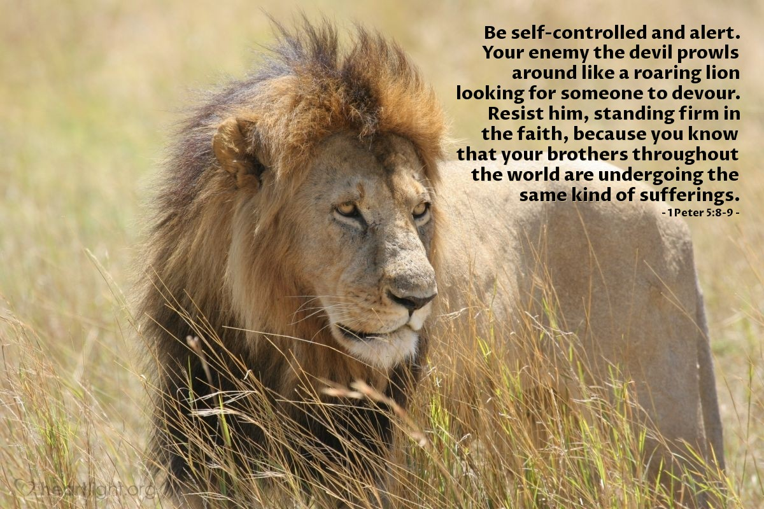
Overcoming Discouragement
Choose to be faithful
  Matthew 25:23
Habitually giving thanks
  1 Thessalonians 5:16-18
Resist discouragement
  1 Peter 5:8-9
Richie Thetford www.thetfordcountry.com

Slide 5

Conclusion
God is with us
We are deeply valued
Resist the Devil
Position our hearts in faithful service to God
  Believe and trust
  Be obedient
  Read the Bible and pray
  Be faithful in all things
  Give thanks constantly
  Resist discouragement
Richie Thetford www.thetfordcountry.com

