Slide 1
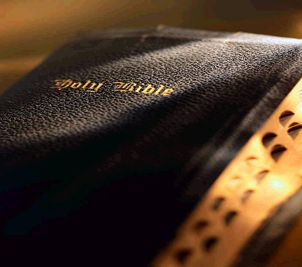
Disciples of Christ
Disciple: “a student” – “a learner” – “a pupil”
In the Bible the word is used most often to refer to a follower of Jesus
Matthew 28:19-20
Richard Thetford www.thetfordcountry.com

Slide 2
Follow Christ
Christ’s Invitation
Matthew 4:19
“no strings attached” – our full and dedicated commitment to follow Jesus is a must!
Richard Thetford www.thetfordcountry.com

Slide 3
Follow Christ
Must follow in order to serve Him
John 12:26
Must faithfully serve Him
Matthew 16:24-27; Luke 9:62
Richard Thetford www.thetfordcountry.com

Slide 4
Will Study
Learn from Jesus
Matthew 11:28-30
Learning as a student is at the heart of what discipleship means
Must Learn Christ Himself
Philippians 2:1-5; 3:8; Jeremiah 9:23-24
Richard Thetford www.thetfordcountry.com

Slide 5
Will Obey
Disciples were taught:
“to obey all things that I have commanded you” – Matthew 28:20
Obedience is a great privilege!
Psalms 40:8
Must obey to be saved
Hebrews 9:27; 5:9
Richard Thetford www.thetfordcountry.com

Slide 6
Will Imitate Him
Pattern ourselves after Him
1 John 2:6; Ephesians 5:1
His example – John 13:15
To be like Him – Matthew 10:24-25
Our lives must be lived as a worthy imitation of Him
1 Corinthians 11:1
Richard Thetford www.thetfordcountry.com

Slide 7
Conclusion
Following Christ involves sacrifice
Luke 9:23-26
Have we counted the cost?
Luke 14:27-33; Matthew 16:26
Once we accept Jesus – we now must listen to Him and obey Him!
“But why do you call Me ‘Lord, Lord,’ and not do the things which I say?” (Luke 6:46)
Richard Thetford www.thetfordcountry.com

