Slide 1
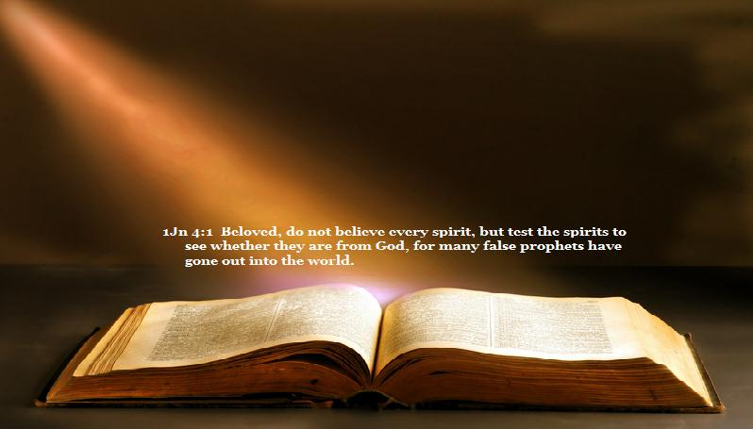
Discernment
“the power or faculty of the mind, by which
it distinguishes one thing from another,
as truth from falsehood”

Slide 2

Discernment
Christians in danger of leaving the Lord
  Hebrews 6:1
  Hebrews 2:1
Dullness of hearing
and failure to
mature exposed

Slide 3
Discernment
For though by this time you ought to be teachers, you need someone to teach you again the first principles of the oracles of God; and you have come to need milk and not solid food. For everyone who partakes only of milk is unskilled in the word of righteousness, for he is a babe. But solid food belongs to those who are of full age, that is,
those who by reason of use have their senses exercised to discern both good and evil.
Hebrews 5:12-14

Slide 4
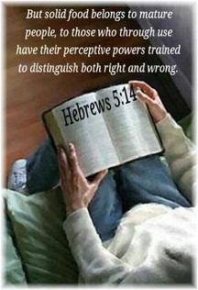
Discernment – Our Senses
All five human senses have their spiritual counterparts
  Taste
    1 Peter 2:1-3
    Psalms 34:8
  Hearing
    Isaiah 55:3
    Revelation 2:7

Slide 5
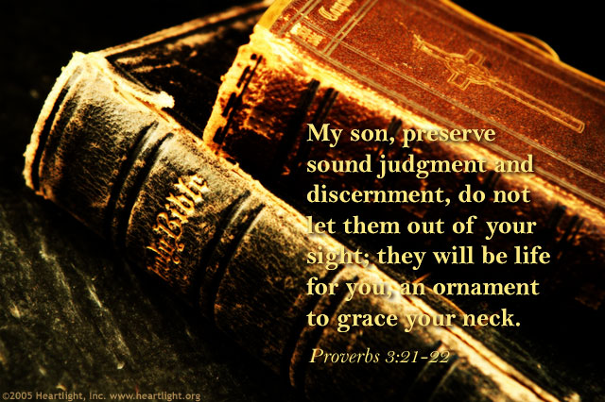
Discernment – Our Senses
  Sight
    Psalms 119:18
    Ephesians 1:18
  Smell
    Philippians 4:18
    2 Corinthians 2:12-17
  Feeling
    2 Kings 22:19
    Ephesians 4:18-19

Slide 6
Conclusion
  The mature Christian is marked by their discernment
  Discernment is a critical measure of spiritual maturity
  Babes are weak in discernment and will accept any kind of spiritual food

Slide 7
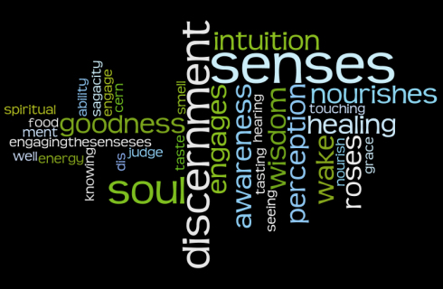
Conclusion
Through the exercise of spiritual senses our discernment between good and evil will produce maturity!

