Slide 1
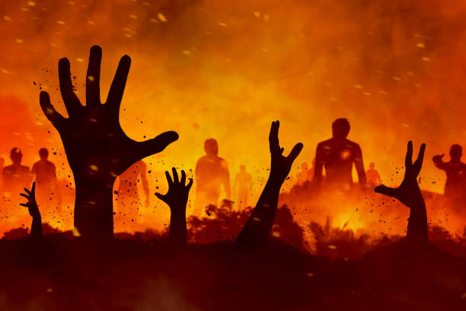
The Devil Knows…
“Be sober, be vigilant; because your adversary the devil walks about like a roaring lion, seeking whom he may devour.”
1 Peter 5:8
Richie Thetford www.thetfordcountry.com

Slide 2
The Devil Knows…
That Jesus is the Son of God
Matthew 4:1-11
Who every accountable child belongs to
God – John 1:12; Philippians 2:15-16
Devil – Acts 13:8-10; 1 John 3:10
That most people have already been secured
Romans 1:20-32; 2 Thessalonians 1:7-9
Richie Thetford www.thetfordcountry.com

Slide 3
The Devil Knows…
That most people don’t realize that:
He is powerful (Ephesians 2:1-2; 6:12)
He is subtle and deceives men (Gen 3:1-7; 2 Cor 11:3)
He is the father of lies (John 8:44)
He is deceitful, a master of disguise (2 Cor 11:14-15)
He is wicked (1 John 2:13)
Richie Thetford www.thetfordcountry.com

Slide 4
The Devil Knows…
He needs to concentrate his efforts on those in God’s Kingdom, the Church
To get them to practice sin any way he can (1 John 3:8)
To cause one to procrastinate (Luke 8:12)
To disguise himself as friendly and helpful (1 Cor 15:33)
To get Christians to tolerate one “pet” sin (1 Cor 5:6-7)
To get Christians to become discouragers (Eph 4:29)
Richie Thetford www.thetfordcountry.com

Slide 5
The Devil Knows…
That he has lost those that:
Study (2 Timothy 2:15; Hebrews 11:6)
Practice Righteousness (Romans 12:1-2; 6:17-18)
Watch for him (Acts 20:28-31)
Resist him (James 4:7)
Fight against him (Ephesians 6:11-16)
Are faithful until death (Revelation 2:10)
Richie Thetford www.thetfordcountry.com

