Slide 1

The Deity of Christ (4)
Whatever confusion there is arises because we tend to speculate rather than accept
divine revelations and not go beyond them.

Slide 2

We Can Know
Jesus existed on an equality with God before He came to earth
  Philippians 2:5-7
  John 1:1
  John 1:14
  John 10:30
By definition, Deity cannot give up any of these attributes and remain Deity. Deity is not temporary or transitory.

Slide 3
We Can Know
That God the Son became flesh
  1 Timothy 3:16
  Colossians 2:9
  John 8:14
  John 8:58
He gave up the glory that He had while in heaven
Matthew 17:2
2 Peter 1:16-17
Jesus both “humbled” (emptied) Himself and “took upon Him the form of a servant” (Philippians 2:7)

Slide 4

We Can Know
He was a man – Not just a man
  Hebrews 2:17-18
He later returned to the glory of God
  Philippians 3:21

Slide 5

We Can Know
While on earth – Jesus voluntarily limited the divine knowledge that He possessed
  Genesis 22:12
  Luke 2:52
  John 10:17-18
  Matthew 24:36

Slide 6
We Can Know
That Jesus was tempted like we are
  Hebrews 4:15
To be tempted is not the sin – the giving in to temptation is the sin
  James 1:14-15
Not necessary for Jesus to exercise His powers of Deity to refrain from sin
  John 8:14

Slide 7
We Can Know
Jesus was both God and man
“The Son of God came in the flesh to confront sin and defeat it. To do that, He had to be tempted, and He was (Hebrews 4:15). To deny that Jesus was tempted because He was God makes no more sense than saying that Jesus could not be God because "God is a spirit" and Jesus had flesh and blood (Hebrews 2:14). Or to deny that Jesus is God because people saw him (1 John 1:1f), yet scripture says "no man has seen God at any time" (John 1:18). We must not confuse statements that apply to God in heaven with the statements that apply to "God with us" (Matthew 1:23).” (Tom Roberts)

Slide 8
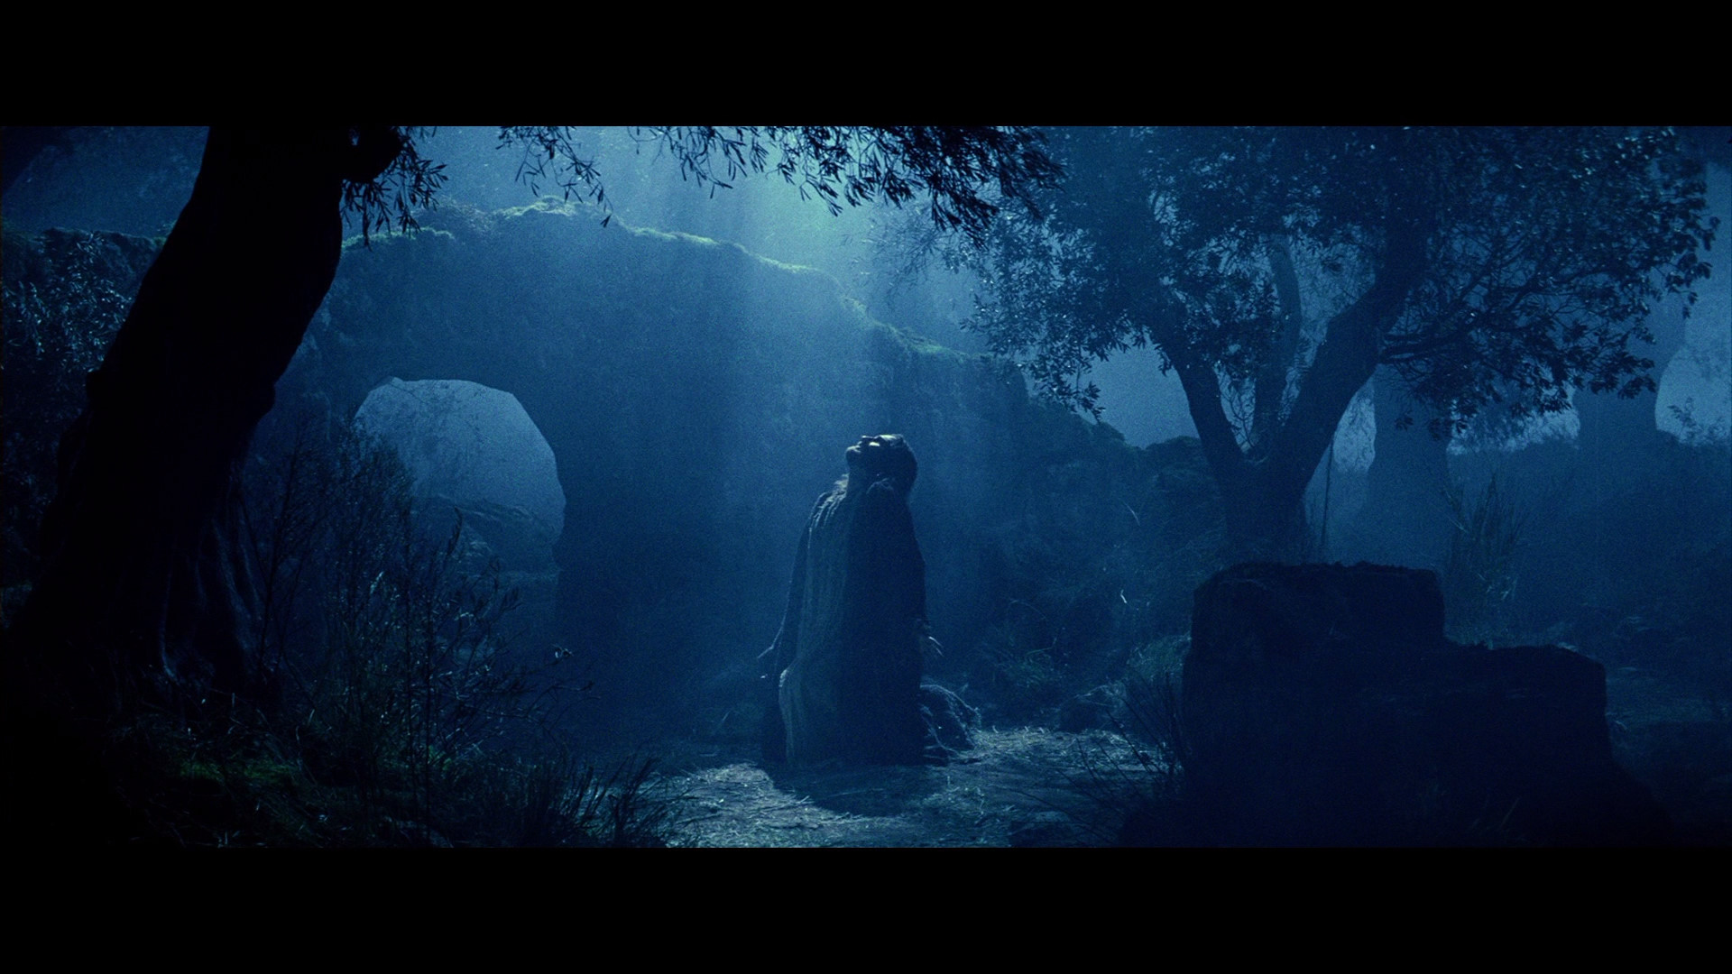
The Deity of Christ
While it is true that man does not have to sin and that Jesus became a man, we cannot draw the conclusion therefore that Jesus was “only a man, an ordinary guy like you and me.”
Jesus was in fact God as He dwelt here on earth

