Slide 1
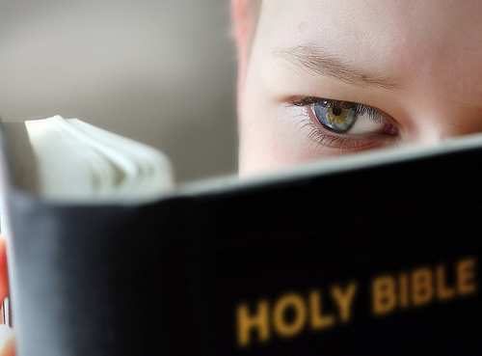
Death is Precious for God’s Saints
Psalms 116:1-19
Richie Thetford www.thetfordcountry.com

Slide 2
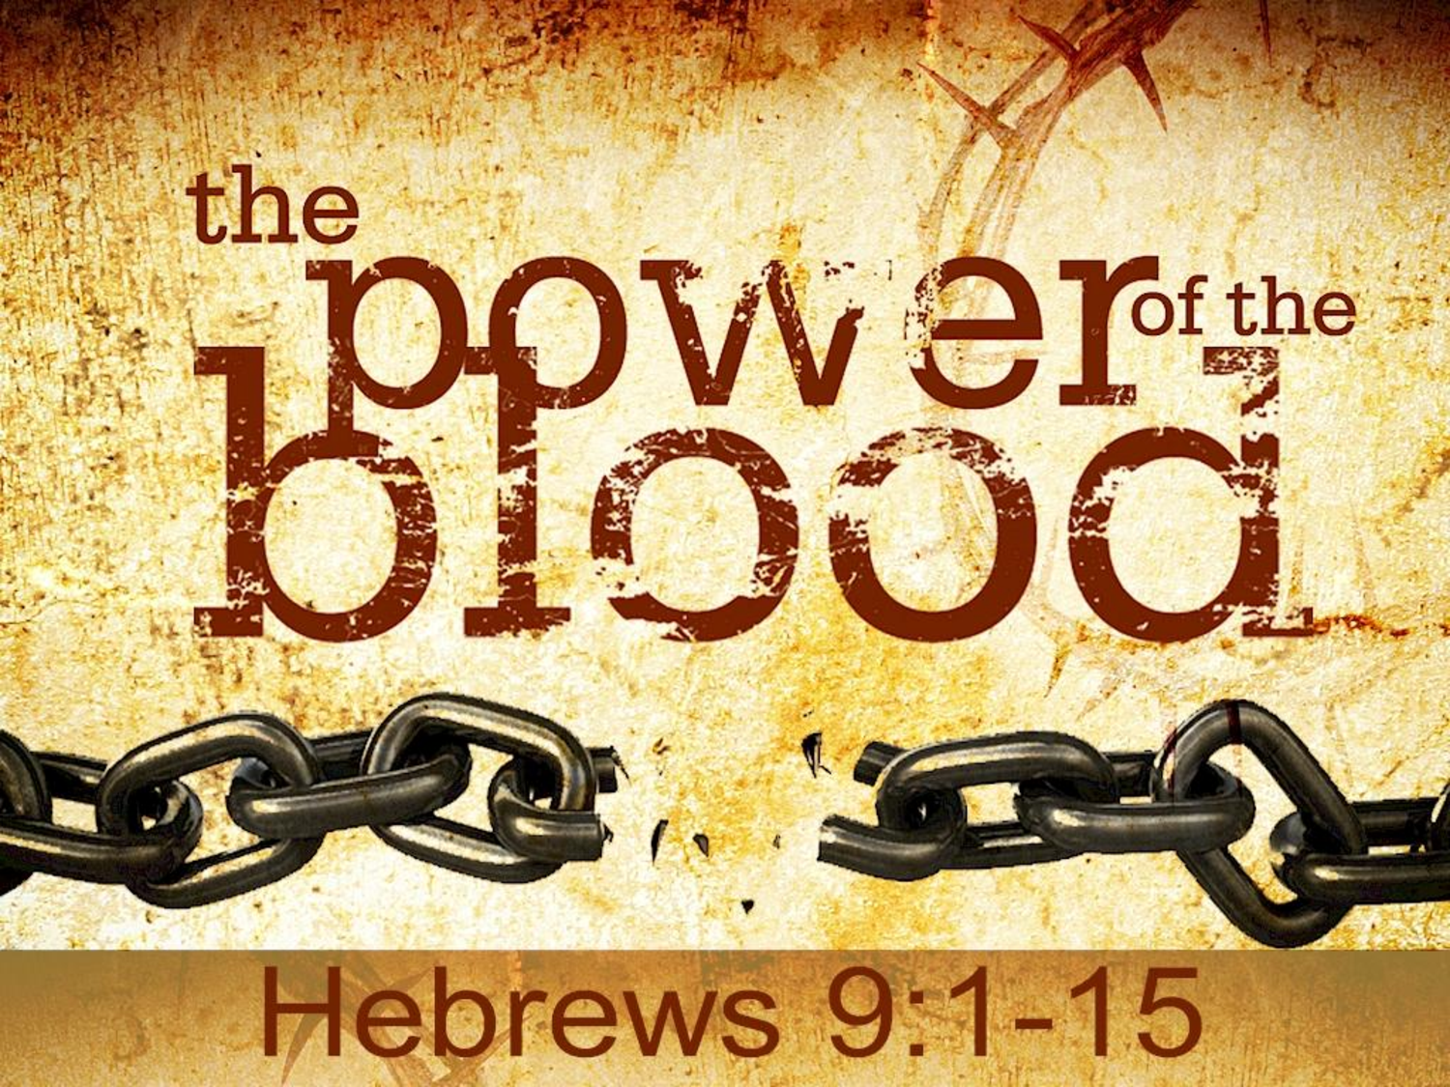
Because He Purchased Them
Christ’s death
Romans 3:23-26
Hebrews 9:15
Church bought with His blood
Acts 20:28
Richie Thetford www.thetfordcountry.com

Slide 3
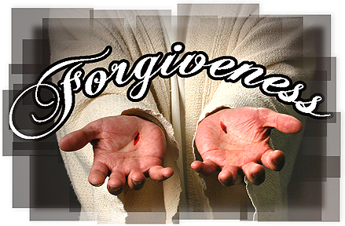
Because They Accept His Pardon
Based on His love and sacrifice
1 John 4:9-10
Must accept it or reject it
Psalms 51:1-3, 17, 19
Luke 23:39-43
Must meet the conditions
Mark 16:15-16
Richie Thetford www.thetfordcountry.com

Slide 4
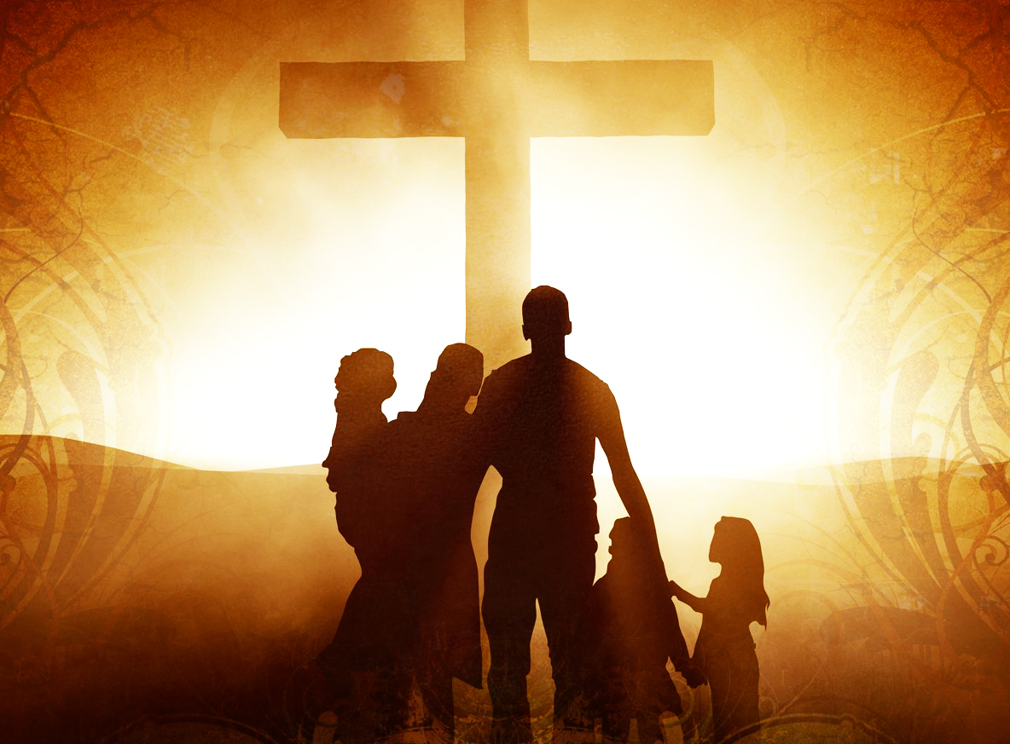
Because They Worship Him
All should worship Him
Psalms 96:7-9
John 4:20-24
Pattern for true worship
Acts 2:42
Richie Thetford www.thetfordcountry.com

Slide 5
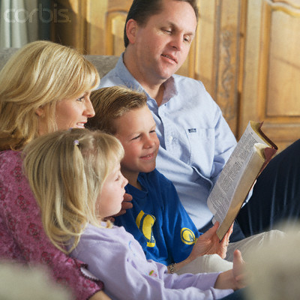
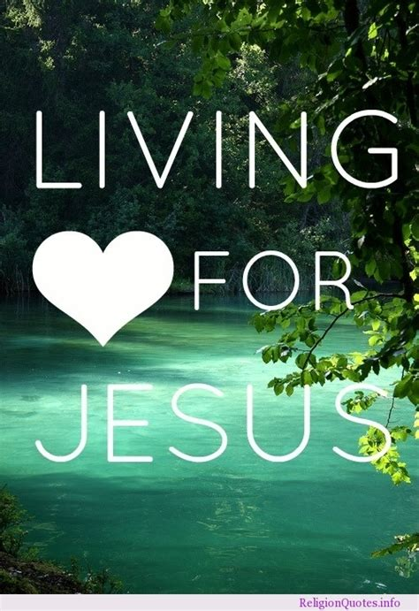
Because They Live for Him
Our life’s purpose
Ecclesiastes 12:13
Luke 9:23
Romans 12:1-2
Galatians 2:20
Richie Thetford www.thetfordcountry.com

Slide 6
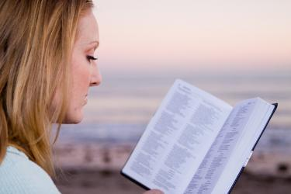
Because They Are Faithful to Him
Only a few remain faithful
2 Timothy 2:19
2 Timothy 4:6-8
Revelation 2:10
“Precious in the sight of the LORD is the death of His saints.”
Psalms 116:15
Richie Thetford www.thetfordcountry.com

