Slide 1

Dare to Be a
Daniel 6:4-23
Richie Thetford www.thetfordcountry.com

Slide 2
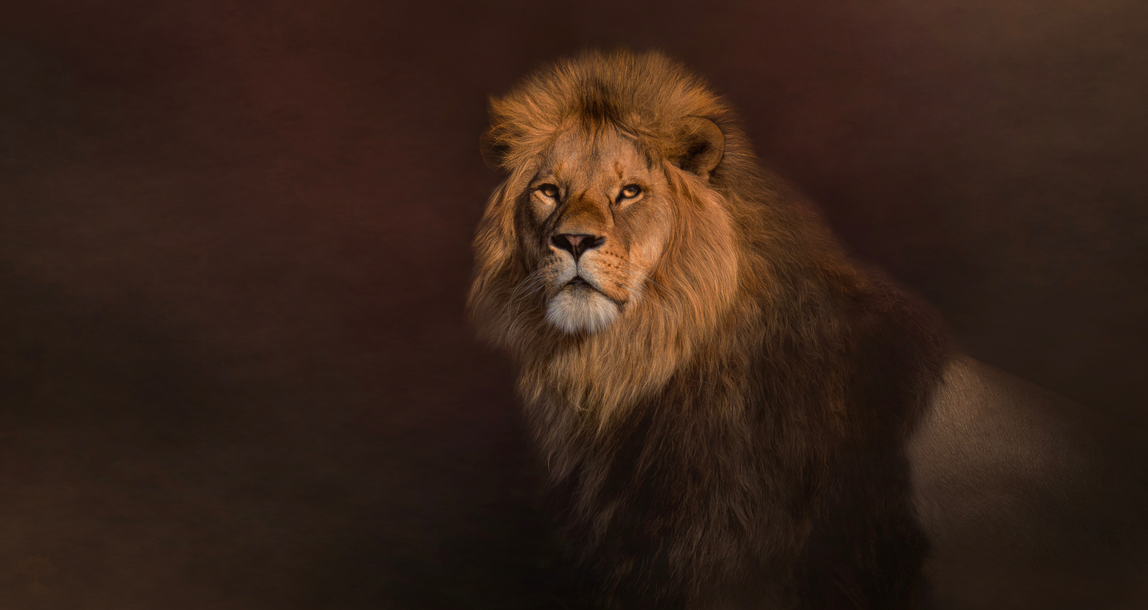
He Was Blameless in His Conduct
Had to manufacture the only “fault”
  1 Timothy 3:2, 10
  1 Peter 4:15-16
“If you were to be placed on trial for being a Christian,
would there be enough evidence to convict you?”
Richie Thetford www.thetfordcountry.com

Slide 3
He Was Unblemished in His Character
Lived most of his life as a captive in an idolatrous land
  James 1:27
  2 Peter 3:11
Consider some of the influences
  Daniel 1:3-5; 3:48; 5:29; 6:1-2
Contrasting Daniel with God’s people
  Exodus 32:21-24
  1 Samuel 13:11-13; 1 John 5:3-5
Richie Thetford www.thetfordcountry.com

Slide 4
He Was Unbending in His Commitment
His commitment to God
  Psalms 1:1-3
  Deuteronomy 6:1-9
His commitment to daily prayer
  Daniel 6
His commitment was not superficial
  Hebrews 11:24-26
Richie Thetford www.thetfordcountry.com

Slide 5
Dare to Be a
May we always resolve to become like this man of God
Richie Thetford www.thetfordcountry.com

