Slide 1
The Courage of Ananias
Courage: “mental or moral strength
to venture, persevere, and withstand danger, fear or difficulty” (Webster)
Richie Thetford www.thetfordcountry.com

Slide 2

The Courage of Ananias
Moses challenged the children of Israel to have courage
  Deuteronomy 31:6
God reminded Joshua to have courage
  Joshua 1:6-7
The courage of Ananias
  Acts 9:10-22
Richie Thetford www.thetfordcountry.com

Slide 3


His Courage Caused Him to Be Ready
Acts 9:10
His answer “Here I am, Lord.”
  1 Samuel 3:10
  Isaiah 6:8
  Hebrews 11:8
Our courage must cause us to be ready
  Romans 1:15
  1 Peter 3:15
  Galatians 6:10
Richie Thetford www.thetfordcountry.com

Slide 4
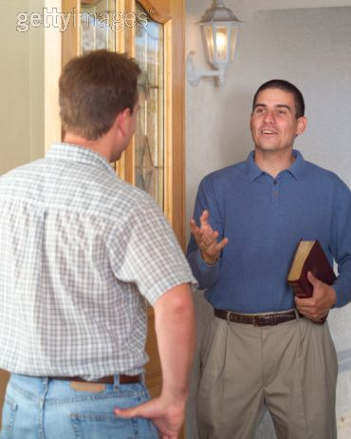
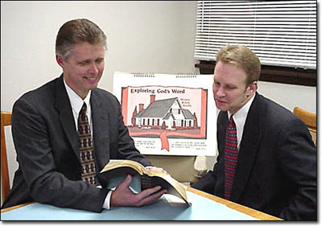
His Courage Caused Him to Go Where
He Normally Would Not Have
Acts 9:11-12
We are human – but we need to strive to develop courage
  2 Timothy 1:7
Richie Thetford www.thetfordcountry.com

Slide 5
His Courage Caused Him to Be Realistic
Acts 9:13-14
Trying to make sure he was following the right course of action
We need to be realistic with our courage today
  Must be willing to do whatever is needed, following the right course
Richie Thetford www.thetfordcountry.com

Slide 6
Caused Him to Be Receptive to the Word
Acts 9:15-17
Ready to do what was needed
The Lord often has a higher purpose for us
  Isaiah 55:8-11
Study the Bible to be able to make righteous judgments
Took courage for Ananias to go to Saul
  Acts 9:17
Richie Thetford www.thetfordcountry.com

Slide 7

Courage Helped Cause Great Results
Acts 9:18-22
What if Ananias had been afraid to say what Paul needed to hear?
We never know whom the person we convert will convert
We must obey Matthew 13 and sow the seed of the kingdom!
Richie Thetford www.thetfordcountry.com

Slide 8
Conclusion
In Ananias we can see the kind of courage that pleases God
We need patience, tact – and courage!
It takes courage to break away
from whatever it is that is keeping us
from living for, and serving Christ!
Richie Thetford www.thetfordcountry.com

