Slide 1
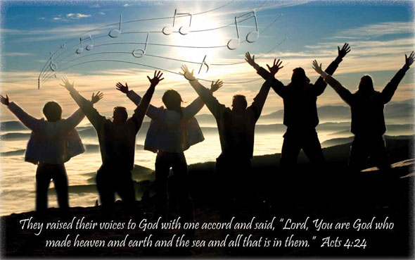
Count It All Joy!
James 1:2-8
Whether we are dealing with trials on the outside or temptations on the inside, it is through faith in God that we CAN experience victory!
Richie Thetford www.thetfordcountry.com

Slide 2

Count It All Joy
We will fall into various trials
  Acts 14:22
Strong Christians learn to
develop an attitude of Joy
  Acts 5:41
  Philippians 2:17
  1 Peter 1:6
Richie Thetford www.thetfordcountry.com

Slide 3
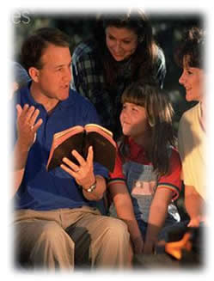
Testing Faith – Produces Patience
Can’t learn to have patience if our faith
is never tested
  Romans 5:3
  1 Peter 1:7-9
  1 Peter 4:12-13
Testing our faith works for us
  2 Corinthians 4:17
Patience builds character
Romans 5:3-4
Richie Thetford www.thetfordcountry.com

Slide 4
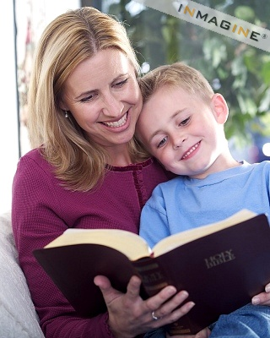
The Results of Patience
Trials produce patience
  Endure trials – Matthew 5:16
Produces spiritual maturity
  Matthew 5:48
  1 Peter 2:2
One that has learned patience is one that has matured, through use, of God’s Word. It does not come to one overnight – it takes effort
Hebrews 5:12-14
Richie Thetford www.thetfordcountry.com

Slide 5

Count It All Joy!
When we understand that God is the one that we live for, then we can be joyful when trials come our way
The testing of our faith produces patience and patience helps to develop a Christ-like character
Richie Thetford www.thetfordcountry.com

