Slide 1
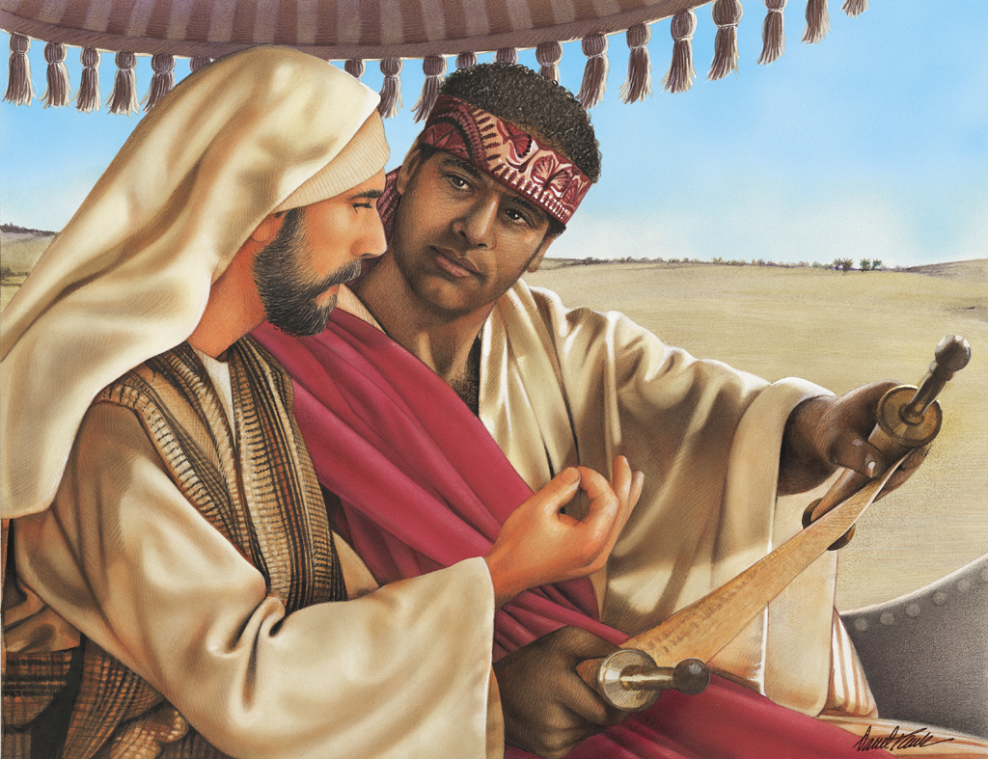
The Conversion of the Ethiopian
Acts 8:26-40
Richie Thetford www.thetfordcountry.com

Slide 2
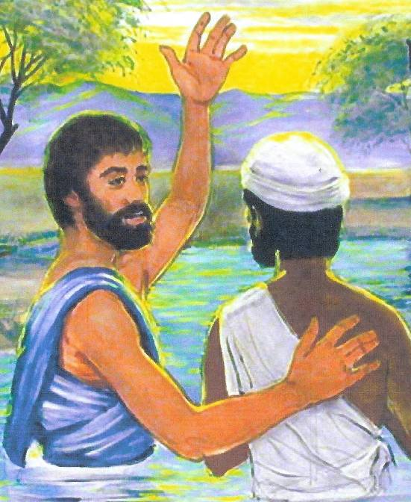
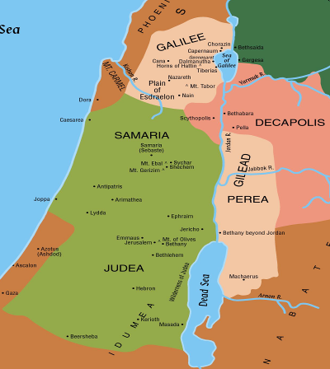
The Conversion of the Ethiopian
Philip preached the gospel in Samaria
Christians were given spiritual gifts by the laying on of the Apostle’s hands
Luke wrote of the conversion
Richie Thetford www.thetfordcountry.com

Slide 3
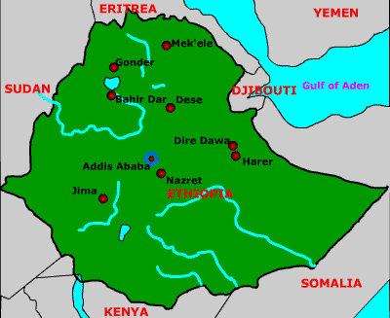
The Conversion of the Ethiopian
Ethiopia
Region of Africa
Descendants of Ham
Richie Thetford www.thetfordcountry.com

Slide 4
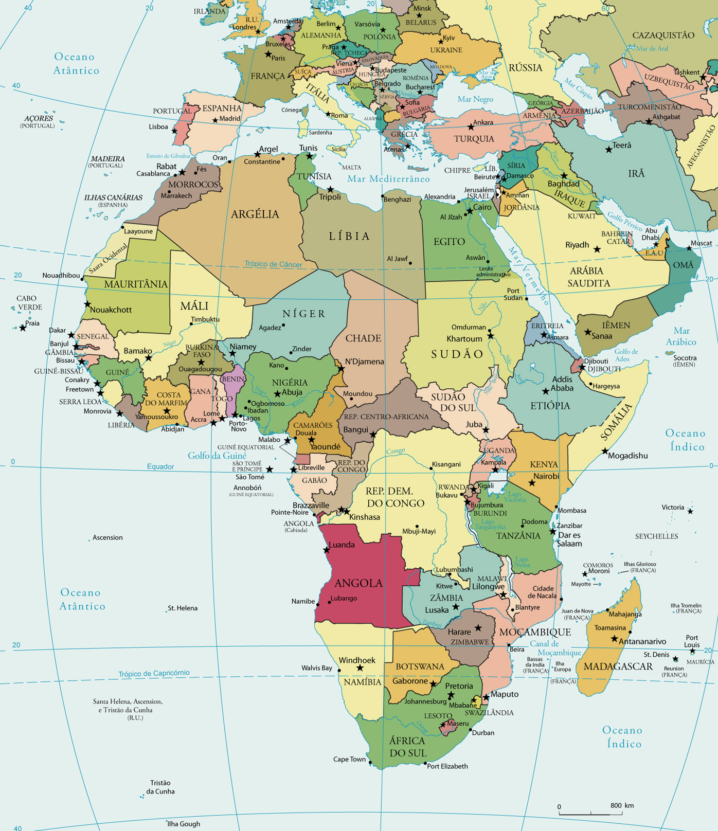
The Conversion of the Ethiopian
Was of high rank
Acts 8:27
Was a proselyte
“convert to Judaism”
Gone to Jerusalem to Worship
Approximately 1,400 miles!
Richie Thetford www.thetfordcountry.com

Slide 5
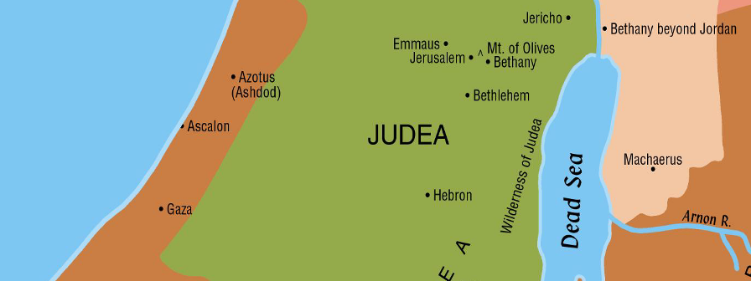
The Conversion of the Ethiopian
The Ethiopian was now returning home
on the road to Gaza
Richie Thetford www.thetfordcountry.com

Slide 6
Persons Involved in his Conversion
God
He sent an angel (8:26)
Angel
Sent to Philip (8:26)
Angel’s are messengers (Numbers 22:23, 31)
Instructed Philip
Richie Thetford www.thetfordcountry.com

Slide 7
Persons Involved in his Conversion
Philip
Obedient preacher (8:27)
Like Abraham (Hebrews 11:8)
Like Paul (Acts 26:19)
Ethiopian
Religious – had just been to Jerusalem (8:27)
Returning home by way of Gaza reading the scriptures (8:28)
Richie Thetford www.thetfordcountry.com

Slide 8
Persons Involved in his Conversion
Holy Spirit
Spoke to Philip (8:29)
Did not speak to the Ethiopian
Operates through the Word (John 6:63)
Brought the preacher to the sinner and the preacher preached the Word
“So then faith comes by hearing, and hearing by the word of God.” (Rom 10:17)
Richie Thetford www.thetfordcountry.com

Slide 9
What Did the Preacher Do?
Ran to the chariot (8:30)
Heard the Ethiopian reading
The Ethiopian answered (8:31)
Philip preached Jesus to him (8:32-35)
Ethiopian asked a question (8:34)
Philip preached Jesus (8:35)
Ethiopian asked another question (8:36)
Richie Thetford www.thetfordcountry.com

Slide 10
What Did the Preacher Do?
Philip answered (8:37)
Ethiopian was baptized (8:38)
Immersion
Romans 6:3-4
Colossians 2:12
For forgiveness of sins
Acts 2:38; 22:16
Went away rejoicing!
Richie Thetford www.thetfordcountry.com

Slide 11
The Ethiopian traveled a long way to worship God – willing to be submissive to His will
He immediately confessed Christ and was immersed in water – for the forgiveness of sins
How far are we willing to travel to do God’s will?
Richie Thetford www.thetfordcountry.com

