Slide 1
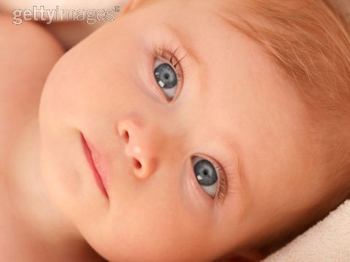
CONTENTMENT
Contentment is one of our greatest possessions
Richie Thetford www.thetfordcountry.com

Slide 2
Contentment
“As for me, I will see Your face in righteousness; I shall be satisfied when I awake in Your likeness.” (Psalms 17:15)
“Contentment is the pearl of great price, and whoever procures it at the expense of ten thousand desires makes a wise and a happy purchase.”
-- John Balquy
Richie Thetford www.thetfordcountry.com

Slide 3
Contentment
“As for me, I will see Your face in righteousness; I shall be satisfied when I awake in Your likeness.” (Psalms 17:15)
“Contentment is natural wealth, luxury is artificial poverty.”
-- Socrates
“If you are content, you have enough to live comfortably.”
-- Plautus
Richie Thetford www.thetfordcountry.com

Slide 4
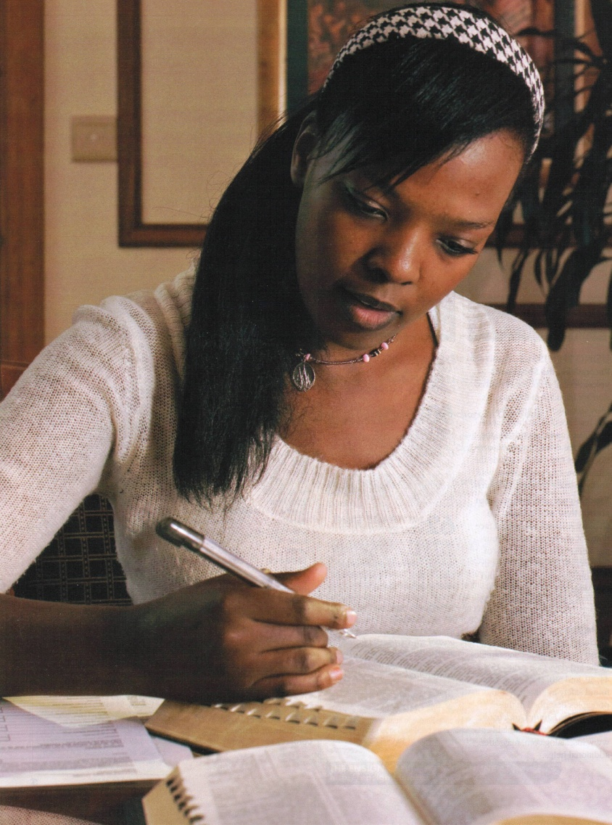
Men Seek Contentment
Worldly pleasure
Will not last
Psalms 17:14
More to Life
Hebrews 11:24-26
Riches
Ecclesiastes 5:10-11
Proverbs 22:1; 30:8-9
Richie Thetford www.thetfordcountry.com

Slide 5
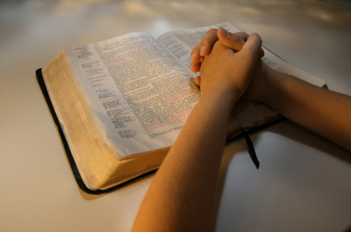
Men Seek Contentment
Power
James 4:6
James 1:17
Jeremiah 10:23
Knowledge
A knowledge that does not lead one to acknowledge and subject himself to God is misdirected knowledge
1 Timothy 6:20-21
Richie Thetford www.thetfordcountry.com

Slide 6
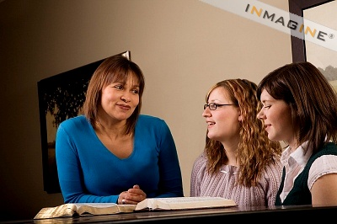
True Contentment
Living Righteously
Proverbs 14:34
2 Corinthians 3:18
Always keep focused on God
Eccl 6:9; Phil 4:11; Heb 13:5
“Now godliness with contentment is great gain. For we brought nothing into this world, and it is certain we can carry nothing out. And having food and clothing, with these we shall be content.” (1 Timothy 6:6-8)
Richie Thetford www.thetfordcountry.com

Slide 7
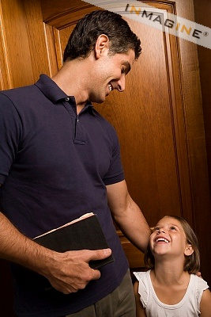
Conclusion
“I shall be satisfied when I awake in Your likeness.” (Psalms 17:15)
Happiness is the result of character
NOT THINGS
“But seek first the kingdom of God and His righteousness, and all these things shall be added to you.”
(Matthew 6:33)
Richie Thetford www.thetfordcountry.com

