Slide 1
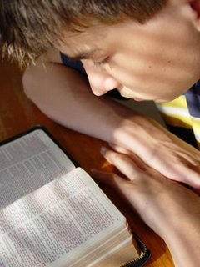
Committing Ourselves to Excellence
“Study to shew thyself approved unto God, a workman that needeth not to be ashamed, rightly dividing the word of truth.”
2 Timothy 2:15
Richard Thetford www.thetfordcountry.com

Slide 2
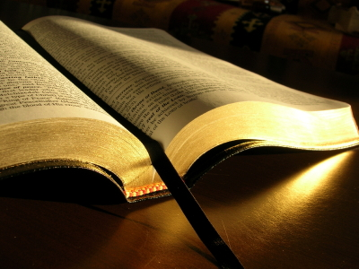
Mediocrity
Nothing higher than “getting by”
Content with low level of quality
Nothing above “adequate” or “good enough”
Work offered is inferior
Haggai 1:4
Malachi 1:8
Proverbs 3:9
Richard Thetford www.thetfordcountry.com

Slide 3
Mediocrity
“The general tendency of things throughout the world is to render mediocrity the ascendant power among mankind.” John Stuart Mill
“Mediocre”
Of moderate to low quality; average or inferior
When we do only “what is easy” then mediocrity increases
Richard Thetford www.thetfordcountry.com

Slide 4
Excellence
We should have a commitment to excellence in ALL we do
Ecclesiastes 9:10
Colossians 3:23-24
Should have a higher standard of excellence in the Lord’s work
1 Corinthians 15:58
2 Corinthians 9:6
Richard Thetford www.thetfordcountry.com

Slide 5
Excellence
Take pride in our work
Galatians 6:4
We have a duty to “adorn the doctrine of God our Savior in all things” (Titus 2:10)
Quality Knowledge
Quality Principles
Quality Actions
Richard Thetford www.thetfordcountry.com

Slide 6
Excellence
Commitment to excellence requires extra effort
Carefulness and hard work are required
“See then that you walk circumspectly, not as fools but as wise” Ephesians 5:15 (NKJV)
“Study to shew thyself approved unto God, a workman that needeth not to be ashamed, rightly dividing the word of truth.” 2 Timothy 2:15 (KJV)
Richard Thetford www.thetfordcountry.com

Slide 7
Conclusion
Strive to “give of our best” to the Master
Go “beyond ordinary”
Strive for the “quality life”
Nothing but the best is good enough for the Lord who gave His life for us!
It is not a shame to fail; it is a shame to aim low
For the love of Christ compels us, because we judge thus: that if One died for all, then all died; and He died for all, that those who live should live no longer for themselves, but for Him who died for them and rose again. 2 Corinthians 5:14-15
Richard Thetford www.thetfordcountry.com

