Slide 1
Commissioned To Do Personal Work
Jesus Commissioned
HIS DISCIPLES
to do personal work
Richie Thetford www.thetfordcountry.com

Slide 2
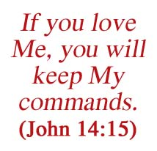
Disciples Are To Seek The Lost
Jesus has ALL authority
Matthew 28:18-20
Luke 24:46-48
Disciples took this charge seriously!
Obedience was proof of their love for Him
John 14:15
Matthew 7:21
Richie Thetford www.thetfordcountry.com

Slide 3
Glad Tidings
Gospel is glad tidings
Gospel means “good news” “glad tidings”
Receives the forgiveness of sins (Acts 2:38)
Recipient of a “new joy!” (Acts 2:46-47)
Gives a reason for living and a renewed confidence in death (Acts 7:55-60)
A DESIRE to share the gospel with others
2 Corinthians 5:14-15, 20
Richie Thetford www.thetfordcountry.com

Slide 4
Lost Without the Gospel
One is lost if the gospel is not obeyed
2 Thessalonians 1:6-9
Mark 16:16
Gospel is the ONLY way sinners can enter into a proper relationship with God
Romans 1:16-17
To obey – one must first hear
Romans 10:14-17
Richie Thetford www.thetfordcountry.com

Slide 5
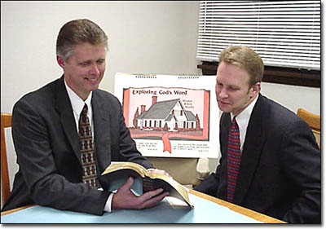
Must Spread the Gospel
Can’t disregard the commandments
James 4:17; 1 Corinthians 9:16-17
Soul winning is the highest work!
Jesus is our example
Luke 19:10; John 15:1-2
Soul winning should be a natural part of our life
2 Corinthians 4:12-14
Richie Thetford www.thetfordcountry.com

Slide 6
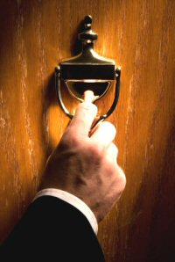
Commissioned to do Personal Work
Spreading the gospel is NOT just a preacher responsibility
Must pray for laborers so there can be a harvest
Matthew 9:37-38
Richie Thetford www.thetfordcountry.com

