Slide 1
Color blindness but soul seeing
Racism is wrong – but why is it wrong?
Not because a group of people claim it’s wrong
Not because the government says it’s wrong
Not because the media claims it’s wrong
It is wrong because there is a God and His Holy Word declares that it is wrong
Richie Thetford www.thetfordcountry.com

Slide 2
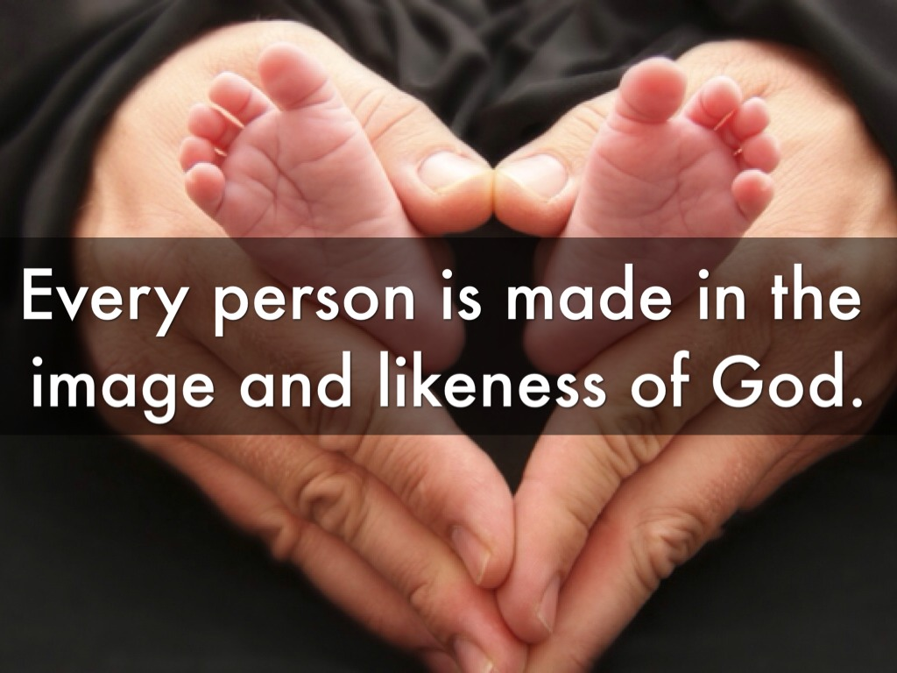
Created in god’s image
God created male and female
Genesis 1:26-27
All races made in God’s likeness
Acts 17:28-29
James 3:8-9
All beings bear the image of the divine
Richie Thetford www.thetfordcountry.com

Slide 3
God only made one race
Variety of colors – one human race
Acts 17:26
Homo sapiens
“humans regarded as a species.”
Richie Thetford www.thetfordcountry.com

Slide 4
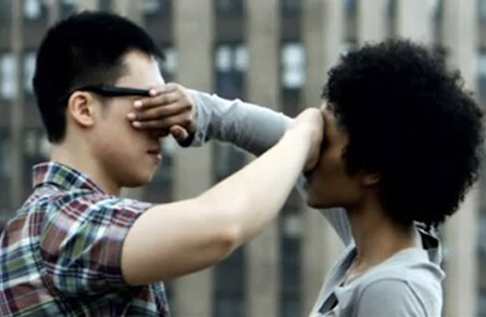
God doesn’t play favorites
Perfectly just and fair
Deuteronomy 10:17-19
God’s character
Acts 10:34-35
Galatians 2:6
We are to be color blind
Richie Thetford www.thetfordcountry.com

Slide 5
Love is not racist
Christians to be characterized by love
James 2:8-9
Romans 13:9-10
Christians set apart from the world
1 John 4:20-21
Richie Thetford www.thetfordcountry.com

Slide 6
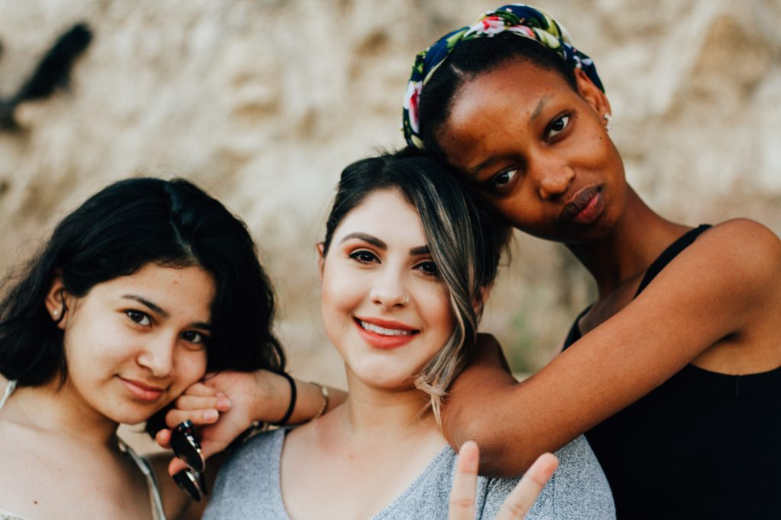
Jesus died for everyone
Died for the entire world
John 3:16-17
1 John 4:14
Gospel of Jesus is for everyone
Mark 16:15-16
Revelation 14:6
Ecclesiastes 12:7
Richie Thetford www.thetfordcountry.com

Slide 7
Color blindness but soul seeing
conclusion
Let us be “color blind” but “soul seeing” like our Heavenly Father who looks on the heart
“Do not judge according to appearance, but judge with righteous judgment.”
John 7:24
Richie Thetford www.thetfordcountry.com

