Slide 1
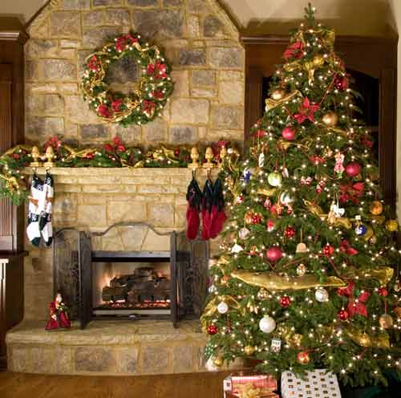
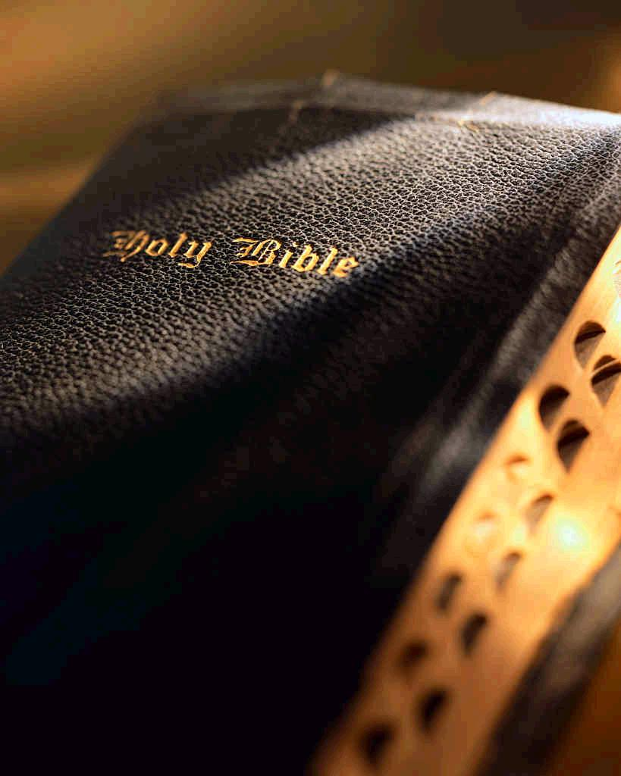
Christmas and Christ

Slide 2
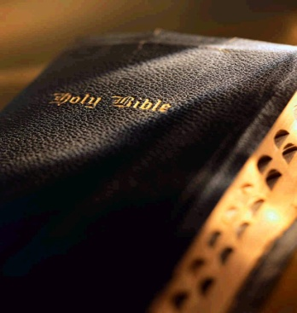
Christmas and Christ
False reasons for not celebrating Christmas as Christ’s birthday
We do not think the birth of Christ is important
Matthew 1:20-21

Slide 3
Christmas and Christ
False reasons for not celebrating Christmas as Christ’s birthday
We do not want to honor or remember Christ
Acts 11:26; 1 Corinthians 11:23-26; Acts 20:7; Colossians 2:14-16; 1 Peter 2:24; Hebrews 9:15-17

Slide 4
Christmas and Christ
Reasons we do not celebrate Christmas as Christ’s birthday
Bible does not give the date of Christ’s birth
Matthew 2:1; Luke 3:1-3; Luke 2:7-18; Matthew 2:1-11

Slide 5
Christmas and Christ
Reasons we do not celebrate Christmas as Christ’s birthday
Doing so violates many divine principles
2 Timothy 3:16-17
Ephesians 2:10
Matthew 7:23

Slide 6
Christmas and Christ
One does not have God (2 John 9)
It is a presumption (Psalm 19:13)
It is of man (Matthew 15:9)
It is adding to the Word (Rev 22:18)
It is another gospel (Galatians 1:8)

Slide 7
Christmas and Christ
Reasons we do not celebrate Christmas as Christ’s birthday
It is of human origin
Encyclopedia of Religion by Fern
World Book Encyclopedia
Britannica Encyclopedia
“Christmas” -- “Christ and Mass”

Slide 8
Christmas and Christ
What about the non-religious aspect of Christmas?
Christmas is both religious and secular in nature
Christians can do certain things of a secular nature on Christmas day
1 Corinthians 8:4-8

Slide 9
Christmas and Christ
What about the non-religious aspect of Christmas?
Christians must be careful not to attach religious significance to Christmas
Be careful not to give the impression of believing it to be Christ’s birthday

Slide 10
Christmas and Christ
Conclusion
We can do non-religious things on Christmas if we desire
Practicing things of Christmas to commemorate the birth of Christ is done so without Bible authority
John 14:15, 21; Matthew 15:9

