Slide 1

Christian Characteristics
LOVE
2 Peter 1:5-10
Most think of love as the outward acts
The gift of the Father was the act of love
“For God so loved the world that He gave His only begotten Son, that whoever believes in Him should not perish but have everlasting life.”
John 3:16
Richie Thetford www.thetfordcountry.com

Slide 2

Importance of Christian Love
1 Corinthians 13:1-13
Promises shown:
  God dwells in us
    1 John 4:16
  Heirs of the kingdom
    James 2:5
  Receive the crown of life
    James 1:12
Richie Thetford www.thetfordcountry.com

Slide 3
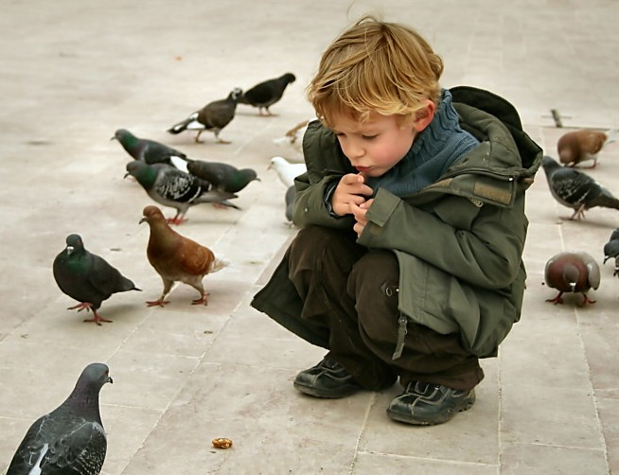

Characteristics of Christian Love
Patience
  “suffers long”
    1 Corinthians 13:4
    1 Peter 2:19-21
Kindness
  “is kind”
    Ephesians 4:32
    1 Corinthians 8:12
Richie Thetford www.thetfordcountry.com

Slide 4

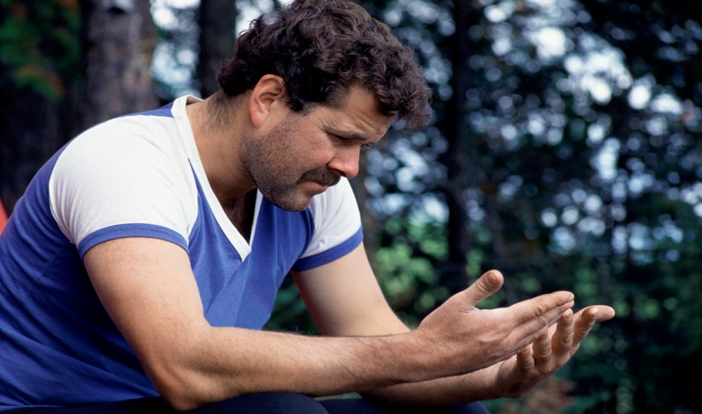
Characteristics of Christian Love
Liberality
  “does not envy”
    Romans 12:15
Humility
  “does not brag and is not arrogant”
    Proverbs 16:18
    Matthew 18:1-4
Richie Thetford www.thetfordcountry.com

Slide 5

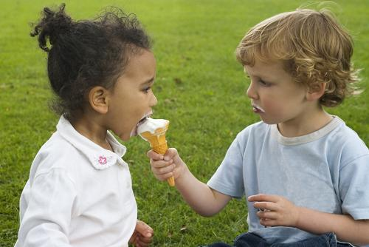
Characteristics of Christian Love
Courtesy
  “does not behave rudely”
    1 Corinthians 13:5
Unselfish
  “does not seek its own”
    Philippians 2:4
    1 Corinthians 10:33
Richie Thetford www.thetfordcountry.com

Slide 6


Characteristics of Christian Love
Good Temper
  “is not provoked”
    Proverbs 16:32
Justice
  “thinks no evil”
    Proverbs 10:12
    Proverbs 17:9
Richie Thetford www.thetfordcountry.com

Slide 7

Characteristics of Christian Love
Righteousness
  “rejoices in the truth”
    1 Corinthians 13:6
    2 John 4
Richie Thetford www.thetfordcountry.com

Slide 8

Summary
1 Corinthians 13:7-8
Bears all things
Believes all things
Hopes all things
Endures all things
Never fails
Richie Thetford www.thetfordcountry.com

Slide 9

Conclusion
Love is the greatest!
WHY?
Faith will turn into reality
Hope will be realized
Love will endure forever!
“it never fails”
Richie Thetford www.thetfordcountry.com

