Slide 1
Christian Characteristics
BROTHERLY KINDNESS
2 Peter 1:5-10
Translated: “love of the brethren”
Warmheartedness, Goodness, Generosity, Helpfulness
The Cause: LOVE
The Effect: KINDNESS
John 13:34-35; 1 Peter 1:22; 1 John 4:21
Richie Thetford www.thetfordcountry.com

Slide 2
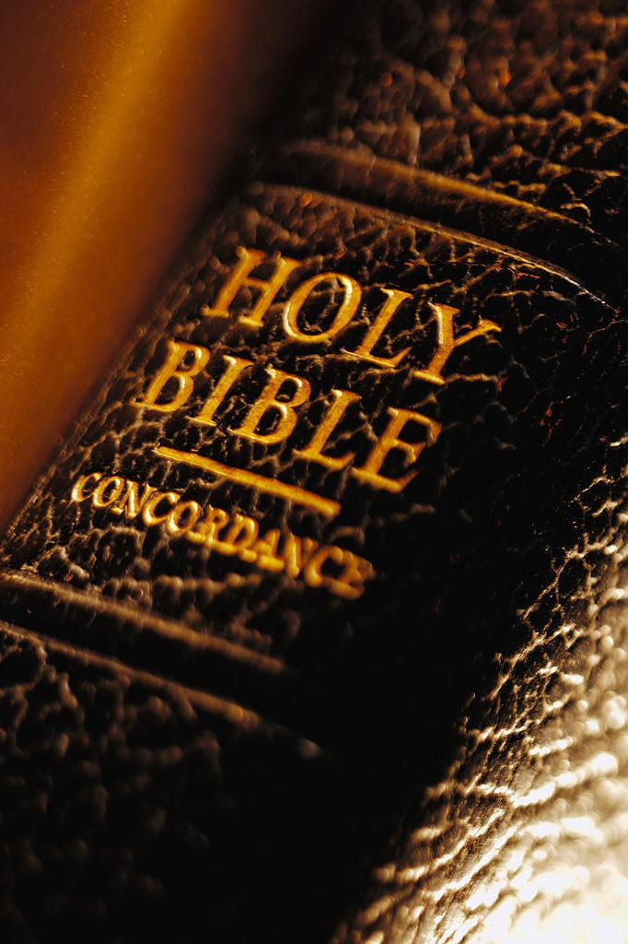
Brotherly Kindness Commanded
In the Old Testament
  Zechariah 7:8-10
  Deuteronomy 22:1
By Peter
  1 Peter 2:17
By Paul
“And be kind to one another, tenderhearted, forgiving one another, just as God in Christ forgave you.” Ephesians 4:32
Richie Thetford www.thetfordcountry.com

Slide 3
Ways Brotherly Kindness
Can Be Shown
Through our conversation
  Proverbs 31:26
  Proverbs 15:4; 15:1
  Colossians 4:6
“kindness makes a person attractive. If you would win the world, melt it, do not hammer it.”
-- Alexander Maclaren
Richie Thetford www.thetfordcountry.com

Slide 4
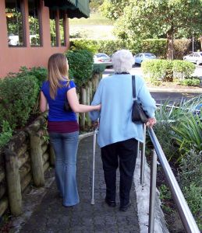
Ways Brotherly Kindness
Can Be Shown
Through sympathy toward one another
  1 Corinthians 12:25
  2 Timothy 1:16-18
  Matthew 14:14
Richie Thetford www.thetfordcountry.com

Slide 5

Ways Brotherly Kindness
Can Be Shown
By practicing the “golden rule”
“Therefore, whatever
you want men to do to you, do also to them,
for this is the Law and
the Prophets.”
Matthew 7:12
To get the full understanding of the meaning of this verse:
Change places
with the
other fellow!
Richie Thetford www.thetfordcountry.com

Slide 6
Ways Brotherly Kindness
Can Be Shown
By doing good for evil
  Matthew 5:46-48
  1 Peter 3:8-12
  Romans 12:17-21
two wrongs have never made a right!
Richie Thetford www.thetfordcountry.com

Slide 7
Conclusion
When we sin against
THE BRETHREN
We sin against Christ
1 Corinthians 8:12; Acts 9:3-5
Richie Thetford www.thetfordcountry.com

