Slide 1
Christian Characteristics
GODLINESS
2 Peter 1:5-10
“Piety, which is characterized by a God-like attitude, does that which is well-pleasing to God”
God-likeness
Richie Thetford www.thetfordcountry.com

Slide 2


Godliness Commanded
Heaven
By Peter
  2 Peter 3:11
By Paul
  1 Timothy 4:7
  Titus 2:11-13
Richie Thetford www.thetfordcountry.com

Slide 3
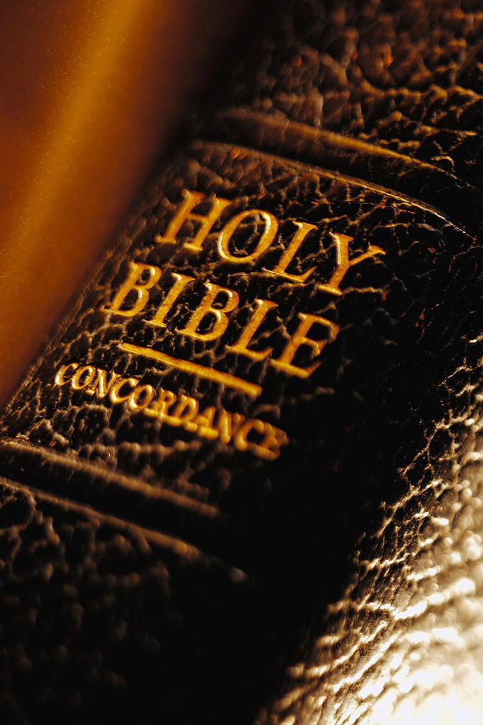
Ways We Can Be Like God
In Love
  John 3:16
  Romans 5:8
  Matthew 22:36-40
  1 John 3:10; 4:7, 11
  Matthew 5:43-46
In Impartiality
  1 Peter 1:17; James 2:1-9
Richie Thetford www.thetfordcountry.com

Slide 4
Ways We Can Be Like God
In Mercy
  Titus 3:5
  Luke 6:32-36
In Holiness
  1 Chronicles 16:29
  Matthew 5:48
  1 Peter 1:13-16
Richie Thetford www.thetfordcountry.com

Slide 5
Godliness Often Misconstrued
Some think that gain is godliness
  1 Timothy 6:3-5
Some practice an outward form of godliness
  2 Timothy 3:5
  Matthew 23:27-28
A God-like person will be evident to others
Richie Thetford www.thetfordcountry.com

Slide 6

Results of Godliness
Ensures persecution
  2 Timothy 3:12
Godliness works deliverance
from temptation
  1 Corinthians 10:13
  2 Peter 2:9
Richie Thetford www.thetfordcountry.com

Slide 7
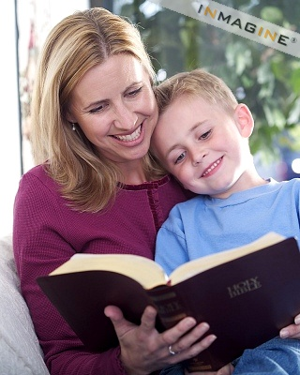
Results of Godliness
Godliness with contentment
is where we gain
  1 Timothy 6:6
  Matthew 6:33
Godliness prepares us for
the life to come
  1 Timothy 4:8
“Be content with what you have, never with what you are.”
Richie Thetford www.thetfordcountry.com

Slide 8

Conclusion
Pray for conditions favorable
to practicing godliness
  1 Timothy 2:1-3
Godly people are set
apart for the Lord
  Psalms 4:3
Richie Thetford www.thetfordcountry.com

Slide 9
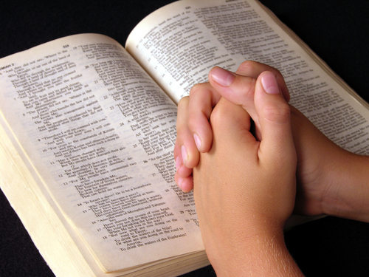
Conclusion
Good works become professors
of godliness
  1 Timothy 2:9-10
Must strive to be
like Him – to be
with Him in eternity!
  Psalms 17:15
  1 John 3:2-3
Richie Thetford www.thetfordcountry.com

