Slide 1

Christian Characteristics
KNOWLEDGE
2 Peter 1:5-10
“awareness; acquaintance with facts; range of information; all that has been perceived or grasped by the mind; learning; enlightenment; the body of facts accumulated by mankind” (Webster’s College Dictionary)
“who desires all men to be saved and to come to the knowledge of the truth”
1 Timothy 2:4
Richie Thetford www.thetfordcountry.com

Slide 2


Knowledge Commanded
By Peter
  2 Peter 3:18
By Paul
  Romans 16:19
  1 Corinthians 14:20
  Hebrews 5:12-14
“but grow in the grace and knowledge of our Lord and Savior Jesus Christ…”
Richie Thetford www.thetfordcountry.com

Slide 3

Things We Need to Know
The Will of God
  Ephesians 5:17
  Romans 6:17-18
  Colossians 1:9-10
The Love of Christ
  Ephesians 3:17-19
  1 Timothy 1:15
  John 14:1-3
“Therefore do
not be unwise, but understand what the will of the Lord is”
Richie Thetford www.thetfordcountry.com

Slide 4

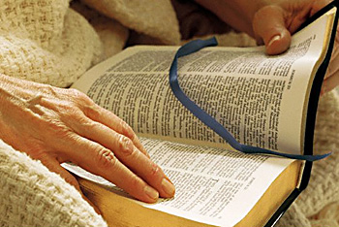
Things We Need to Know
The Hope of God’s Calling
  Ephesians 1:18
    It is an anchor
    of the soul
The Greatness of
His Power
  Ephesians 1:19-22
  1 Corinthians 6:14
“This hope we have as an anchor of the soul, both sure and steadfast…”
Richie Thetford www.thetfordcountry.com

Slide 5
Why We Need to Know
Ignorance of His Will is NO Excuse
  Ephesians 4:18; Acts 17:30
No study – no knowledge
No knowledge – no understanding
No understanding -- IGNORANCE
“…for they being ignorant of God’s righteousness, and going about to establish their own righteousness, have not submitted themselves unto the righteousness of God.”
Romans 10:3
Richie Thetford www.thetfordcountry.com

Slide 6

Why We Need to Know
Hope Influences Us
  1 Corinthians 15:19
  1 Thessalonians 4:13
His Power Has Given All We Need
  2 Peter 1:3
Knowledge of His power increases our faith
We “CAN" Do It!
Richie Thetford www.thetfordcountry.com

Slide 7
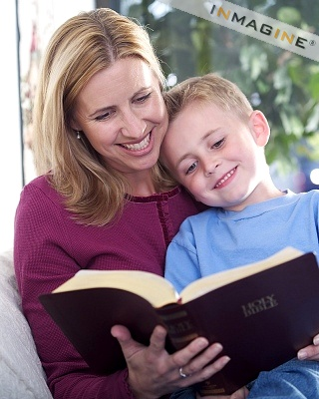
Source of Our Knowledge
B-I-B-L-E
Treasures of Wisdom and
Knowledge Are in Christ
  Colossians 2:3
Obtained Through Study
Psalms 119:104; 2 Timothy 2:15;
2 Timothy 3:15; Ephesians 3:4
Richie Thetford www.thetfordcountry.com

Slide 8
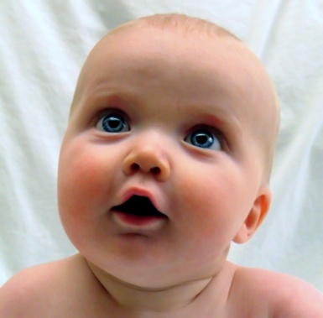
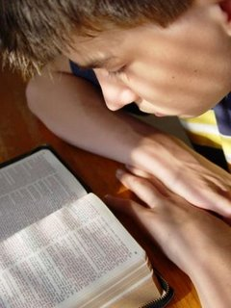
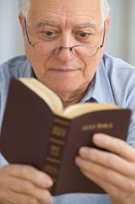
Results of Knowledge
2 Peter 3:18
“but grow in the grace and knowledge of our Lord and Savior Jesus Christ...”
1 Peter 2:1-3
Luke 12:41-48
James 4:17
Richie Thetford www.thetfordcountry.com

Slide 9
CONCLUSION
We Are Often Responsible For Our Own Ignorance!
  Matthew 13:15
Eternity Based Upon:
  Our knowledge of
  God’s Holy Word
  How we apply it in our daily life
Romans 1:28
“And even as they did not like to retain God in their knowledge...”
Let us NOT “mature in our weakness”
Richie Thetford www.thetfordcountry.com

