Slide 1
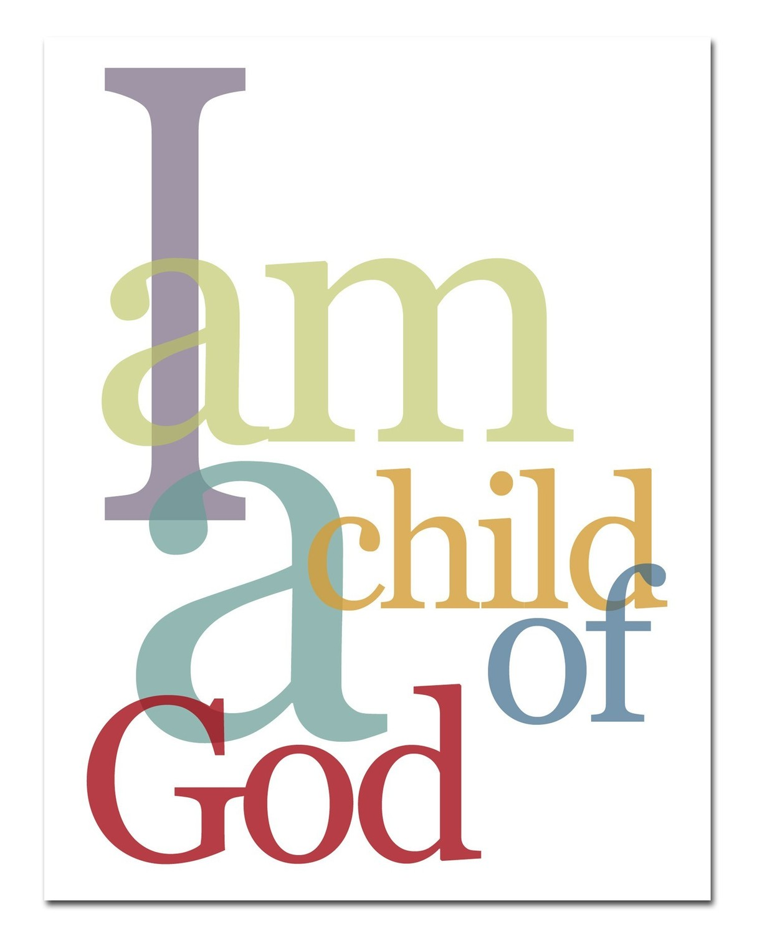
Children of God
1 John 3:1-10
Richie Thetford www.thetfordcountry.com

Slide 2

Who Are the Children of God?
Exhibit faith in Christ
  Galatians 3:26
Peacemakers
  Matthew 5:9
Children of the resurrection
  Luke 20:36
Richie Thetford www.thetfordcountry.com

Slide 3
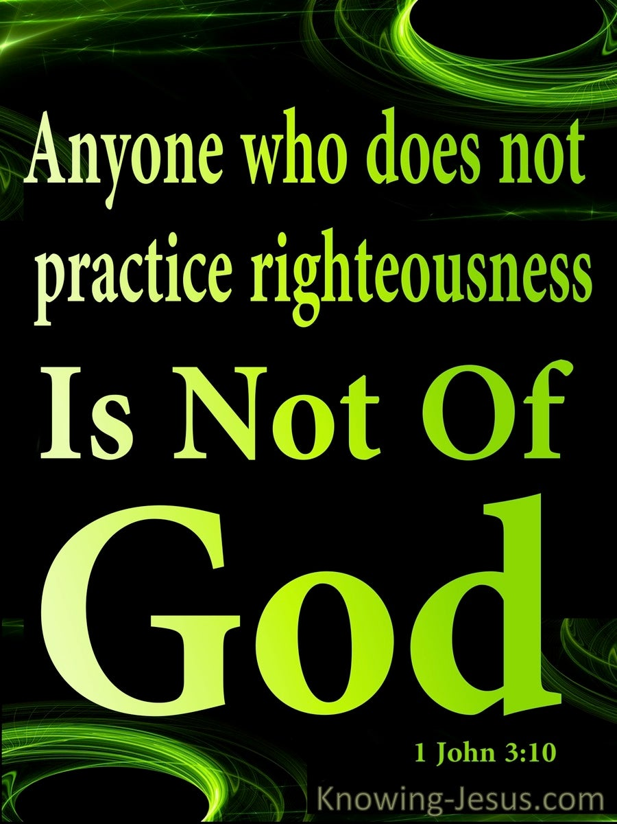
Who Are Not Children of God?
Children of the flesh
  Romans 9:8
Not practicing righteousness
  1 John 3:10
Richie Thetford www.thetfordcountry.com

Slide 4
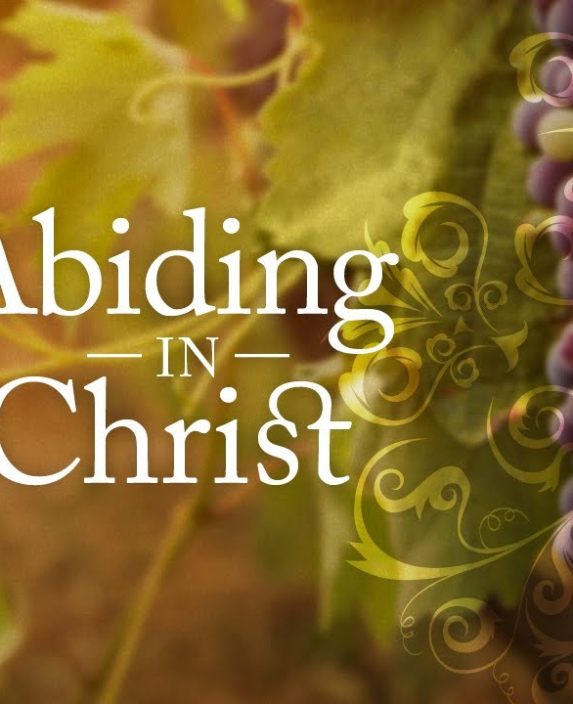
What Does It Mean to Abide in Him?
To walk as He walks
  1 John 2:6
Being righteous
  1 John 3:7
Richie Thetford www.thetfordcountry.com

Slide 5
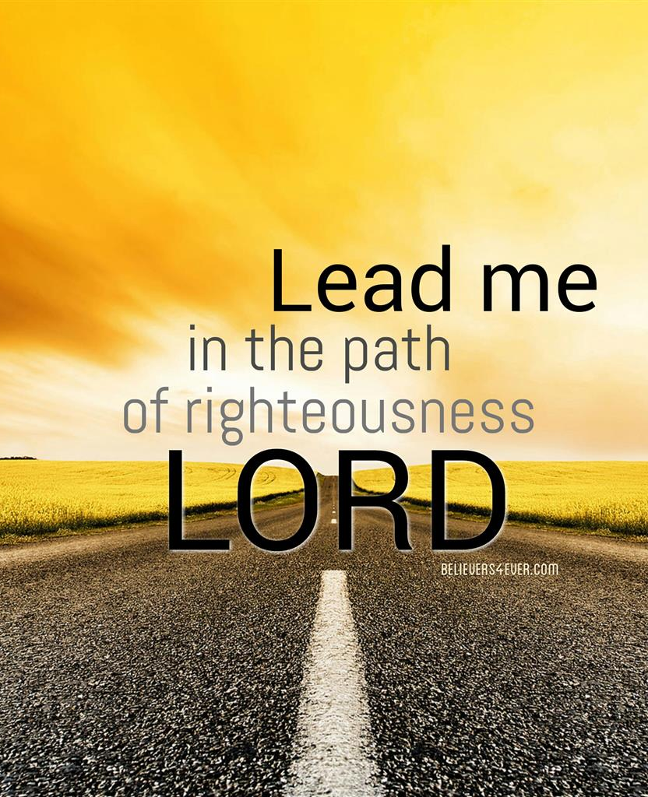
What is Righteousness?
Belief in the Lord
  Genesis 15:6
Doing God’s will
  Deuteronomy 6:25
Speaking the truth
  Proverbs 12:17
Richie Thetford www.thetfordcountry.com

Slide 6
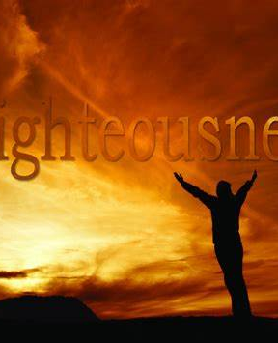
What is Righteousness?
Life without death
  Proverbs 12:28
Better than things without it
  Proverbs 16:8
Not to be turned away from
  Ezekiel 18:26
  Ezekiel 33:13
Richie Thetford www.thetfordcountry.com

Slide 7

What is Righteousness?
To be pursued
  Matthew 5:6
  Matthew 5:10
  Matthew 6:33
Obedience to Christ
  Romans 6:16
Richie Thetford www.thetfordcountry.com

Slide 8
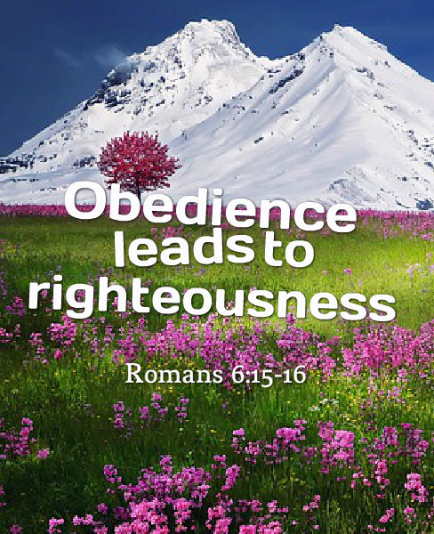
What is Righteousness?
Walking after the Spirit
  Romans 8:4
Not linked to unbelievers
  2 Corinthians 6:14
Richie Thetford www.thetfordcountry.com

Slide 9

Difficulty in Practicing Righteousness
Trying to be like the world
  1 Peter 3:14
We are a “special” people
  Titus 2:14
  1 Peter 2:9
Richie Thetford www.thetfordcountry.com

Slide 10
Children of God are faithful in Christ
Belief in the Lord
Doing God’s will
Speaking the truth
Obedience in Christ
Walking after the Spirit
Richie Thetford www.thetfordcountry.com

