Slide 1
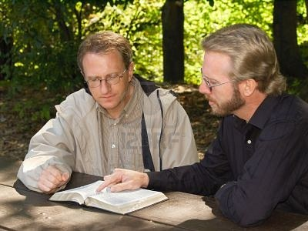
Certainties That Should Sober Us
“Let us hear the conclusion of the whole matter: Fear God and keep His commandments,
For this is man’s all.”
Ecclesiastes 12:13
Richie Thetford www.thetfordcountry.com

Slide 2
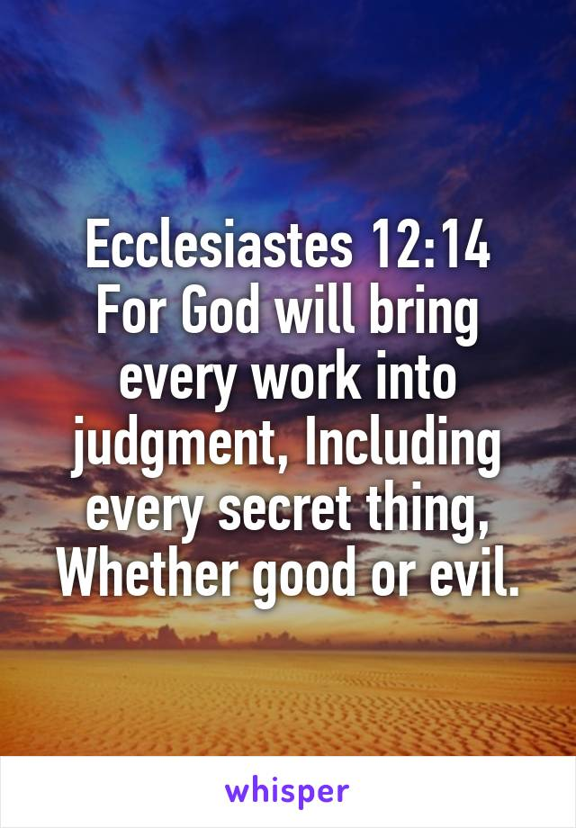
The Certainty of Sin
Sin will find us out
  Numbers 32:23
Will be revealed at the judgment
  Ecclesiastes 12:14; 11:9
We can’t deceive God
  Hebrews 4:13
  Galatians 6:7-8
Richie Thetford www.thetfordcountry.com

Slide 3
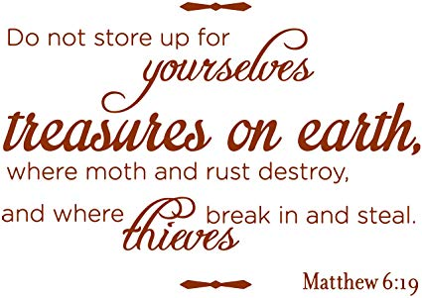
The Certainty of Leaving Earthly Possessions
The words of Paul:
  1 Timothy 6:7-10
Can’t take earthly things with us
  Job 1:21
The rich fool
  Luke 12:13-21
Invest in heavenly treasures!
  Matthew 6:19-21
Richie Thetford www.thetfordcountry.com

Slide 4
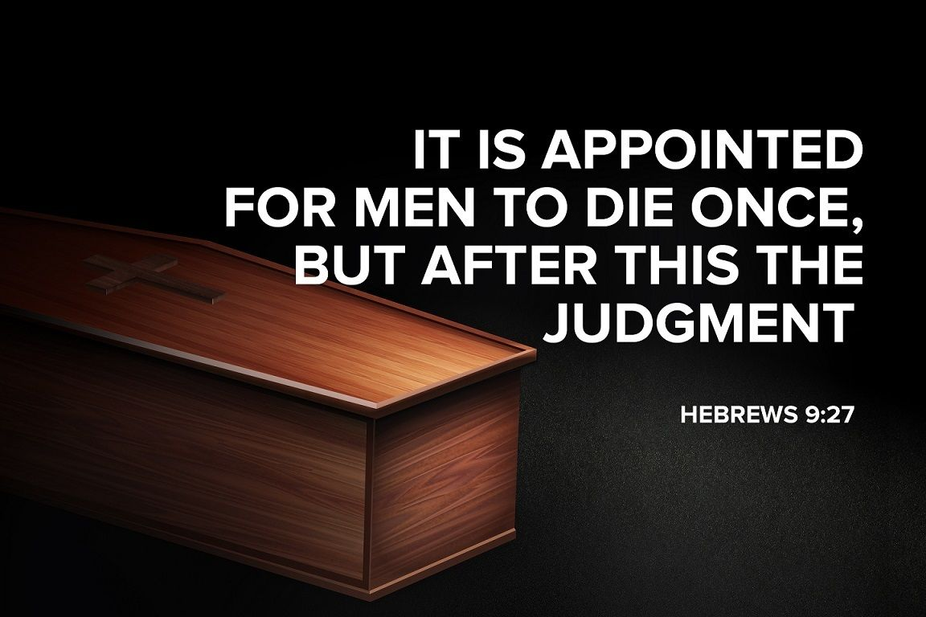
The Certainty of Death
An appointment of God
  Hebrews 9:27
  Ecclesiastes 8:8
Death came because of sin
  Romans 5:12
Because of sin, God blessed us
  1 Corinthians 15:35-44, 50
  Philippians 1:21
Richie Thetford www.thetfordcountry.com

Slide 5
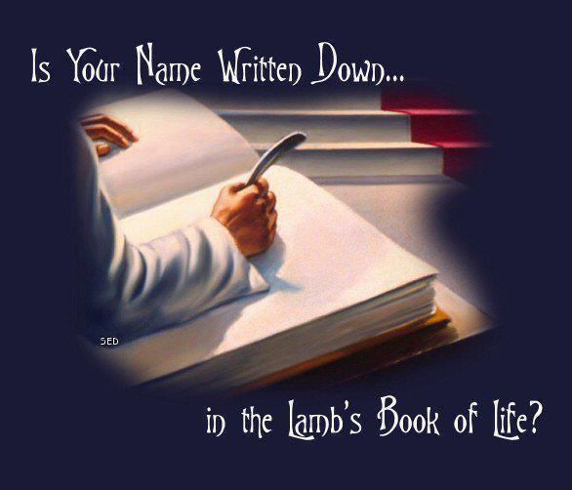
The Certainty of the Judgment
Appointed by God
  Hebrews 9:27; Acts 17:30-31
All will be present to give an account
  Matthew 25:31-32
  2 Corinthians 5:10
  Romans 14:10-12
Our destiny is settled by the way we live
  Revelation 20:12
Richie Thetford www.thetfordcountry.com

Slide 6

The Certainty of Reward or Punishment
There will be a separation
  Matthew 25:32
Righteous will be rewarded
  Matthew 25:33-40
  Revelation 22:14
Wicked will be punished
  Matthew 25:41-46
  2 Thessalonians 1:7-9
  Revelation 20:10
Richie Thetford www.thetfordcountry.com

Slide 7
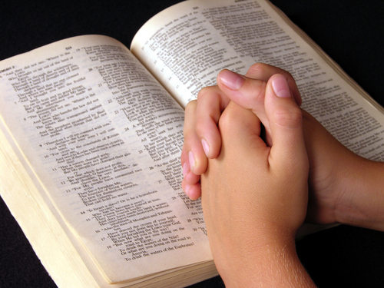
Certainties That Should Sober Us
Take warning and live as God orders us
  1 Peter 1:17
  Proverbs 1:7
Learn things that are certain
Act accordingly before it is too late
Richie Thetford www.thetfordcountry.com

