Slide 1
Calvinism
Total Hereditary Depravity

Slide 2
Calvinism
Total Hereditary Depravity
Man’s nature is corrupt
No ability to choose good over evil
Unconditional Election
God’s choice – A few saved
All others excluded from salvation
Limited Atonement
Limited to certain individuals
Righteousness to chosen ones only
Irresistible Grace
Faith by direct operation of the Holy Spirit
Holy Spirit never fails to convert the elect
Perseverance of the Saints
Given faith, kept in faith
If fall away, then never in grace
TULIP
Theory

Slide 3
Total Hereditary Depravity
The “Five Points of Calvinism” by Steele and Thomas, Presbyterian and Reformed Publishing Company, states the following:
….That Man’s Nature Is Corrupt Throughout
“When Calvinists speak of man as being totally depraved, they mean that man’s nature is corrupt, perverse, and sinful throughout. The adjective total does not mean that each sinner is as totally or completely corrupt in his actions and thought as it is possible for him to be. Instead, the word total is used to indicate that the whole of man’s being has been affected by sin. The corruption extends to every part of man, his body and soul; sin has affected all (the totality) of man’s faculties – his mind, his will, etc.”

Slide 4
Total Hereditary Depravity
The “Five Points of Calvinism” by Steele and Thomas, Presbyterian and Reformed Publishing Company, states the following:
….That Man Doesn’t Have the Ability To Choose Spiritual Good Over Evil
“Man did not come from the hands of his Creator in this depraved, corrupt condition. God made Adam upright; there was no evil whatsoever in his nature. Originally, Adam’s will was free from the dominion of sin; he was under no natural compulsion to choose evil, but through his fall he brought spiritual death upon himself and all his posterity. He thereby plunged himself and the entire race into spiritual ruin and lost for himself and his descendants the ability to make right choices in the spiritual realm. His descendants are still free to choose – every man makes choices throughout life – but inasmuch as Adam’s offspring are born with sinful natures, they do not have the ABILITY to choose spiritual good over evil.

Slide 5
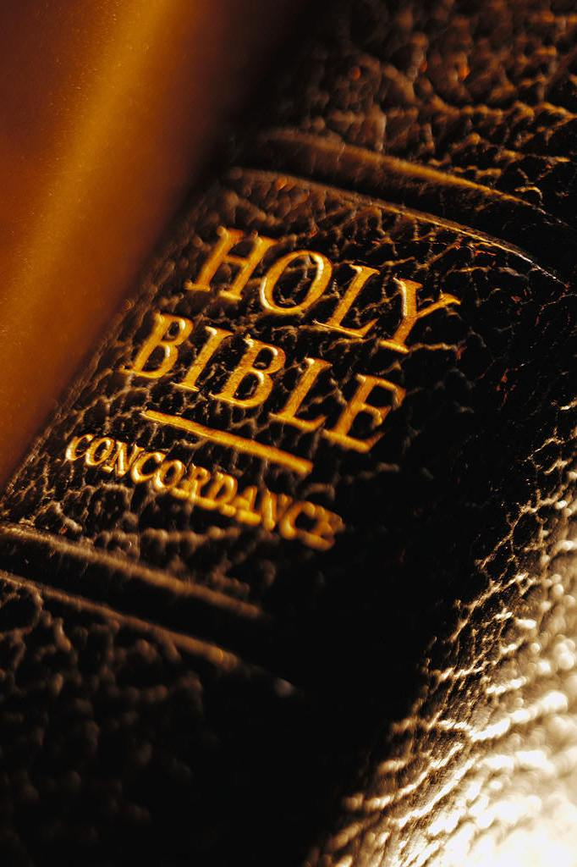
Total Hereditary Depravity
Infants Are Sinless at Birth
Was Christ born a sinner?
Galatians 4:4
Hebrews 2:17
Philippians 2:7
How could Christ “know no sin?”
2 Corinthians 5:21
Hebrews 4:15

Slide 6
Total Hereditary Depravity
Infants Are Sinless at Birth
Is God depraved?
Acts 17:29
Hebrews 12:9
Ecclesiastes 12:7
Do children of Christians inherit a purified nature?
1 Peter 1:22-23
Matthew 5:8

Slide 7
Total Hereditary Depravity
Infants Are Sinless at Birth
An infant is born without sin
Ezekiel 18:20
Matthew 19:14
2 Samuel 12:15-23

Slide 8
Total Hereditary Depravity
Man Has Freedom to Choose to Obey or Reject
Responsible for our own actions
Isaiah 7:16
Luke 7:29-30
Matthew 23:37
Justice demands that God judge each one accordingly
Ezekiel 18:25-32
2 Corinthians 5:10
Romans 14:12

Slide 9
Total Hereditary Depravity
Man Has Freedom to Choose to Obey or Reject
Sinful deeds and repentance are performed by choice
Romans 16:12-13, 16
James 1:13-15
Isaiah 59:1-2
Acts 17:30
Acts 2:38

Slide 10
Total Hereditary Depravity
This doctrine denies the free choice of man, and leaves God to blame if anyone is left lost and not chosen by Him
Then Peter opened his mouth and said: "In truth I perceive that God shows no partiality. But in every nation whoever fears Him and works righteousness is accepted by Him.
Acts 10:34-35
who desires all men to be saved and to come to the knowledge of the truth.
1 Timothy 2:4
He who rejects Me, and does not receive My words, has that which judges him — the word that I have spoken will judge him in the last day. John 12:48

