Slide 1
Calling BLACK BLACK
and WHITE WHITE
What Is Sin?
Lawlessness
1 John 3:4; 5:17
Love Not The World
Must live IN the world but must not be OF the world
1 John 2:15-17; James 4:4-8
Richie Thetford www.thetfordcountry.com

Slide 2
Calling BLACK BLACK
and WHITE WHITE
Practice Makes Perfect
Applies to all that we do in life
GOOD
Philippians 4:9; Hebrews 5:14; 2 Peter 1:10
BAD
Romans 1:32; Galatians 5:19-21; 1 John 3:10
Willful sin means no more sacrifice for sin
Hebrews 10:24-31
Richie Thetford www.thetfordcountry.com

Slide 3
BLACK Adultery Murder Envy Strife Lying Homosexuality Unfaithfulness
GRAY Instrumental Music Modesty Dancing Mixed Swimming Bad Movies Smoking Social Drinking
WHITE Love Joy Peace Longsuffering Kindness Goodness Faithfulness Self-Control Knowledge Gentleness Godliness
Galatians 5:19-21
Ephesians 4:25
1 Timothy 1:10
Hebrews 10:25
Revelation 2:10
Galatians 5:22-25
2 Peter 1:2-10
Richie Thetford www.thetfordcountry.com

Slide 4
BLACK
Adultery
Murder
Envy
Strife
Lying
Homosexuality
Unfaithfulness
Galatians 5:19-21
Ephesians 4:25
1 Timothy 1:10
Hebrews 10:25
Revelation 2:10
Richie Thetford www.thetfordcountry.com

Slide 5
WHITE
Love
Joy
Peace
Longsuffering
Kindness
Goodness
Faithfulness
Self-Control
Knowledge
Gentleness
Godliness
Galatians 5:22-25
2 Peter 1:6-10
Richie Thetford www.thetfordcountry.com

Slide 6
GRAY Instrumental Music Modesty Dancing Mixed Swimming Bad Movies Smoking Social Drinking
Richie Thetford www.thetfordcountry.com

Slide 7
Colossians 3:16-17
Ephesians 5:19
GRAY
Instrumental Music
Modesty
Richie Thetford www.thetfordcountry.com

Slide 8
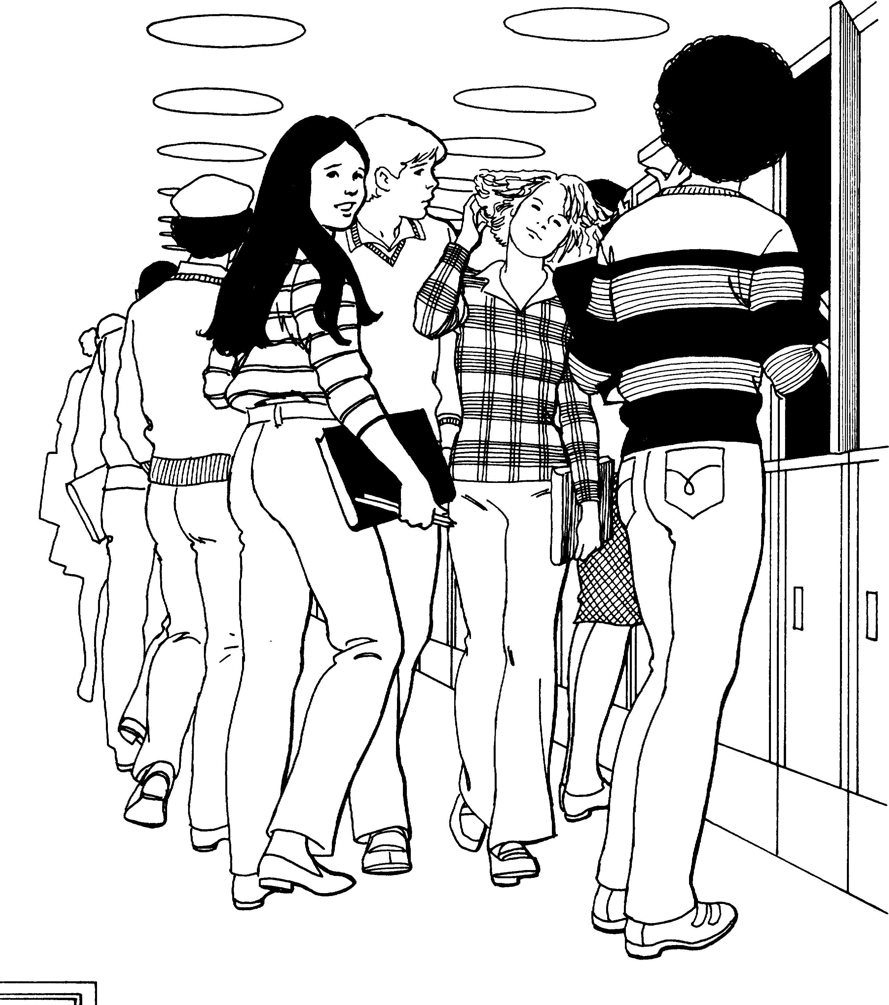
Modesty What Does the Bible Say?
Prove all things (1 Thessalonians 5:21)
Do all in the name of the Lord (Colossians 3:17)
Do all to the glory of God (1 Corinthians 10:31)
Work to glorify God (1 Peter 2:11-15)
Not to be a stumbling block (Luke 17:1-2)
No offense, but profit (1 Corinthians 10:32)
Live beyond reproach (1 Peter 3:15f)
Let your light shine (Matthew 5:16)
Richie Thetford www.thetfordcountry.com

Slide 9
Colossians 3:16-17
Ephesians 5:19
1 Thessalonians 5:21-22
Matthew 5:28
1 Corinthians 15:33
2 Corinthians 7:1
Romans 13:14
1 Corinthians 10:31
Matthew 5:8
Philippians 4:8-9
Titus 1:15
Matthew 5:16; 7:12
1 Corinthians 6:12; 9:27
1 Corinthians 6:19-20
1 Peter 2:9; 4:3
GRAY
Instrumental Music
Modesty
Dancing
Mixed Swimming
Inappropriate Movies/TV
Smoking
Social Drinking

Slide 10
BLACK Adultery Murder Envy Strife Lying Homosexuality Unfaithfulness Instrumental Music Modesty Dancing Mixed Swimming Bad Movies Smoking Social Drinking
GRAY
WHITE Love Joy Peace Longsuffering Kindness Goodness Faithfulness Self-Control Knowledge Gentleness Godliness
That which one might call “GRAY” is really “BLACK”
Galatians 5:22-25;
2 Peter 1:2-10
Richie Thetford www.thetfordcountry.com

Slide 11
Calling BLACK BLACK
and WHITE WHITE
The law of God is made for the lawless, disobedient and ungodly. It is for those who PRACTICE things that are contrary to sound doctrine
1 Timothy 1:9-10
Richie Thetford www.thetfordcountry.com

Slide 12
Calling BLACK BLACK
and WHITE WHITE
Children of God, true disciples of Christ, KNOW what things are black and what things are white!
1 John 1:7-10; Galatians 5:24-25
True children of God understand that they are to:
“Keep your heart with all diligence,
For out of it spring the issues of life.” Proverbs 4:23
Richie Thetford www.thetfordcountry.com

