Slide 1
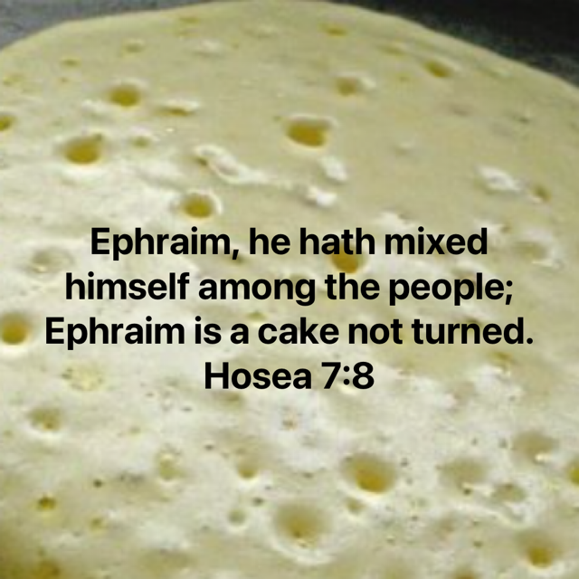
“Cakes not turned”
Illustrates the
spiritual condition
of the northern kingdom
Richie Thetford www.thetfordcountry.com

Slide 2
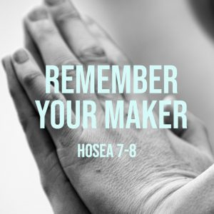
Cooking lesson for life
A circular cake
  Illustrates the spiritual
  condition of the
  Northern Kingdom
  Mingled with other
  nations
  Worshiped idols
Richie Thetford www.thetfordcountry.com

Slide 3

A Christian can be a
“Cake not turned”
Well done inwardly,
raw and doughy inside
  Matthew 15:8-9
  Matthew 23:25-28
Well done in hearing,
raw and doughy
in doing
  James 1:22-25
Richie Thetford www.thetfordcountry.com

Slide 4

A Christian can be a
“Cake not turned”
Attendance
Friend of the World
  James 4:4
Laying up treasures
  Luke 12:13-21
People want possessions…….
God wants people!
Richie Thetford www.thetfordcountry.com

Slide 5
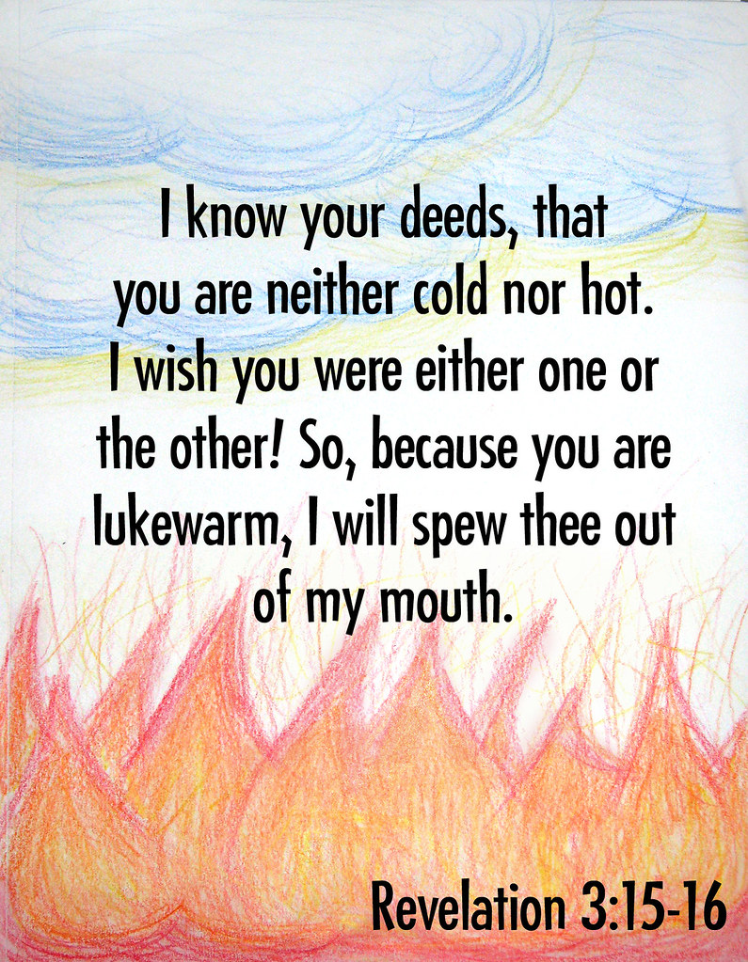
The fate of half-baked
“Cakes not turned”
Doom and destruction
  Hosea 7:12-13
A “Cake not turned”…
  Would not be chosen
  Cannot be served
  If served --- not eaten
  Revelation 3:16
  Hosea 7:9
Richie Thetford www.thetfordcountry.com

Slide 6

How to keep from being a
“Cake not turned”
All or nothing with God
  Matthew 6:24
  Luke 9:62
Pay attention to things
that are spiritual
  Romans 2:13
Richie Thetford www.thetfordcountry.com

Slide 7
“Cakes not turned”
There is a standard of
purity
faithfulness
obedience
Richie Thetford www.thetfordcountry.com

