Slide 1

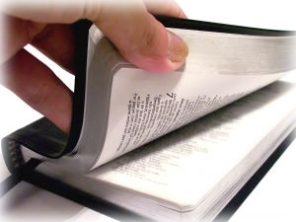
“but test the Spirits…”
1 John 4:1-6
God has given us a standard by which
He demands we use
to test the various teachings of men

Slide 2
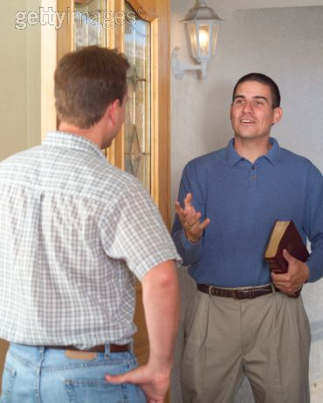
Don’t Believe Every Spirit
“SPIRIT” is “the spiritual proclamation by a human personality”
  “false prophets” are the human personalities with a spiritual proclamation
  – but not from God
Jesus said to him, "I am the way,
the truth, and the life. No one comes
to the Father except through Me.”
John 14:6

Slide 3
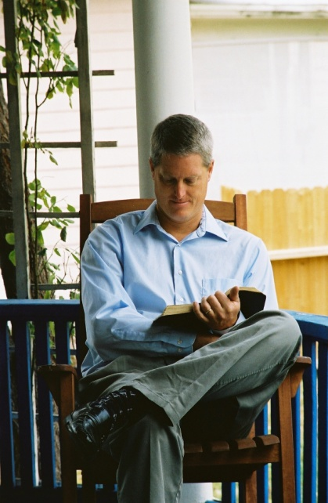
Test (prove) The Spirits
“test or prove” – prove by testing the quality of something. To see if it is genuine or not
(Acts 17:11)
“that the genuineness of your faith,
being much more precious than gold that perishes, though it is tested by fire, may be found to praise, honor, and glory at the revelation of Jesus Christ” 1 Peter 1:7
1 Corinthians 3:13; 1 Timothy 3:10

Slide 4
Test (prove) The Spirits
Many false prophets are professing error
  “spirits” have assumptions that need to be proven
A genuine standard is demanded (V.6)
  Apostolic authority
    The character of the person is revealed

Slide 5

Test (prove) The Spirits
Apostles were guided by the Holy Spirit to present unquestionable truth
  John 16:13
  We can confidently
  take the apostles
  teaching and apply it
  to determine the
  genuineness of the spirits
2 Thessalonians 2:15; 3:6

Slide 6
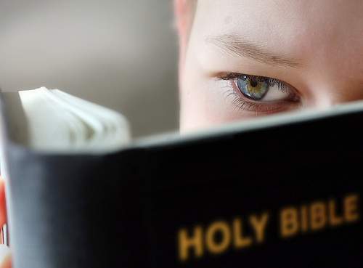
Test (prove) The Spirits
The apostle’s teaching is that which we can “learn” and apply to determine the
genuineness of others
Hold to the pattern set forth by the sound words of the apostles and apply what we have learned in order to “test the spirits”
“Now I urge you, brethren, note those who cause divisions and offenses, contrary to the doctrine which you learned, and avoid them.” Romans 16:17

Slide 7
God’s Blessings Bestowed Upon Those Who
“test the spirits”
Children of God are distinguished from those of the world (V.4-5)
  Children of God have overcome!
  Devil is behind every false teaching
    1 John 5:19
    He lies and twists the truth
Genesis 3:3-6; 2 Corinthians 11:13-16

Slide 8
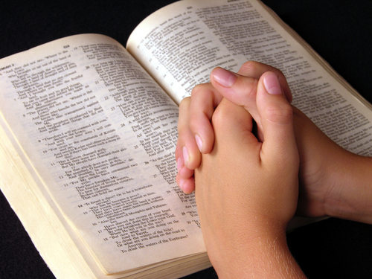
God’s Blessings Bestowed Upon Those Who
“test the spirits”
God’s Word provides
the faithful standard
to expose error
John 3:19-21
2 Timothy 4:2-4
2 Timothy 2:24-26

Slide 9
Behind every blessing is the truth that we CAN know and understand the truth of God’s word
Then Jesus said to those Jews who believed Him, “If you abide in My word, you are My disciples indeed. And you shall know the truth, and
the truth shall make you free.” John 8:31-32
The church will only remain pure and right
in the sight of God when all the members are “testing the spirits,” ensuring that all are
practicing only God’s will for man

