Slide 1
The Bride of Christ
The spiritual marriage relationship between Christ and man is necessary
in order to obtain eternal salvation
Richie Thetford www.thetfordcountry.com

Slide 2
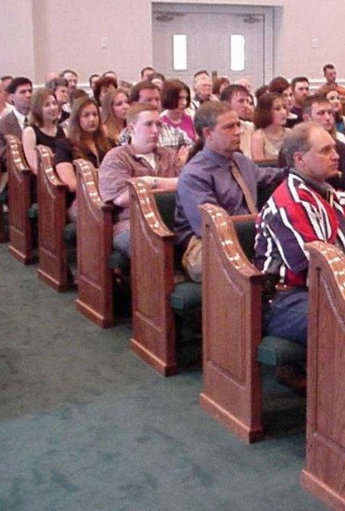

The Bride of Christ
Galatians 3:27
The Bride
Revelation 21:9; 19:7
The Bridegroom
Revelation 19:7; John 3:29
Richie Thetford www.thetfordcountry.com

Slide 3


Marriage Customs
of Ancient Days
Before a man got married, he bought his wife
  Dowry: “a gift by a man to his bride”
  Abraham – Genesis 24:10, 53
  Jacob – Genesis 29:18-30; 31:41
  David – 1 Samuel 17:25
After “bought” by dowry, then engaged
  Matthew 1:19; Deuteronomy 22:23-30
Richie Thetford www.thetfordcountry.com

Slide 4

Marriage Customs
of Ancient Days
When engaged – referred to as husband/wife
  Matthew 1:18, 24
If the wife would become unfaithful:
  Could be stoned – Deuteronomy 22:23
  Put Away – Matthew 1:19
Wedding feast at the end of the engagement
  Son’s wedding – Matthew 22:1-14
After wedding feast, then they lived together
Richie Thetford www.thetfordcountry.com

Slide 5


Jesus came to get a wife
THE CHURCH
Father purposed her to be the bride
from the beginning
  Ephesians 3:7-11, 21
Jesus FIRST bought his bride with
His own blood
  Acts 20:28; Ephesians 5:25
Richie Thetford www.thetfordcountry.com

Slide 6

Jesus came to get a wife
THE CHURCH
Church and Christ referred to as
husband and wife
  Revelation 19:6-9
If church is “unfaithful” upon His return
– can have her stoned – cast into hell
  2 Corinthians 11:2-3; Revelation 20:11-15
Marriage supper to take place upon return
  Revelation 19:6-9
Richie Thetford www.thetfordcountry.com

Slide 7
The Relationship
Old Testament – Man and Woman
Dowry
(Paid)
Gifts
Betrothed (Engaged)
Live Together
Wedding Feast
New Testament – Christ and Church
Dowry
(Paid)
Blood
Betrothed (Engaged)
Live Together
Wedding Feast
Richie Thetford www.thetfordcountry.com

Slide 8


Ephesians 5:22-33
Husband
Wife
Christ
Church
“This is a great mystery, but I speak concerning Christ and the church.”
Richie Thetford www.thetfordcountry.com

