Slide 1
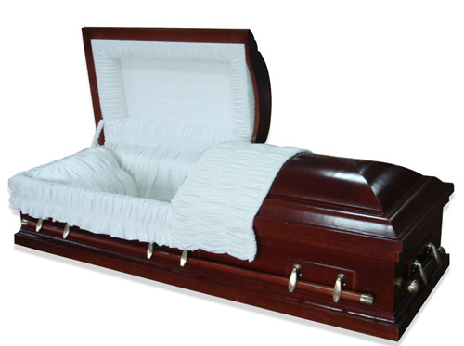
The Brevity of Life
Death comes to the very old, the very young, and everyone in between
Richie Thetford www.thetfordcountry.com

Slide 2
What Happens When We Die?
Does life after death really exist?
Does heaven exist?
Does hell exist?
  If so, what will happen to us when we die?
Will it matter what we believed or how we lived in this life?
Richie Thetford www.thetfordcountry.com

Slide 3
What Happens When We Die?
Most believe that the majority of people go to heaven
  Matthew 7:13-14
    Are you CERTAIN where you will spend eternity?
A sobering thought
  Matthew 7:21-23
    Many religious people WILL NOT enter heaven
We must DO the will of the Father
Richie Thetford www.thetfordcountry.com

Slide 4
Are You Really Saved?
Have you done the will of the Father?
Have you ever questioned whether or not you’re saved?
  Wouldn’t you like to be absolutely SURE of your salvation?
No one has to go through life wondering if they’re saved
  John 8:31-32
Richie Thetford www.thetfordcountry.com

Slide 5

“I have fought the good fight, I have finished the race, I have kept the faith. Finally, there is laid up for me the crown of righteousness, which the Lord, the righteous Judge, will give to me on that Day, and not to me only but also to all who have loved His appearing.”
2 Timothy 4:7-8
Richie Thetford www.thetfordcountry.com

Slide 6
Truth Does Exist
It is real!
  It is not whatever you believe it to be or what someone else believes it to be
TRUTH can set us free!
  John 8:34
    Free from religious burden (practices, rites, ceremonies – nowhere mentioned in the Bible)
Richie Thetford www.thetfordcountry.com

Slide 7
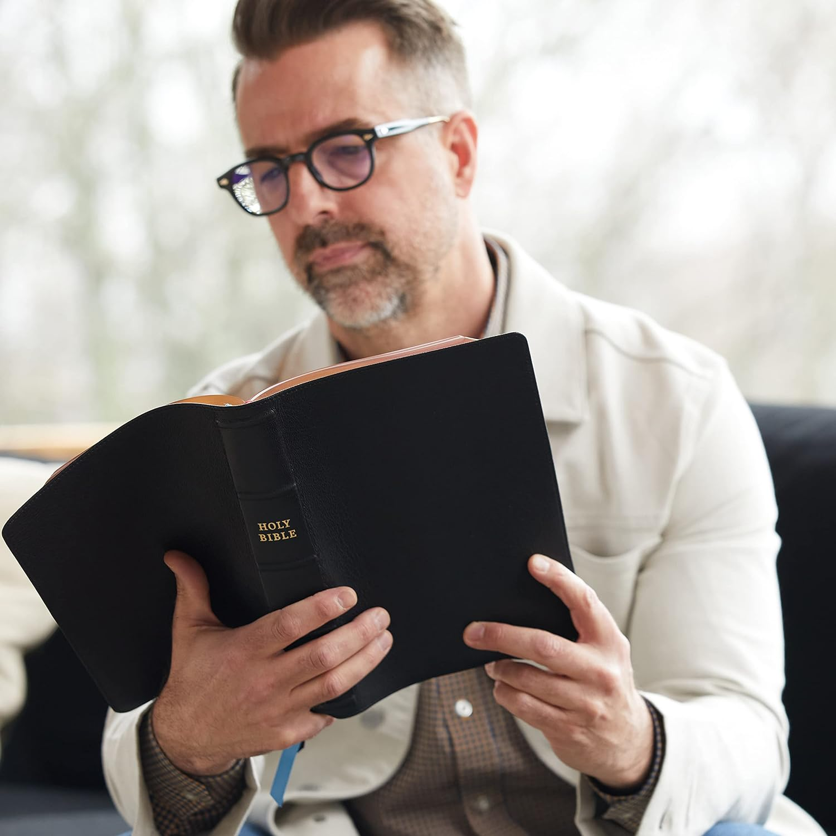
Truth Does Exist
TRUTH can set us free!
  Matthew 15:8-9
    Are you shackled by
    the teachings of men?
Richie Thetford www.thetfordcountry.com

Slide 8
Truth Does Exist
The truth is ONLY found in Jesus
  John 14:6
If we are searching for the truth – and if Jesus is the truth,
then we should go to Jesus to find that truth!
“Buy the truth, and do not sell it, Also wisdom and instruction and understanding.”
Proverbs 23:23
1 Peter 1:22-23
2 Thessalonians 1:7-9
Richie Thetford www.thetfordcountry.com

Slide 9
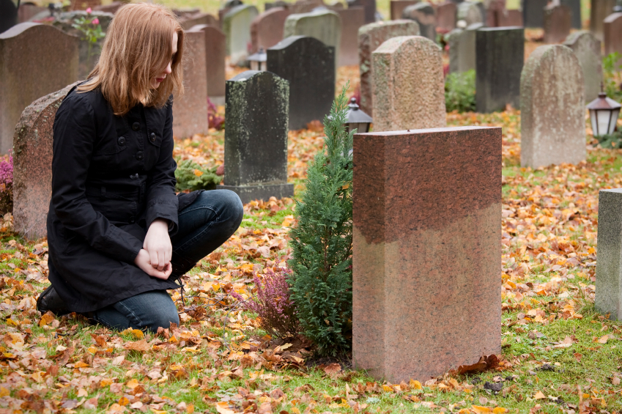
Life is Uncertain
The young, the old, and all ages
in between are in cemeteries all
around the world
  How many died NOT knowing the truth?
We will be judged
  Romans 2:2
  Romans 2:16
Richie Thetford www.thetfordcountry.com

