Slide 1
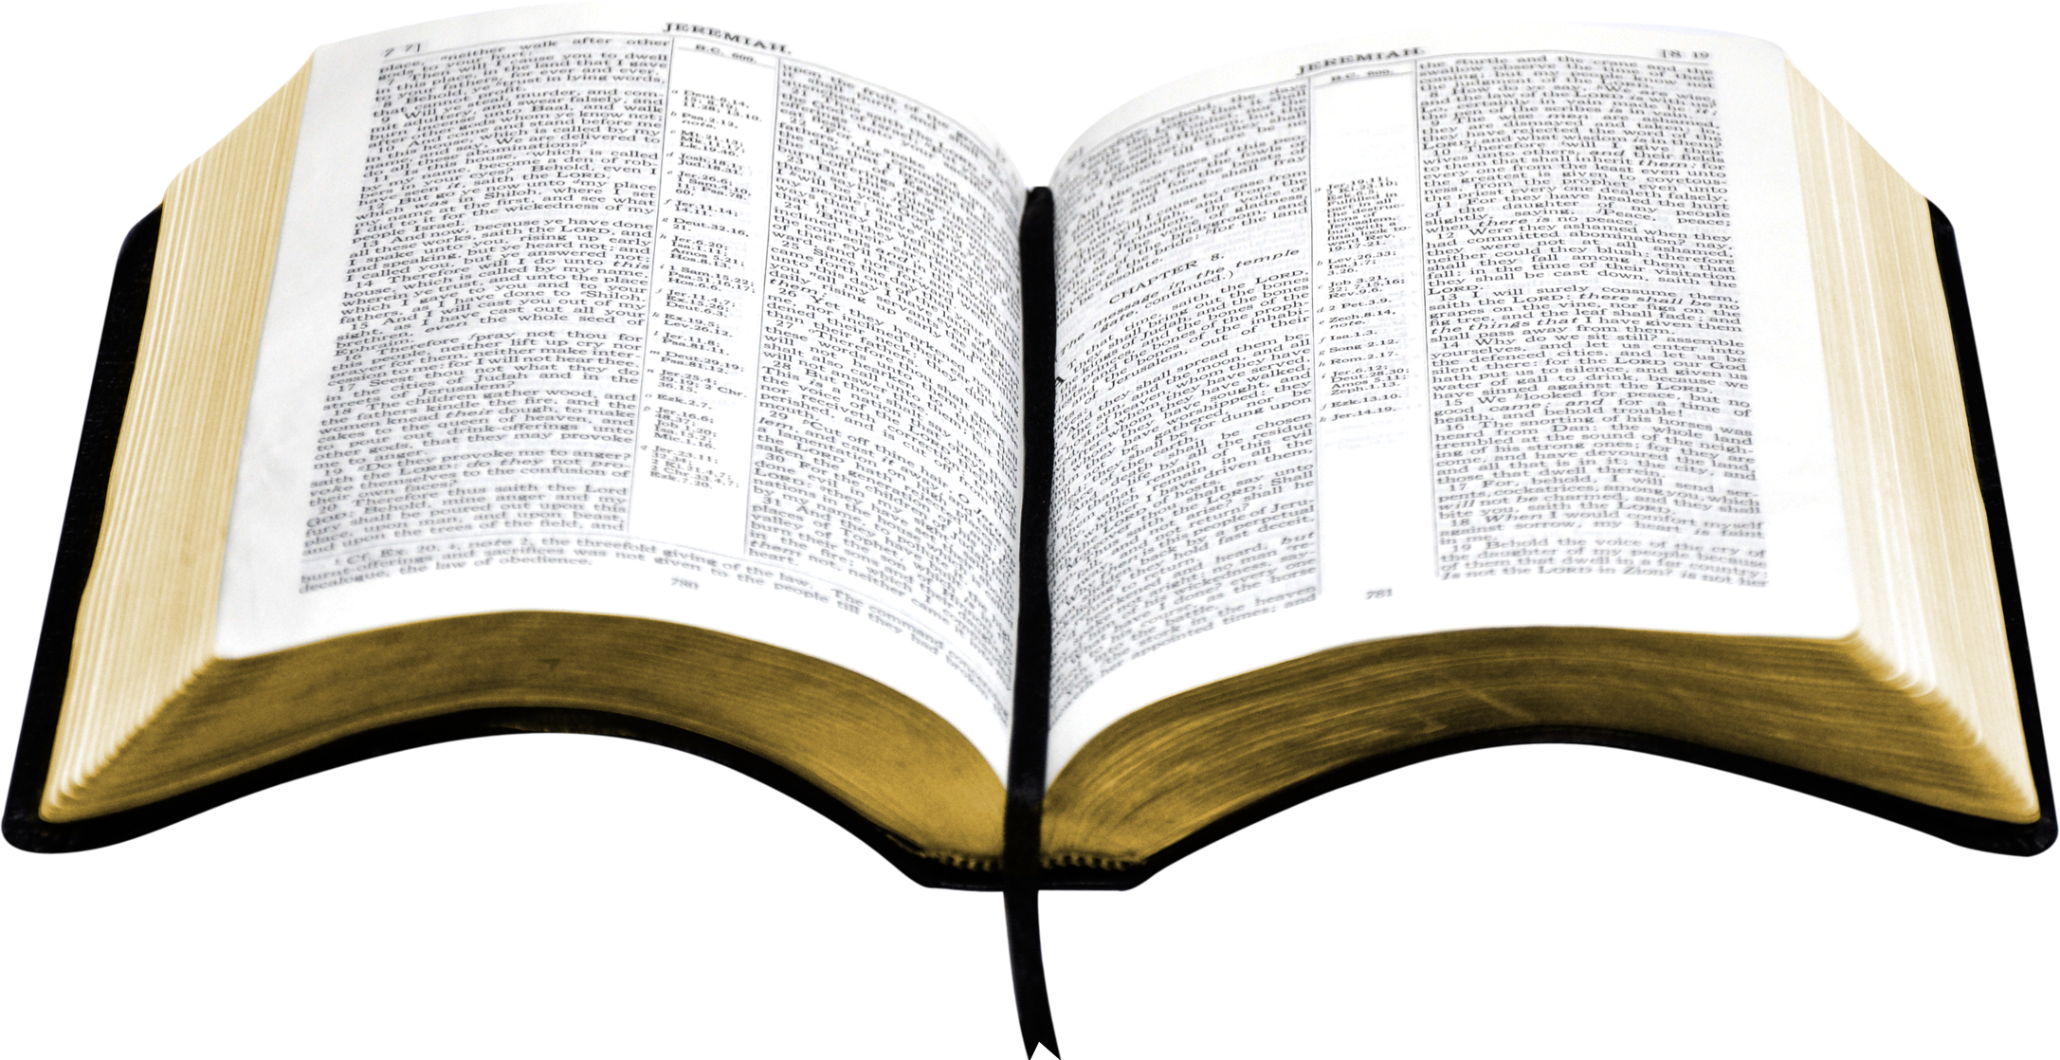
The Book of Life
Revelation 20:12-15
Richie Thetford www.thetfordcountry.com

Slide 2
What Is This Book?
The book of life
Luke 10:20
Revelation 13:8
Revelation 20:12-15
Exodus 32:32-33
Revelation 3:5
Richie Thetford www.thetfordcountry.com

Slide 3
Who Does the Writing?
God
Exodus 32:32-33
Jesus
Revelation 3:5
Revelation 13:8
Richie Thetford www.thetfordcountry.com

Slide 4
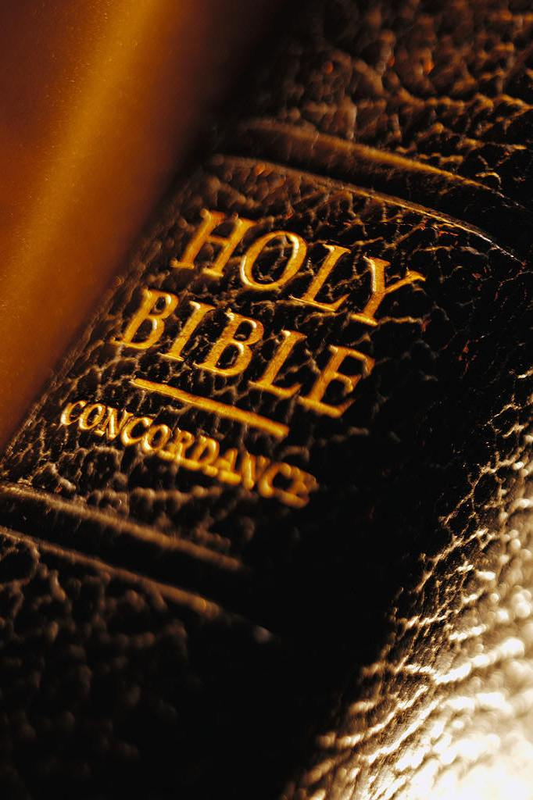
Who Are Written in This Book?
The saved
Revelation 20:12-15
Those without sin
Revelation 21:27
The Holy
Isaiah 4:3
The delivered
Daniel 12:1-3
Laborers in the kingdom
Philippians 4:3
The church
Hebrews 12:23
Richie Thetford www.thetfordcountry.com

Slide 5
Who Are Not Written in This Book?
Those in sin
Exodus 32:32-33
Those who oppress the righteous
Psalms 69:27-28
Non-overcomers
Revelation 3:5
Those who worship the beast
Revelation 13:6-8
Revelation 17:8
Those who take away from God’s words
Revelation 22:19
Richie Thetford www.thetfordcountry.com

Slide 6
The Book of Life
Is your name written in the Lamb’s book of life?
Richie Thetford www.thetfordcountry.com

