Slide 1
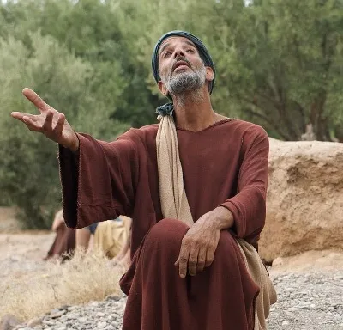
The Blind Man Bartimaeus
Luke 18:35-43
Richie Thetford www.thetfordcountry.com

Slide 2
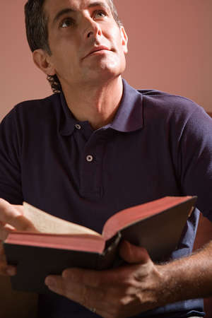
Observations to Consider
The Good News
Luke 18:35-37
Jesus passing by
The “Son of David”
Luke 18:38-39
Richie Thetford www.thetfordcountry.com

Slide 3
Observations to Consider
The Great Cry
Luke 18:38-41
Bartimaeus cried for mercy
Draws attention to his faith
Luke 18:41
Richie Thetford www.thetfordcountry.com

Slide 4
Observations to Consider
The Gracious Announcement
Luke 18:42
Faith in the Lord
We must do likewise
John 8:21, 24
Matthew 7:21
Luke 6:46
Richie Thetford www.thetfordcountry.com

Slide 5
Observations to Consider
The Grand Results
Luke 18:43
Glorified God
Luke speaks of the praise
Luke 5:26
Luke 17:18
Acts 2:47
Acts 3:9
Richie Thetford www.thetfordcountry.com

Slide 6
Conclusion
Our faith will save us IF we act on it
James 2:26
Richie Thetford www.thetfordcountry.com

