Slide 1
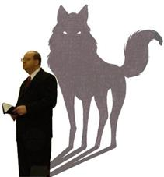
Beware of False Prophets
Matthew 7:15-23
Richard Thetford www.thetfordcountry.com

Slide 2
The Danger of False Prophets
False prophets exist
  They lead men to damnation
Why do they pose a threat?
  Try to get you to believe a lie
    John 8:32
  Blind guides
    Matthew 15:14
    Matthew 7:21-23
Richard Thetford www.thetfordcountry.com

Slide 3
The Danger of False Prophets
Appearance of false teachers
  Appear in sheeps clothing
  Transform themselves into apostles of light
    2 Corinthians 11:13-15
Test of false teachers
  By their fruit
  Not by appearance, personality, reputation, claims, professions, etc.
Richard Thetford www.thetfordcountry.com

Slide 4
Fruit Which Needs to be Judged
Will claim to receive revelation from God
  Not valid today
    1 Corinthians 13:8-10; Jude 3
Will preach a “wide gate”
  Matthew 7:13-14
Will preach a “broad way”
  One can live any manner of life and still be approved of by God
Richard Thetford www.thetfordcountry.com

Slide 5
Fruit Which Needs to be Judged
Often leads an immoral life
  Full of covetousness
    1 Timothy 6:5-6
Leaves a path of destruction
  Galatians 1:6-10
A false teacher may not manifest all of these attributes. He may do only a few of them.
Richard Thetford www.thetfordcountry.com

Slide 6
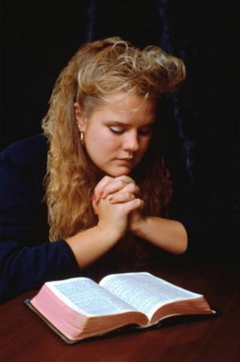
Conclusion
We must consider our soul
  Test what a person is teaching
    1 John 4:1
  Search the scriptures
    Acts 17:11
We are responsible for our own soul
Remember the words of Jesus:
“beware of false prophets”
Richard Thetford www.thetfordcountry.com

