Slide 1
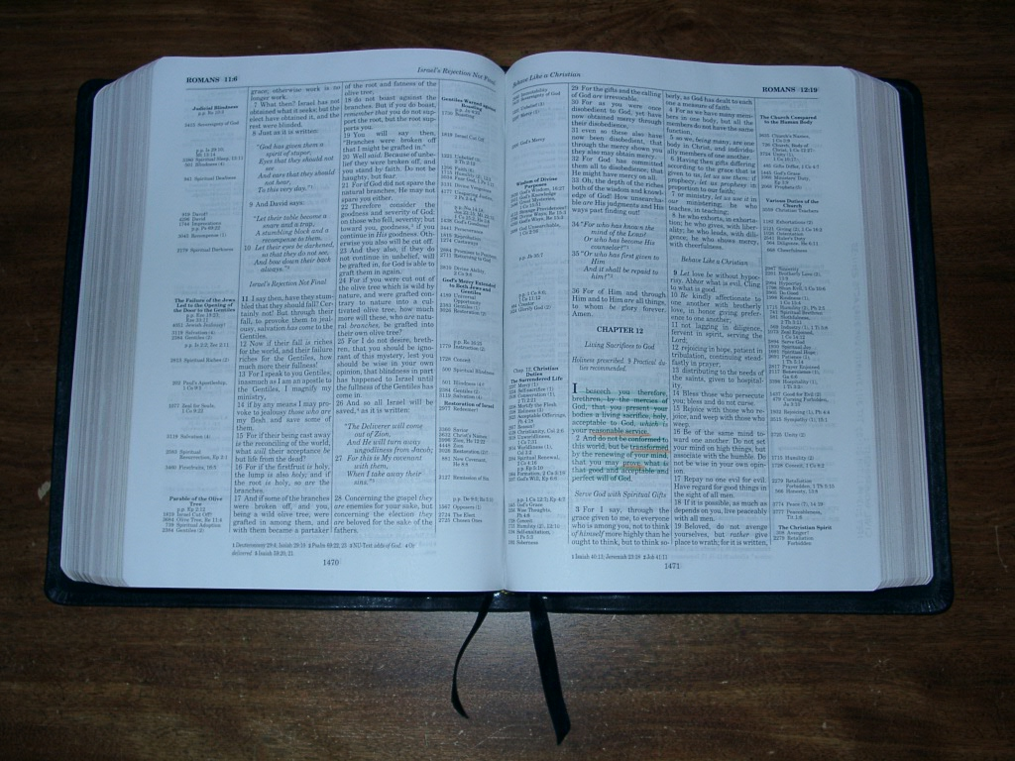
Being devoted to god
Romans 12:1-8
Richard Thetford www.thetfordcountry.com

Slide 2

self sacrifice (v.1)
Contrast between Christian and Gentile
  Romans 1:24
  1 Corinthians 6:12
  1 Corinthians 6:19-20
A complete surrender
of SELF
  2 Corinthians 8:5
Richard Thetford www.thetfordcountry.com

Slide 3

self alteration (v.2)
Two view points
  Negatively
    1 John 2:15-17
  Positively
    To be “transformed”
Richard Thetford www.thetfordcountry.com

Slide 4

self examination (v.3)
Essential to spiritual growth
  2 Corinthians 10:12-18
Examine by the
right standard
  James 1:23-25
Richard Thetford www.thetfordcountry.com

Slide 5

self involvement (v.4-8)
Something for everyone to do
  Our “spiritual service”
Richard Thetford www.thetfordcountry.com

Slide 6

conclusion
Must be devoted
  Colossians 3:17
Grounded in
Scriptures
and shining
lights!
  Matthew 5:16
Richard Thetford www.thetfordcountry.com

