Slide 1
Being abel minded
“Everything we do in life is a result of a choice that is made”
Richard Thetford www.thetfordcountry.com

Slide 2
Abel’s mind set
Abel made a choice to follow God
Genesis 4:1-8
Matthew 23:35
Hebrews 11:4
Richard Thetford www.thetfordcountry.com

Slide 3
The Christian’s mind set
We must choose to obey God
Philippians 2:1-5
Romans 12:1-2
Colossians 3:17
Richard Thetford www.thetfordcountry.com

Slide 4
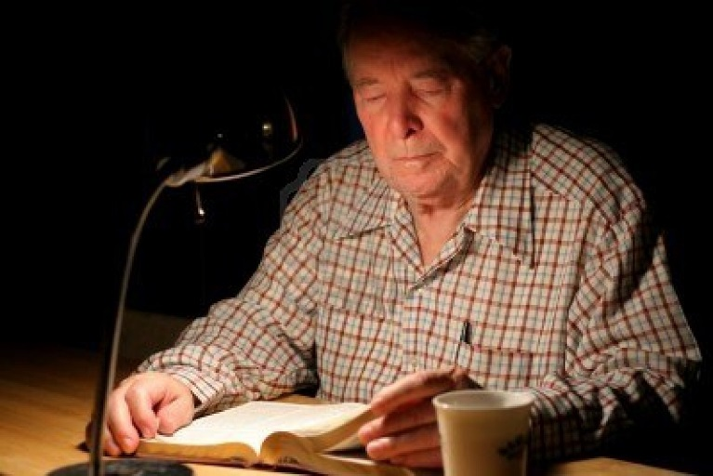
The judgment awaits
Abel, Cain, and all men
Genesis 4:9-13
John 12:48
Revelation 2:10
2 Thessalonians 1:7-9
Richard Thetford www.thetfordcountry.com

Slide 5
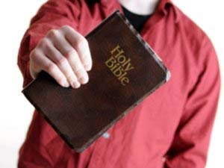
conclusion
God’s Word has been given to all
The choice is ours!
Matthew 7:21-23
May we all be ABEL minded in our life for God!
Richard Thetford www.thetfordcountry.com

