Slide 1
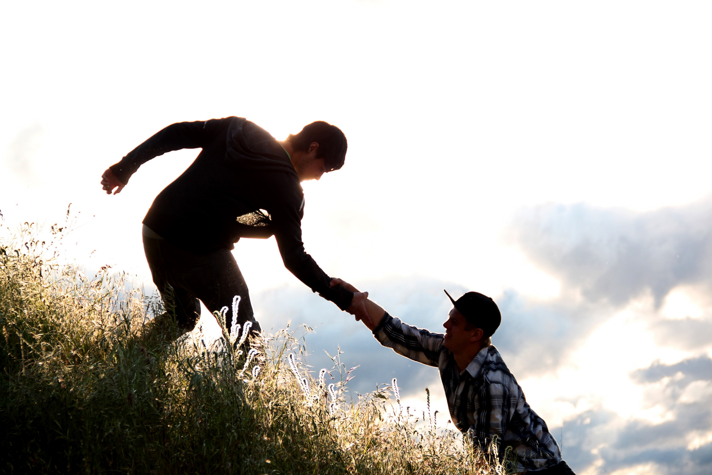
Bearing Burdens
Job 14:1

Slide 2
Introduction
Hating life
Ecclesiastes 2:17
Material blessings
1 Timothy 6:7-10
Proverbs 30:8-9
How do we handle the burdens of life?

Slide 3
Bear Our Own Burdens
Right and wrong
Hebrews 5:13-14
Consequences of sin
We must face death
Hebrews 9:27
Appear at the judgment
Acts 17:30-31

Slide 4
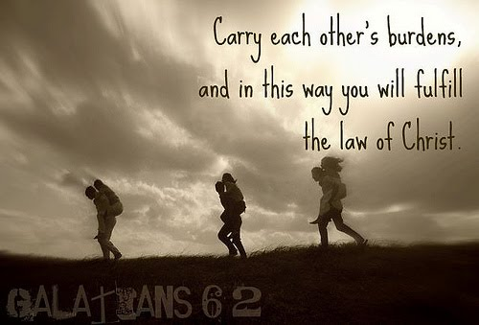
Help Others Bear Their Burdens
A reminder
Matthew 7:12
God wants us to help
Romans 15:1
Bible’s teaching:
Galatians 6:1
1 John 3:16-17
Ephesians 4:32
1 Thessalonians 5:11

Slide 5
Cast Our Burdens on the Lord
Give them to the Lord
1 Peter 5:7
Psalms 55:22
Hebrews 13:5
Allow God to bear our burdens

Slide 6
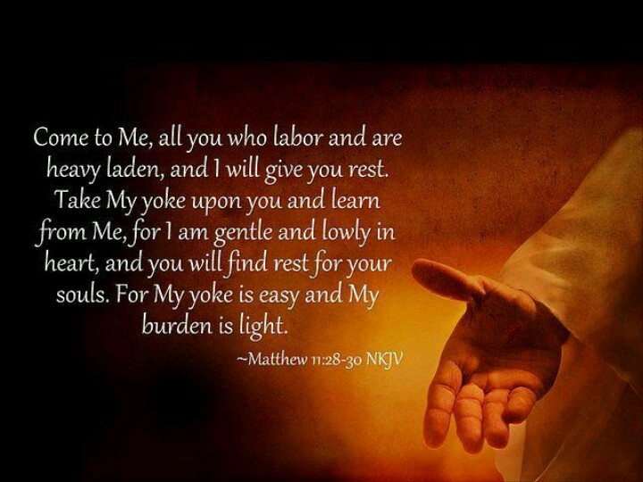
Jesus pleads for us to come to Him

