Slide 1
What It Does and Does Not Do
Richie Thetford www.thetfordcountry.com

Slide 2
Puts us into Christ (Galatians 3:26-27; 1 Corinthians 12:13)
Washes away our sins (Acts 2:38; 22:16)
Saves us (Mark 16:16; 1 Peter 3:21)
Puts us into the kingdom (John 3:5; Colossians 1:13-14)
Richie Thetford www.thetfordcountry.com

Slide 3
DOES NOT
Make a minor an adult
1 Timothy 2:11-15
The “man” of 1 Timothy 2
Forbidding a woman to usurp authority over “the man”
Richie Thetford www.thetfordcountry.com

Slide 4
DOES NOT
Remove temptation
Godly will suffer persecution
2 Timothy 3:12
Will be able to endure temptation
1 Corinthians 10:13
James 1:12
Richie Thetford www.thetfordcountry.com

Slide 5
DOES NOT
Guarantee sinless perfection
Does not make us sinless
1 John 1:10; 3:9-10
Simon still sinned
Acts 8:13-24
Richie Thetford www.thetfordcountry.com

Slide 6
DOES NOT
Guarantee eternal salvation
Given to those who obey
Hebrews 5:8-9
Not the end of obedience
Philippians 2:12; 1 Corinthians 15:58
John 4:24; Colossians 3:1-2
Richie Thetford www.thetfordcountry.com

Slide 7
Eternal Life
IF
…..Be faithful until death, and I will give you the crown of life.
Revelation 2:10
Richie Thetford www.thetfordcountry.com

Slide 8
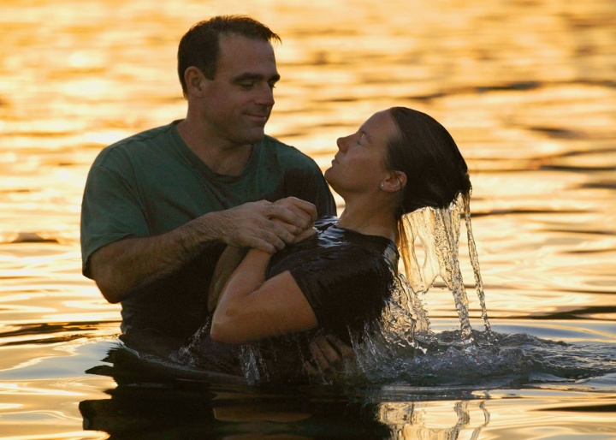
DOES
DOES NOT
Put us into Christ
Wash away our sins
Save us
Put us into the kingdom
Make a minor an adult
Remove temptation
Guarantee sinless perfection
Guarantee eternal life
Baptism opens the fellowship lines between man and God
…be faithful until death, and I will give you the crown of life. Revelation 2:10
Richie Thetford www.thetfordcountry.com

