Slide 1
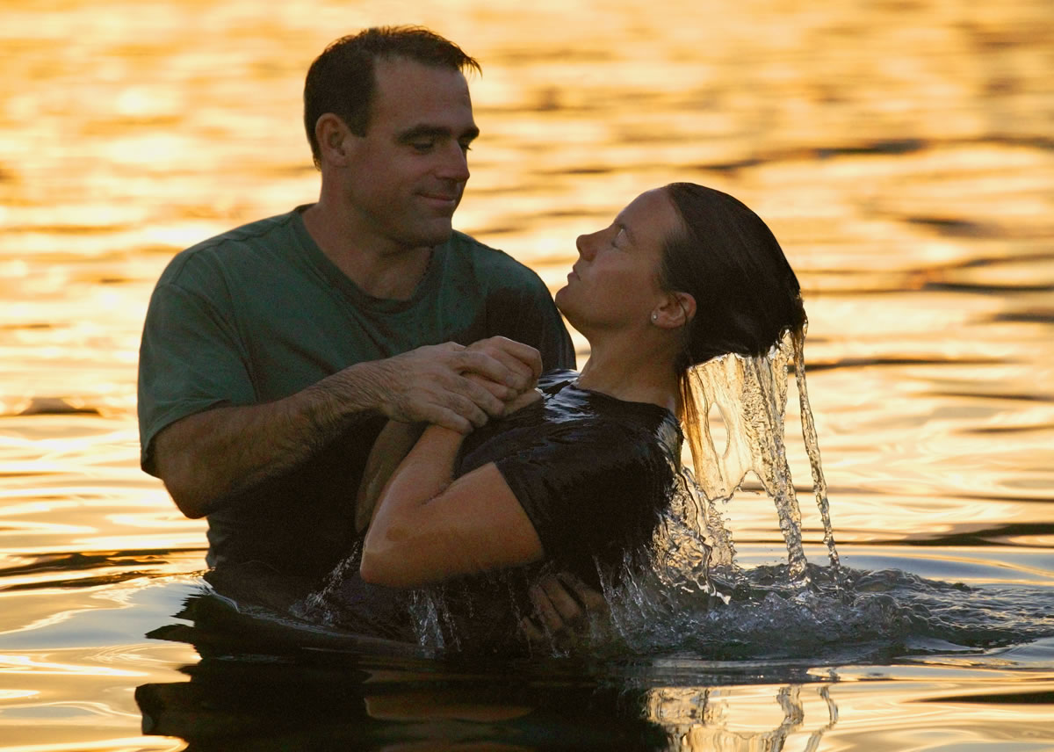
Baptism Now Saves Us
John 14:15
Richie Thetford www.thetfordcountry.com

Slide 2
Who Should Be Baptized?
Jesus’ teaching
Matthew 28:19-20
Must be taught
Matthew 18:3
Must believe
Acts 8:36-37
Richie Thetford www.thetfordcountry.com

Slide 3
How Should Believers Be Baptized?
By immersion
Romans 6:3-6
Colossians 2:11-13
Romans 2:29
John 3:23
Acts 8:38
Richie Thetford www.thetfordcountry.com

Slide 4
How Should Believers Be Baptized?
By immersion
Romans 6:3-6
Colossians 2:11-13
Romans 2:29
John 3:23
Acts 8:38
Richie Thetford www.thetfordcountry.com

Slide 5
How Should Believers Be Baptized?
By immersion
Romans 6:3-6
Colossians 2:11-13
Romans 2:29
John 3:23
Acts 8:38
Richie Thetford www.thetfordcountry.com

Slide 6
Believers Sins Are Forgiven When Baptized
Bible’s teaching
Acts 2:38
Acts 22:16
Richie Thetford www.thetfordcountry.com

Slide 7
Believers Are Baptized Into the Body
Necessary to gain an everlasting union with Christ
Galatians 3:27
1 Corinthians 12:13
Ephesians 1:22-23
Colossians 1:18
Richie Thetford www.thetfordcountry.com

Slide 8
Believers Are Saved When Baptized
Baptism now saves us
1 Peter 3:20-21
Mark 16:15-16
Must remain faithful after baptism
Revelation 2:10
Richie Thetford www.thetfordcountry.com

Slide 9
Conclusion
Do you love Jesus?
John 14:15
Keep His commandment to be baptized
Keep His commandment to remain faithful
If we do not obey:
2 Thessalonians 1:7-10
Richie Thetford www.thetfordcountry.com

