Slide 1
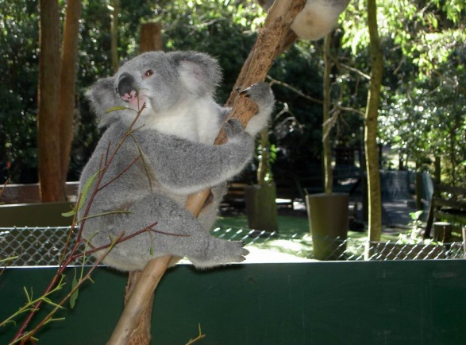
Backsliding Preventives
Backsliding: “to slide backward in morals or religious enthusiasm; to become less virtuous”
(Webster’s New World Dictionary)
Richie Thetford www.thetfordcountry.com

Slide 2
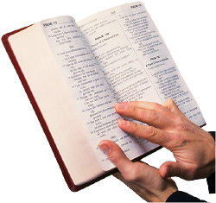
Let God Say Something to Us Every Day
Listen to God – walk not in darkness
  Psalms 119:105; 1 John 1:6-7; John 1:9
Take delight in listening to God
  Psalms 1:1-2; Acts 17:11; John 5:39
We’re commanded to learn of God
  2 Timothy 2:15
Richie Thetford www.thetfordcountry.com

Slide 3
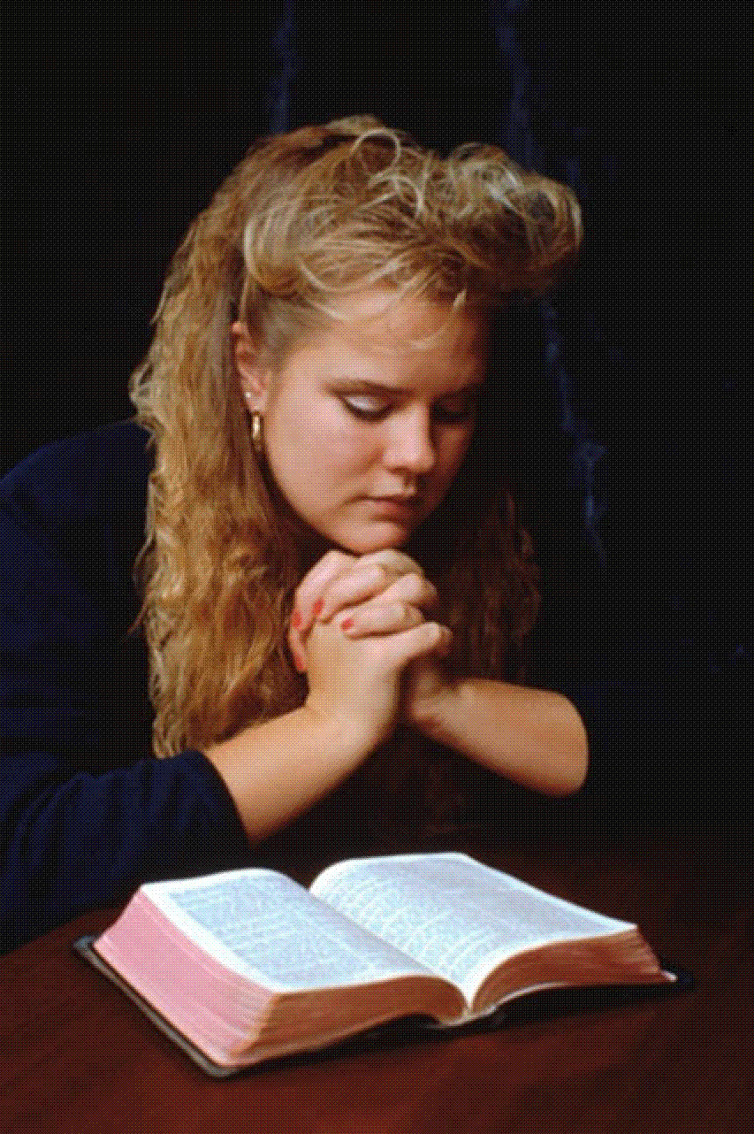
Say Something to God
Every Day
Thank Him for our many blessings
  1 Thessalonians 5:17-18
Prayer will stop sin or sin will stop prayer
  Psalms 66:18
Prayer avails much
  James 5:16
Richie Thetford www.thetfordcountry.com

Slide 4

Say Something for God
Every Day
Share God with others
  James 5:19-20
Our conduct should be worthy of the gospel of Christ
  Philippians 1:27
Look for opportunities to share the Word
Richie Thetford www.thetfordcountry.com

Slide 5
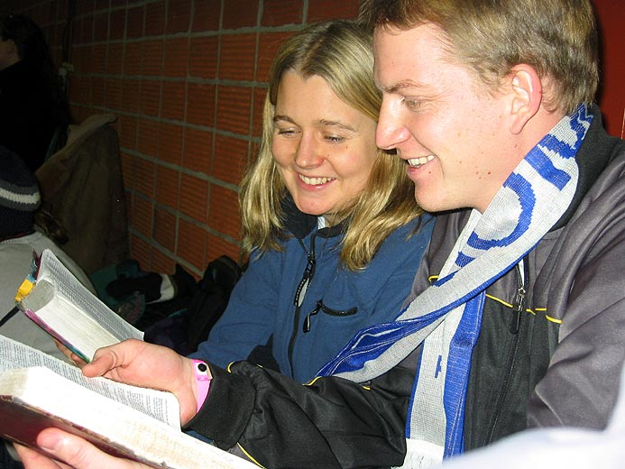
Do Something for God
Every Day
Look for opportunities to do good
  Galatians 6:10
Others should see our good works
  Matthew 5:16
Anything we do for God is not in vain
  1 Corinthians 15:58
Richie Thetford www.thetfordcountry.com

Slide 6

Prevent Backsliding
Let God say something to us every day
Say something to God every day
Say something for God every day
Do something for God every day
Richie Thetford www.thetfordcountry.com

