Slide 1
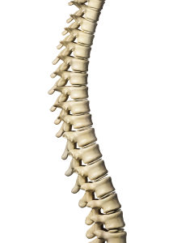
The Backbone of the Church
Richie Thetford www.thetfordcountry.com

Slide 2

Sin Is Ignored
Worldliness not rebuked
  1 Corinthians 5:2
Lukewarmness tolerated
  Revelation 3:16
Richie Thetford www.thetfordcountry.com

Slide 3

Lack of Conviction
Conviction or convenience
  John 4:24
  Psalms 122:1
  Hebrews 10:24-25
  Romans 6:17
Richie Thetford www.thetfordcountry.com

Slide 4
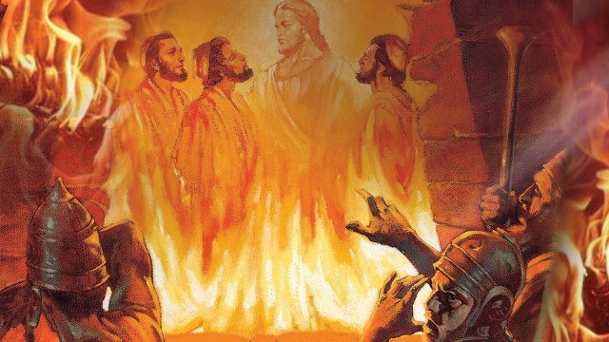
Lack of Conviction
Conviction illustrated
  Daniel 3:14
  Daniel 3:18
Richie Thetford www.thetfordcountry.com

Slide 5

Preaching
Changing our preaching
  2 Timothy 4:2-4
Richie Thetford www.thetfordcountry.com

Slide 6

Tendencies
Cause of dangerous tendencies
  Romans 5:3-5
  2 John 9
Richie Thetford www.thetfordcountry.com

Slide 7

The Solution
Greater respect
  Jude 3
  Ephesians 4:14-15
  Titus 1:13-14
  Galatians 1:6-9
Richie Thetford www.thetfordcountry.com

Slide 8

The Solution
Truth disturbs people
  Galatians 4:16
  2 Timothy 4:2
  Ephesians 6:13-14
Richie Thetford www.thetfordcountry.com

Slide 9
The Backbone of the Church
Lessons learned
  1 Timothy 4:1-3
  2 Thessalonians 2:3-4
Show “backbone” for
Christ and His church!
Richie Thetford www.thetfordcountry.com

