Slide 1
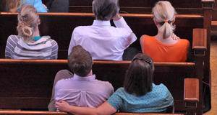
Attendance Faithful, Regular, Steadfast
1 Corinthians 11:17-18, 20, 33-34
“not forsaking the assembling of ourselves together, as is the manner of some, but exhorting one another, and so much the more as you see the Day approaching.” Hebrews 10:25

Slide 2
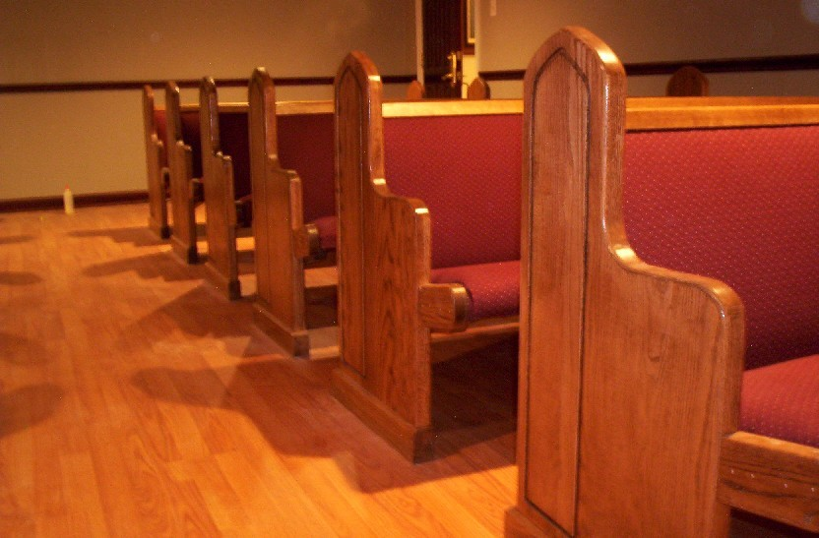
The church is to come TOGETHER
On the first day of the week
Acts 20:7
EVERY first day of the week
Exodus 20:8-11

Slide 3
Reasons to come TOGETHER
To break bread – Lord’s Supper
Acts 20:7
1 Corinthians 11:17-34
Other reasons:
Matthew 28:20
1 John 5:3
John 14:23

Slide 4
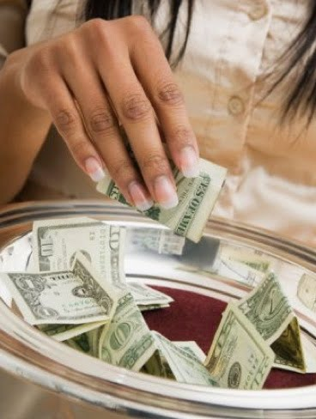
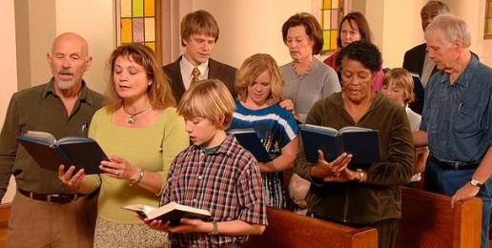
Reasons to come TOGETHER
To lay by in store -- giving
1 Corinthians 16:1-2
To sing praises to God
Colossians 3:16
Hebrews 2:12

Slide 5
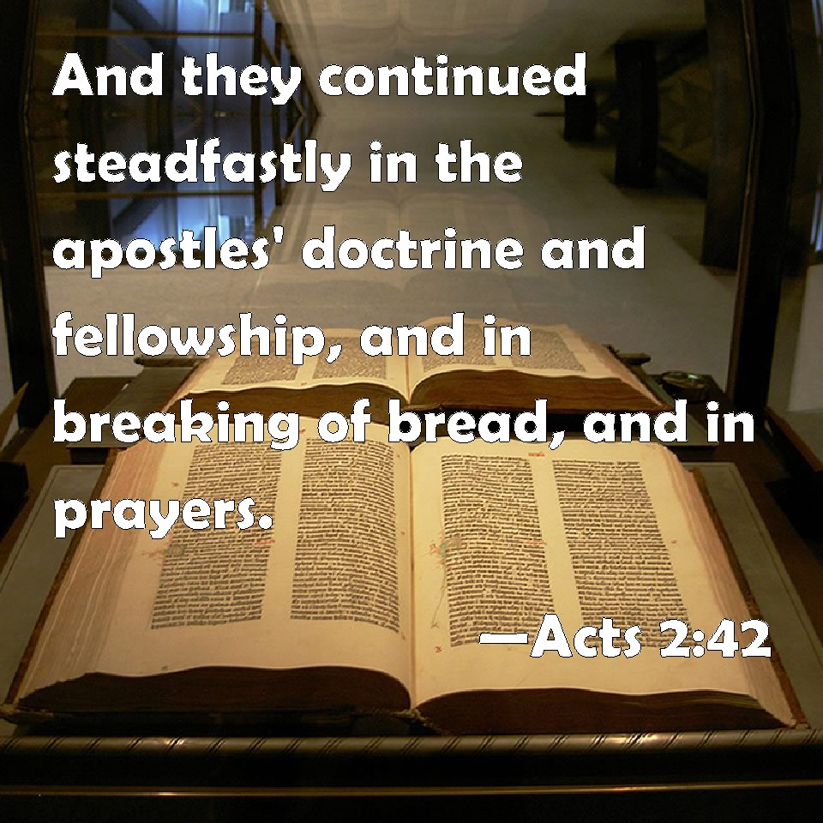
Reasons to come TOGETHER
To follow the example of Acts 2:42
Leviticus 23:15-16
Continued in the Apostle’s Doctrine
Fellowship (singing, giving)
Breaking bread
Prayer

Slide 6
Why some fail to come TOGETHER
Possible fear of persecution
Hebrews 10:23-39
Acts 20:22-24
Unbelief
Hebrews 3:12
Hebrews 4:2
James 2:18

Slide 7
Why some fail to come TOGETHER
No time or many worldly interests
Luke 14:16-20
2 Timothy 4:10
Feeling mistreated
Matthew 18:15-17
Services are dull
John 4:24; Luke 14:24

Slide 8
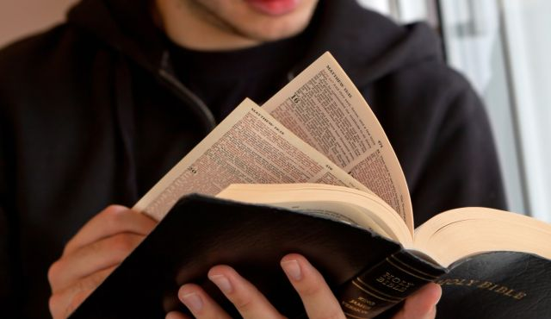
Must one attend ALL the services?
The Bible’s answer:
Hebrews 10:25-26
Titus 3:1
Matthew 6:33
2 Peter 3:18
Psalms 122:1
“Forsake” 1) To quit or leave entirely; to desert; to abandon; to depart from. 2) To abandon; to renounce; to reject. 3) To leave; to withdraw from; to fail

Slide 9
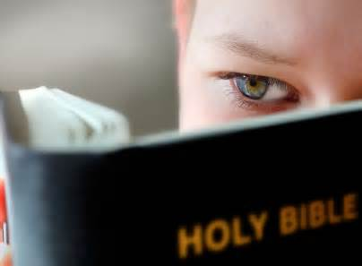
Conclusion
We are obligated
To be where God wants us to be
Given mandatory appointments
Lord’s Day (Acts 20:7; 1 Cor. 16:1-2)
Death (Hebrews 9:27)
Judgment (Acts 17:31)
Eternity (Matthew 25:46)

Slide 10
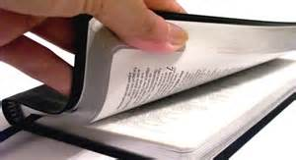
Have you been faithful in all aspects of your life?
“And you shall love the Lord your God with all your heart, with all your soul, with all your mind, and with all your strength”
Mark 12:30

