Slide 1

Are You a “Good” Person?
Matthew 19:16-21
Richie Thetford www.thetfordcountry.com

Slide 2
Having Faith in God
Faith in God is the starting point
  Hebrews 11:6
  Faith in God results in DOING the will of God
Consequences of the view held by the young man
  Luke 18:11-13
  The one who trusts in God is aware
  of his own sin and seeks forgiveness
FORGIVENESS
Richie Thetford www.thetfordcountry.com

Slide 3

Good?
“So He said to him, "Why do you call Me good? No one is good but One, that is, God….” (Matthew 19:17)
Christians realize:
  They are not good in the
  absolute sense
    Absolute goodness is
    an attribute of Deity
  Followers of Christ
  will try to be good
Richie Thetford www.thetfordcountry.com

Slide 4
The Dilemma
“For I know that in me (that is, in my flesh) nothing good dwells; for to will is present with me, but how to perform what is good I do not find. For the good that I will to do, I do not do; but the evil I will not to do, that I practice.
Romans 7:18-19
Our actions do not always measure up to what we have decided to do
  Not good enough to deal with sin through our own good deeds
  Must realize that each wrong deed separates us from God
    Romans 3:23
Richie Thetford www.thetfordcountry.com

Slide 5
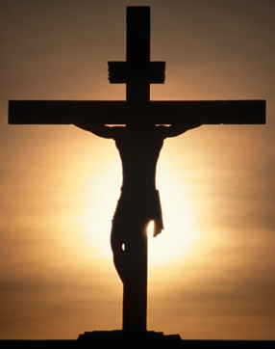
The Answer
Christ came to earth to
make atonement for our sins
  Gave Himself as a sacrifice for sin
Christians have acknowledged
their own sinfulness
With obedient faith –
the Christian tries to do the will of God
“If we confess our sins, He is faithful and just to forgive us our sins and to cleanse us from all unrighteousness.” (1 John 1:9)
Richie Thetford www.thetfordcountry.com

Slide 6

Conclusion
In order to be “good” in the sight
of God, Christ must be trusted
  Confess Christ
    Matthew 10:32
  Be baptized for forgiveness of sins
    Acts 2:38
  Live faithfully the rest of your life
    Luke 9:23
Are You Really A “GOOD” Person?
Richie Thetford www.thetfordcountry.com

